Slide 1
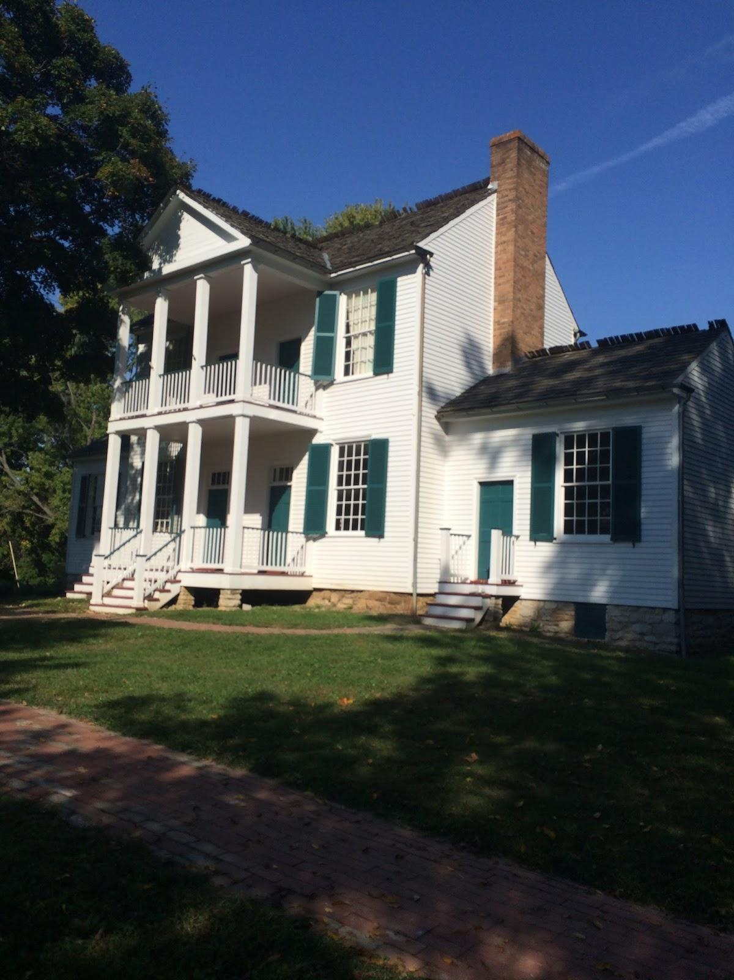
Faust park
By Kamden Allen

Slide 2
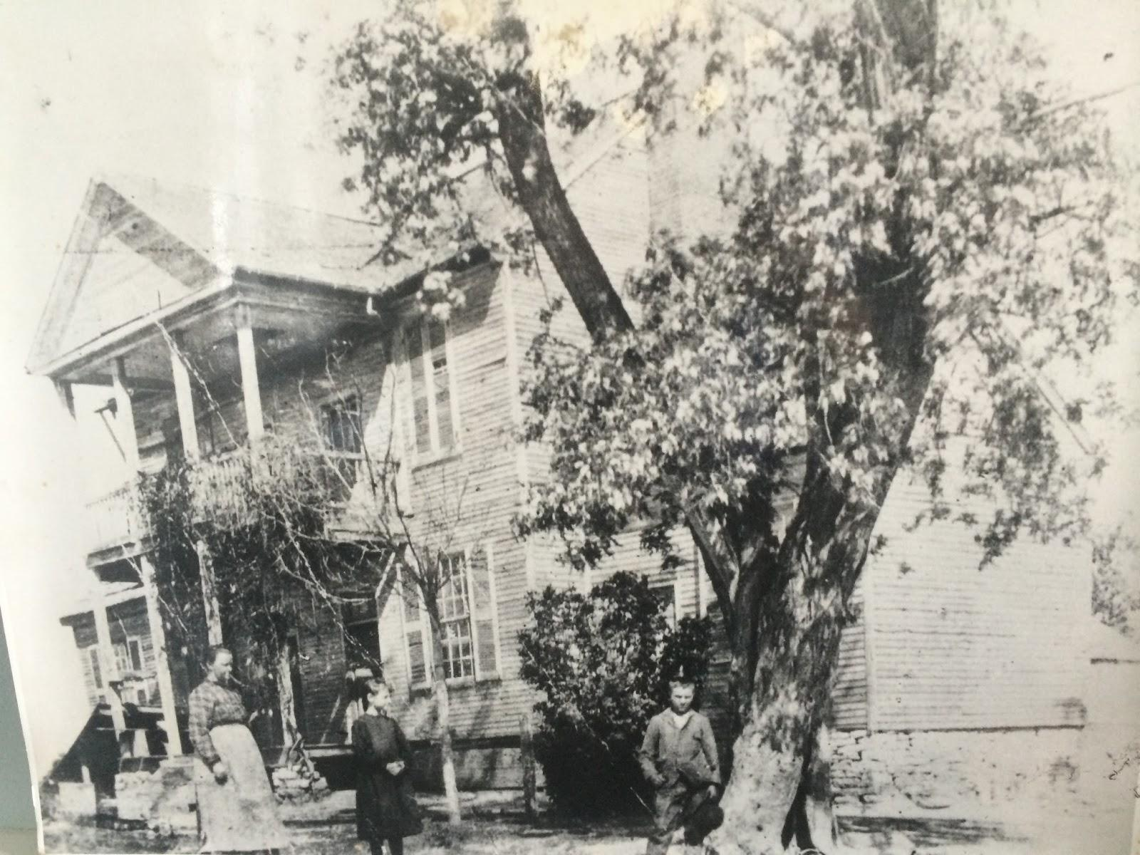
Where He Lived
Fredrick bates lived in thornhill mansion.
With his wife Nancy
And his 4 children
Emily,woodvile,luscious lee,and Fredrick jr.
He was the governer from 1824-1825

Slide 3
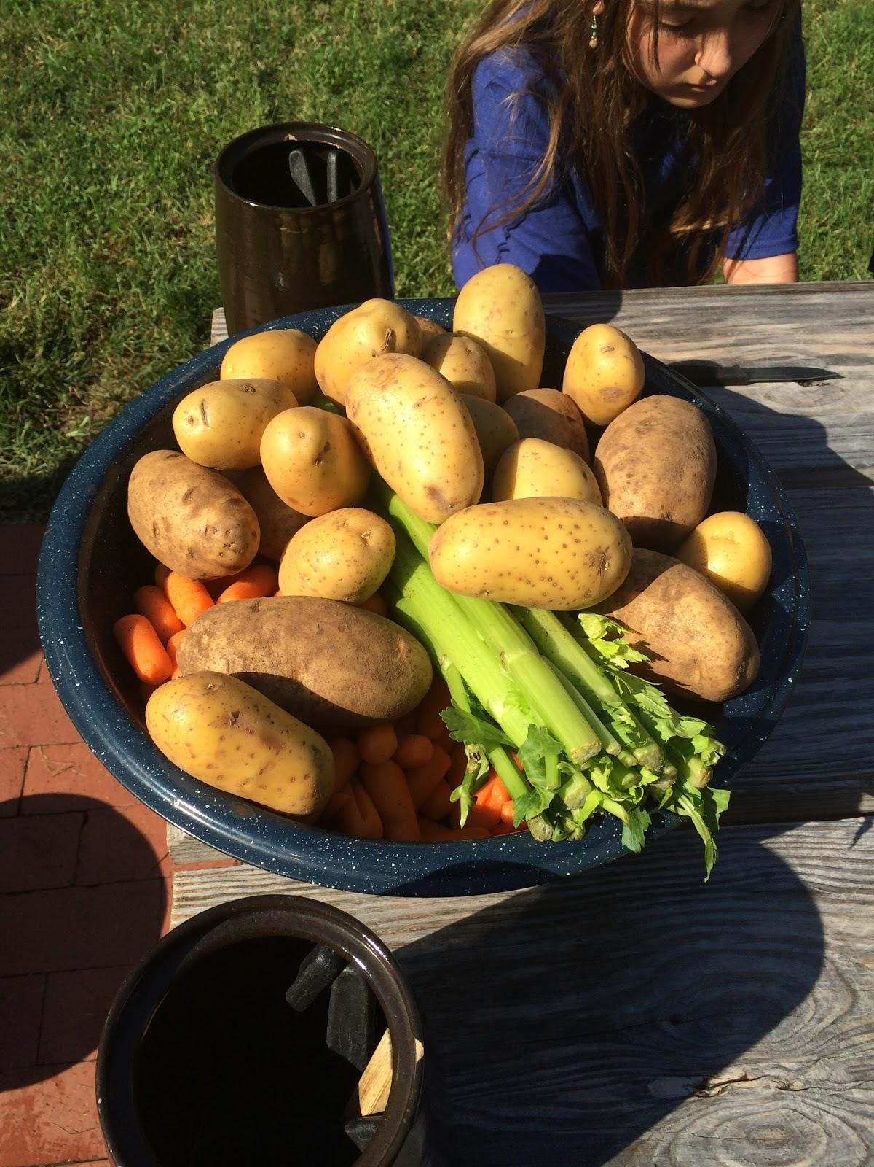
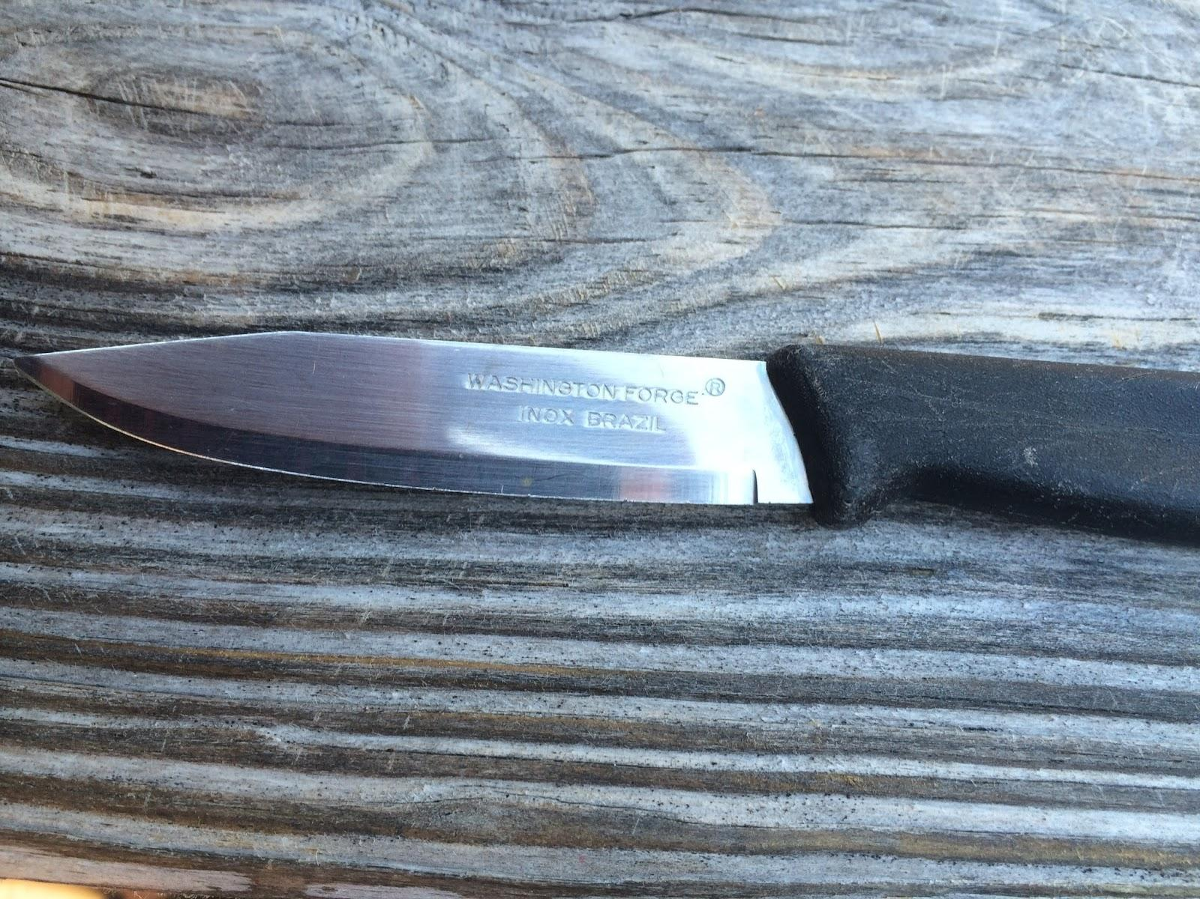
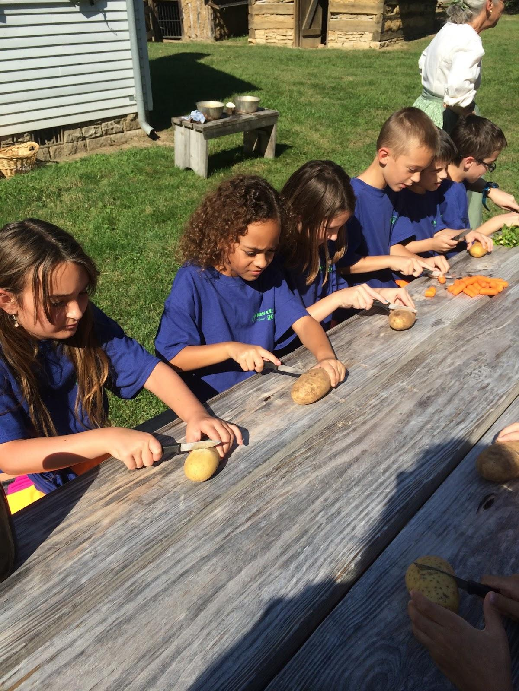
Lunch Time
Chomp,Chomp,Chomp is the sound of cutting food carrots,potatoes,onions and celery cutting with mini knifes and then the chiefs will cook it and we can have some good vegetable soup.

Slide 4
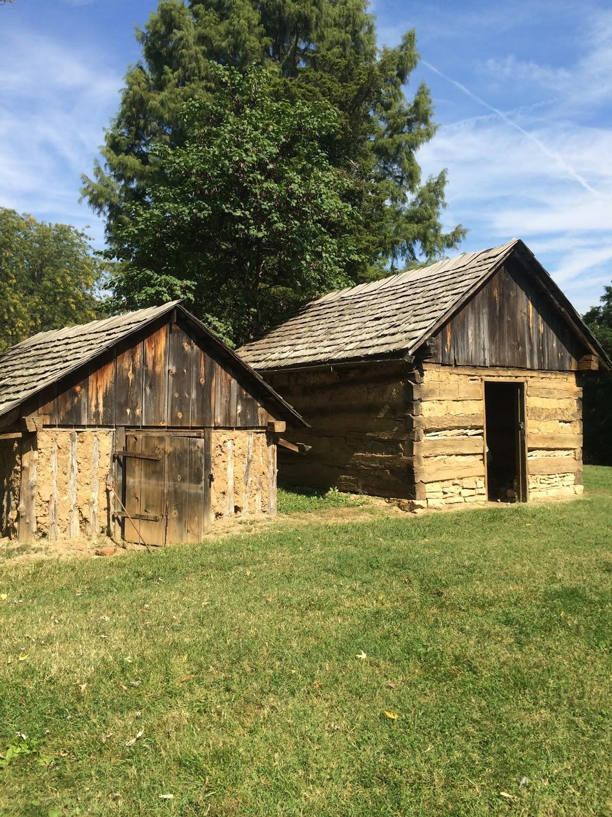
Smoke/ice house
The smoke house is where they would hang animals and cook them over the fire place.and the ice house is where they would put the ice until they could get out.

Slide 5
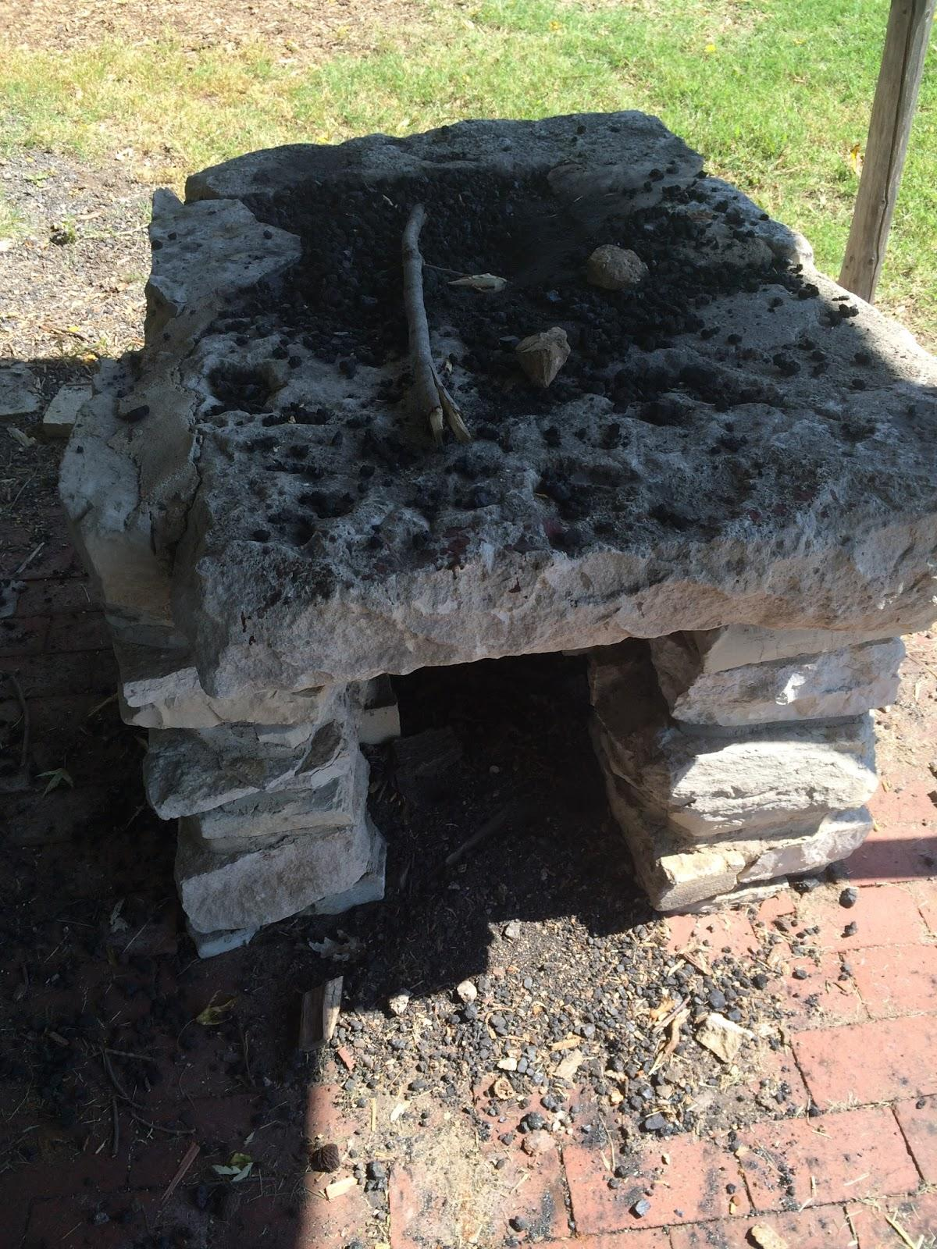
Ben the blacksmith
Sizzle,sizzle Is the sound of the burning grill where the Charkle burns Ben the blacksmith would work at burning nails and tools.ben was a slave.

Slide 6
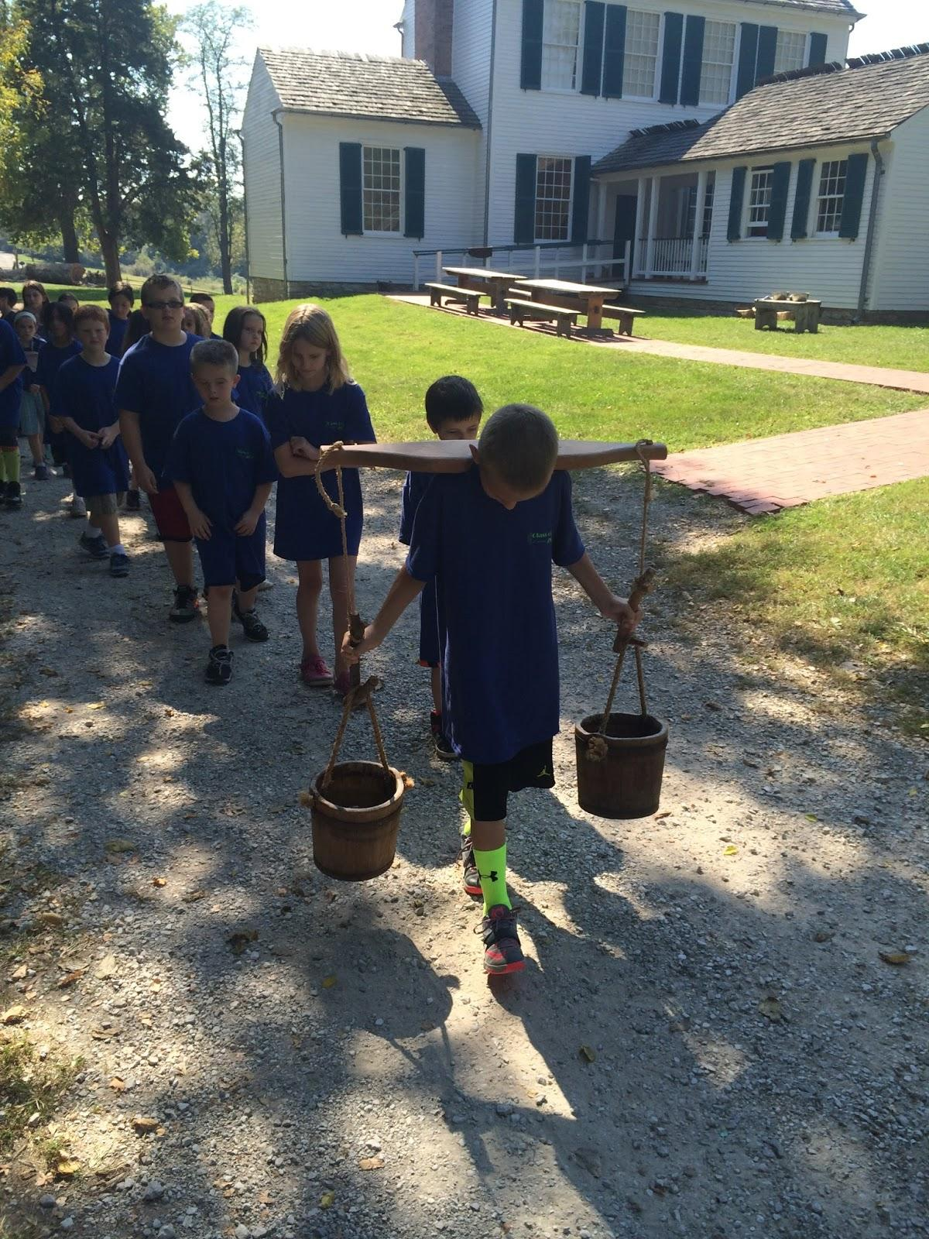
Sling and water carrier.
This is heavyyyy.moand the kids we had to Carry chunks of wood and collect 5 twigs and the wood was heavy.And the twigs were not

Slide 7
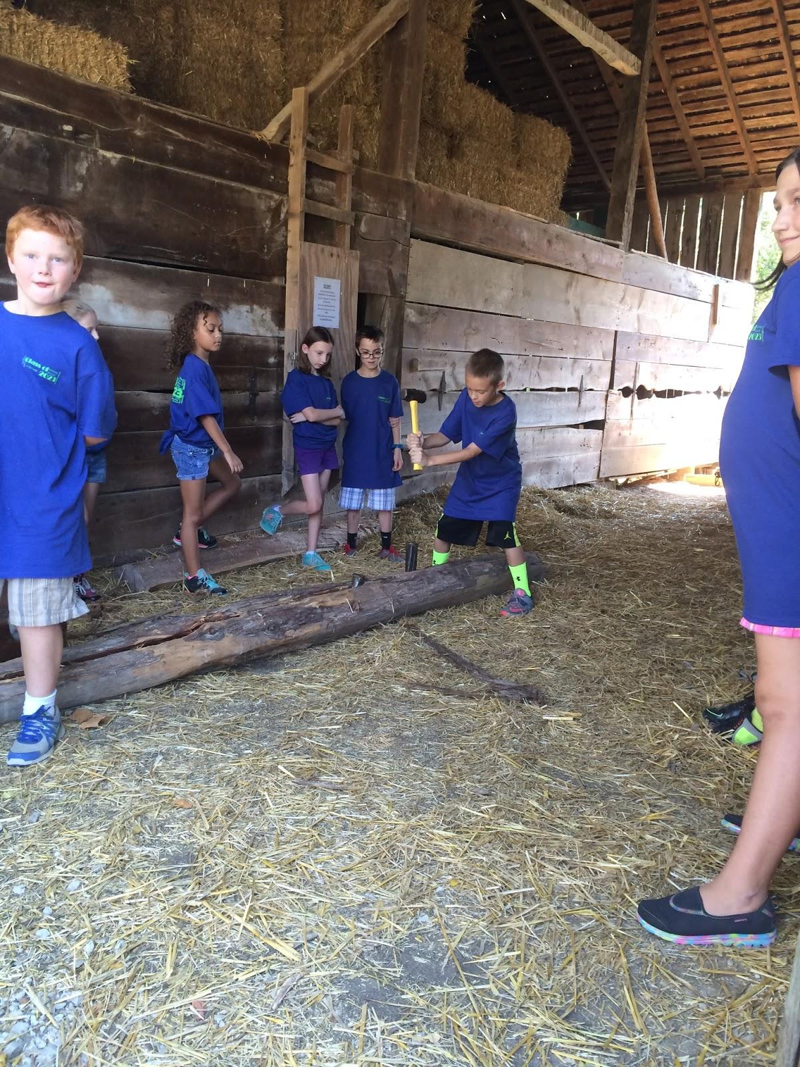
Splitting wood
Bam,Bam,Bam goes the mallet when we hit the wood we were splitting wood with a mallet and hitting a wedge into the wood.did you know aberham Lincoln could split 400 trunks of wood a day and only get paid 25 cents

Slide 8
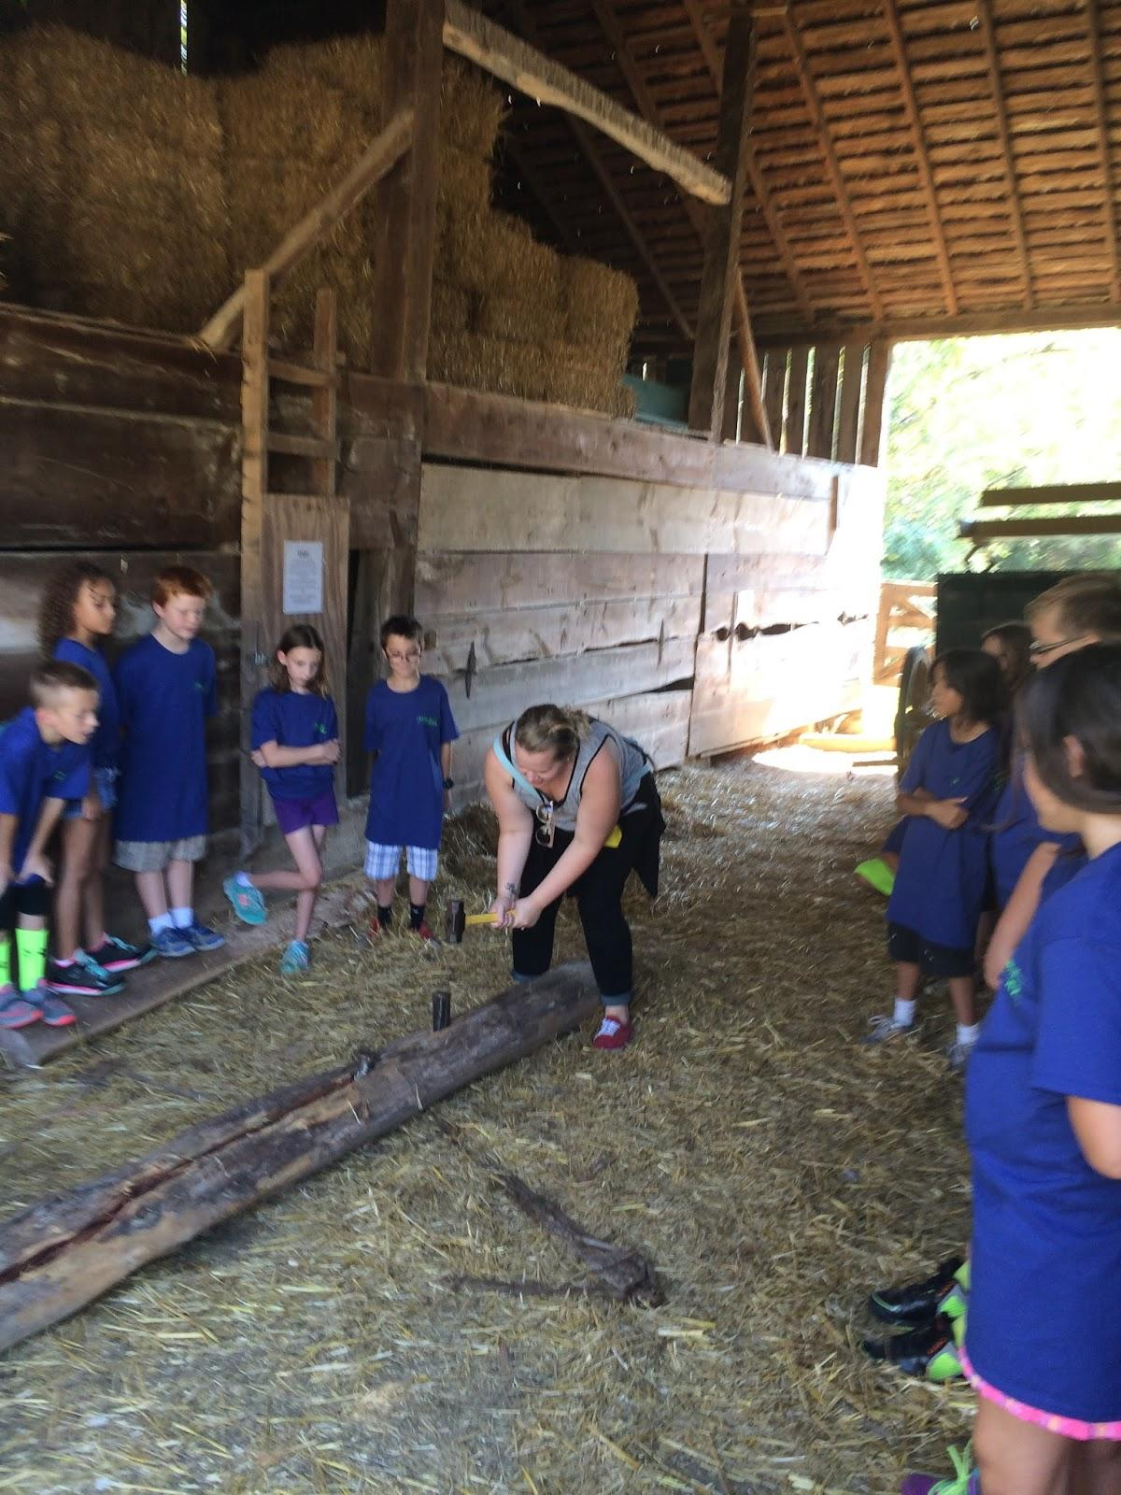
My favorite chore
My favorite chore was hammering the nails inside the wood each of us hammered a nail into wood and split it

Slide 9
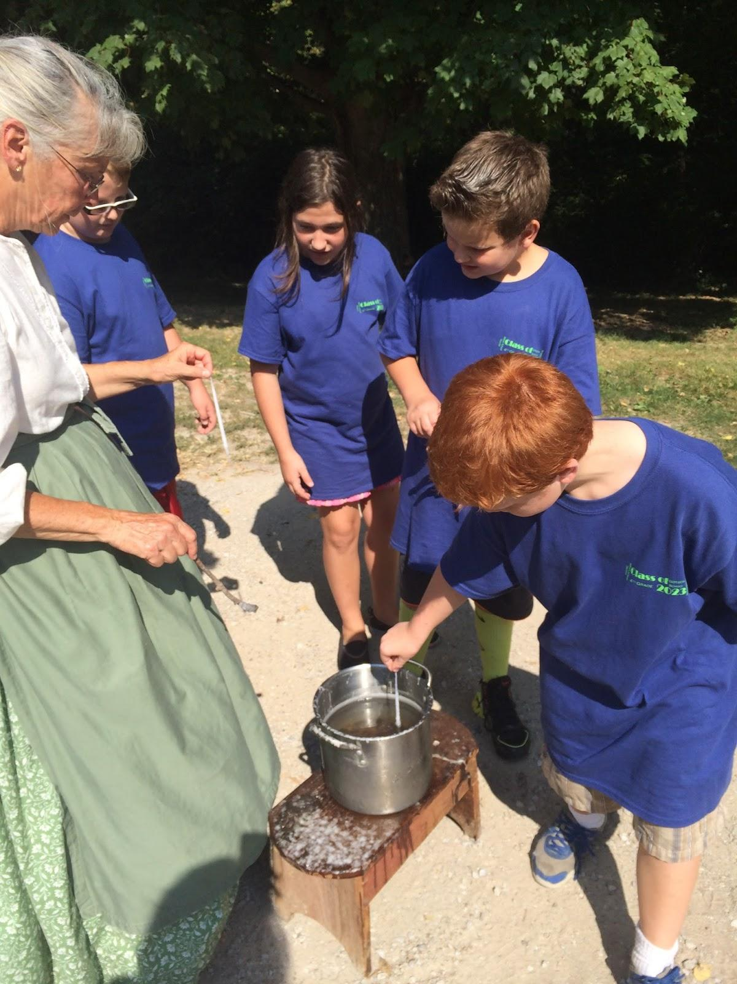
Candels
Hot the candels are very hot.dipping in wax then water wax water wax water for ten times around.

Slide 10
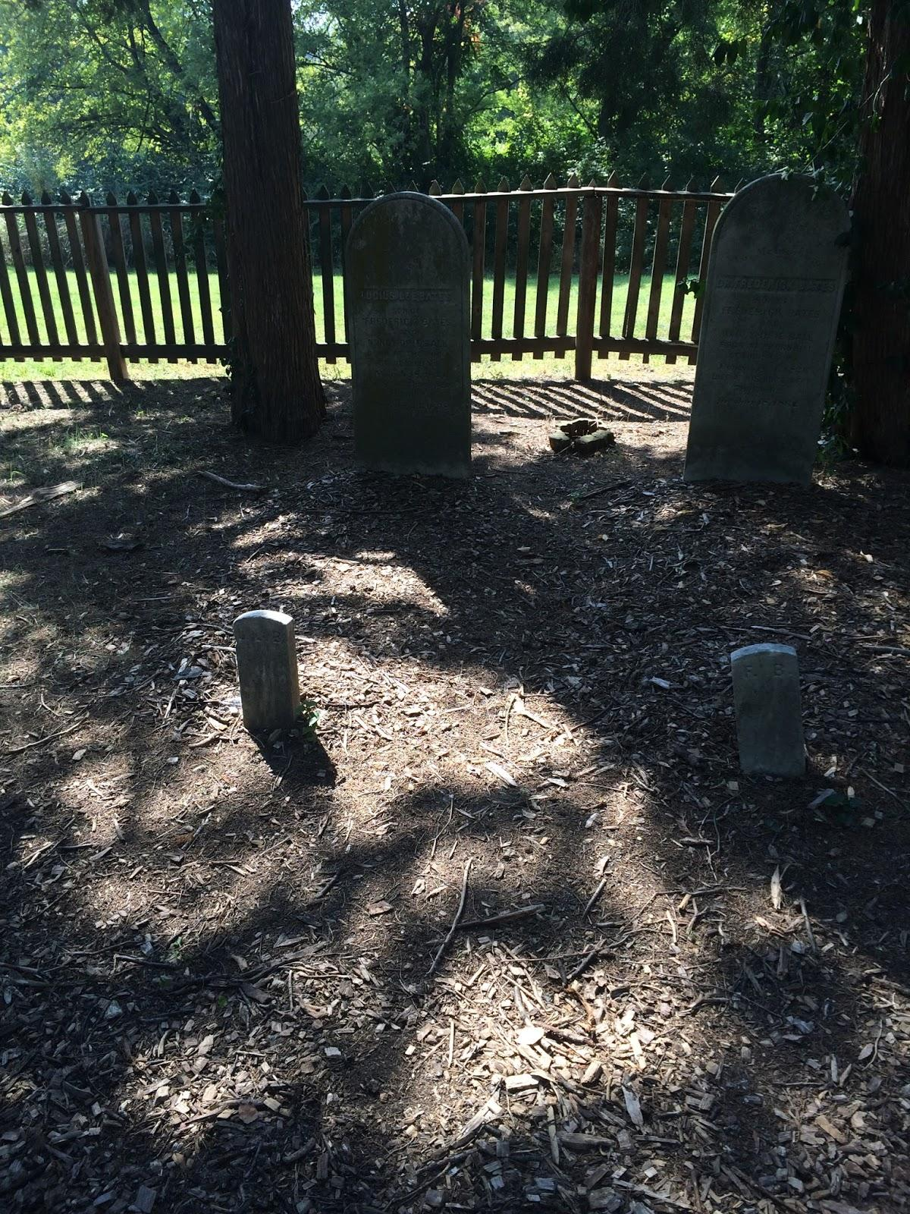
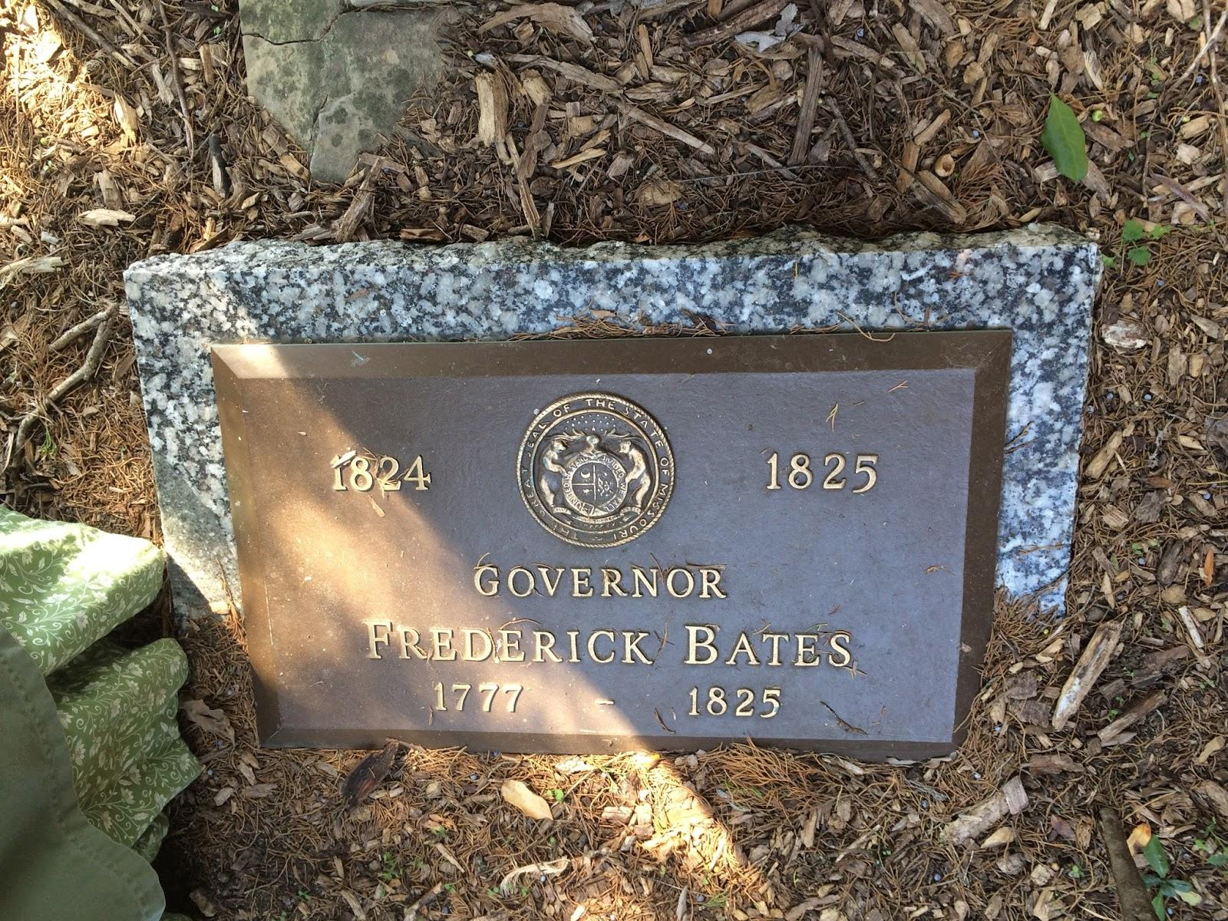
Grave yard/going home
Resting in the grave yard is Fredrick bates Nancy lushus lee Fredrick jr

