Slide 1
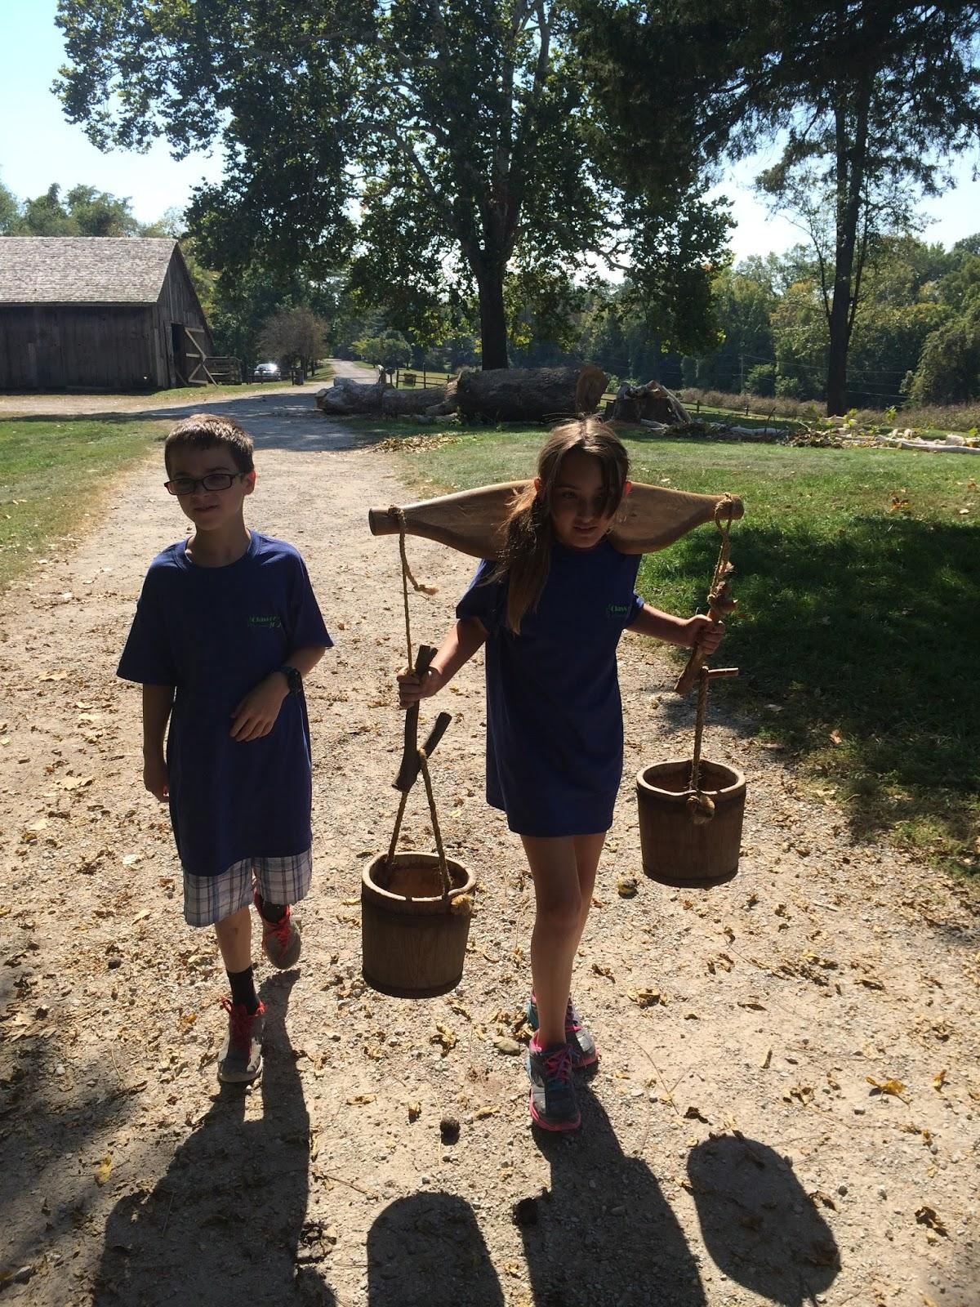
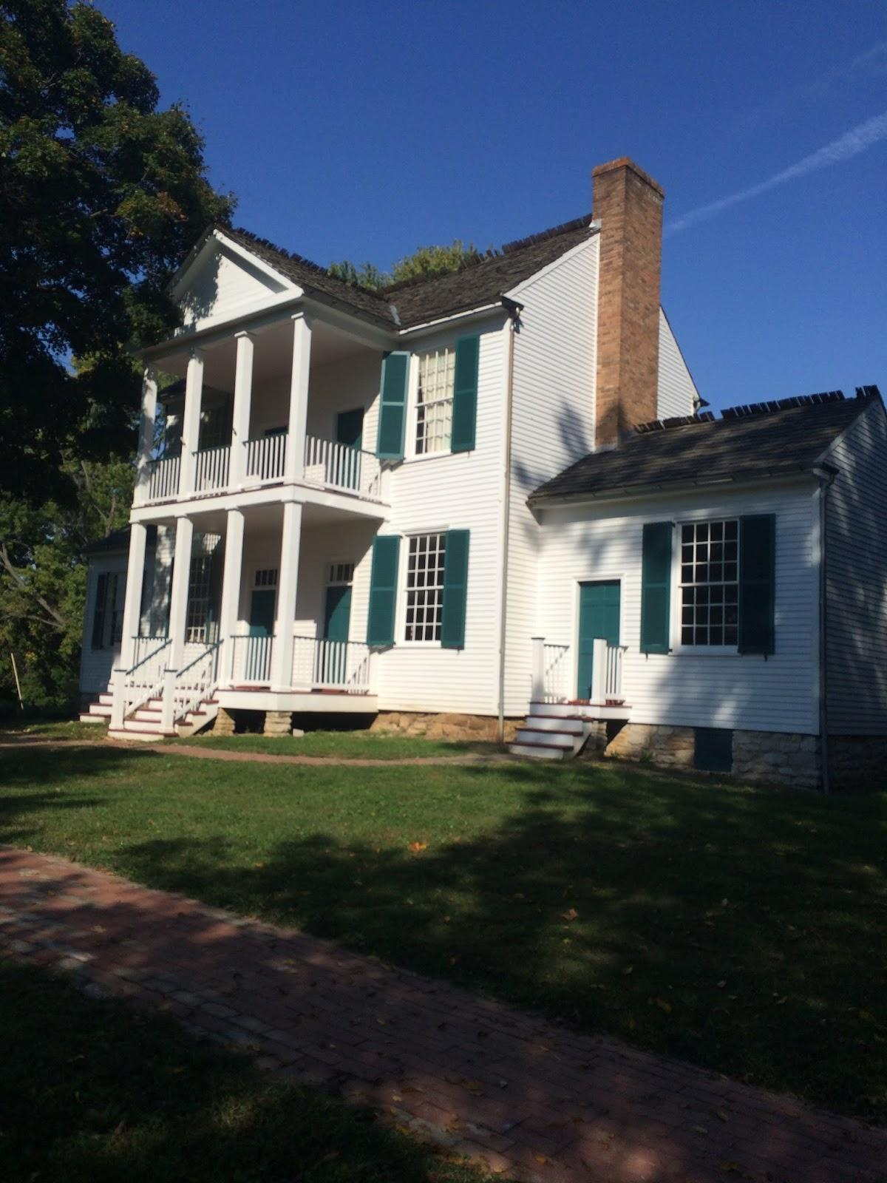
The Pioneer Field Trip
By Ashley Nicole Wedge

Slide 2
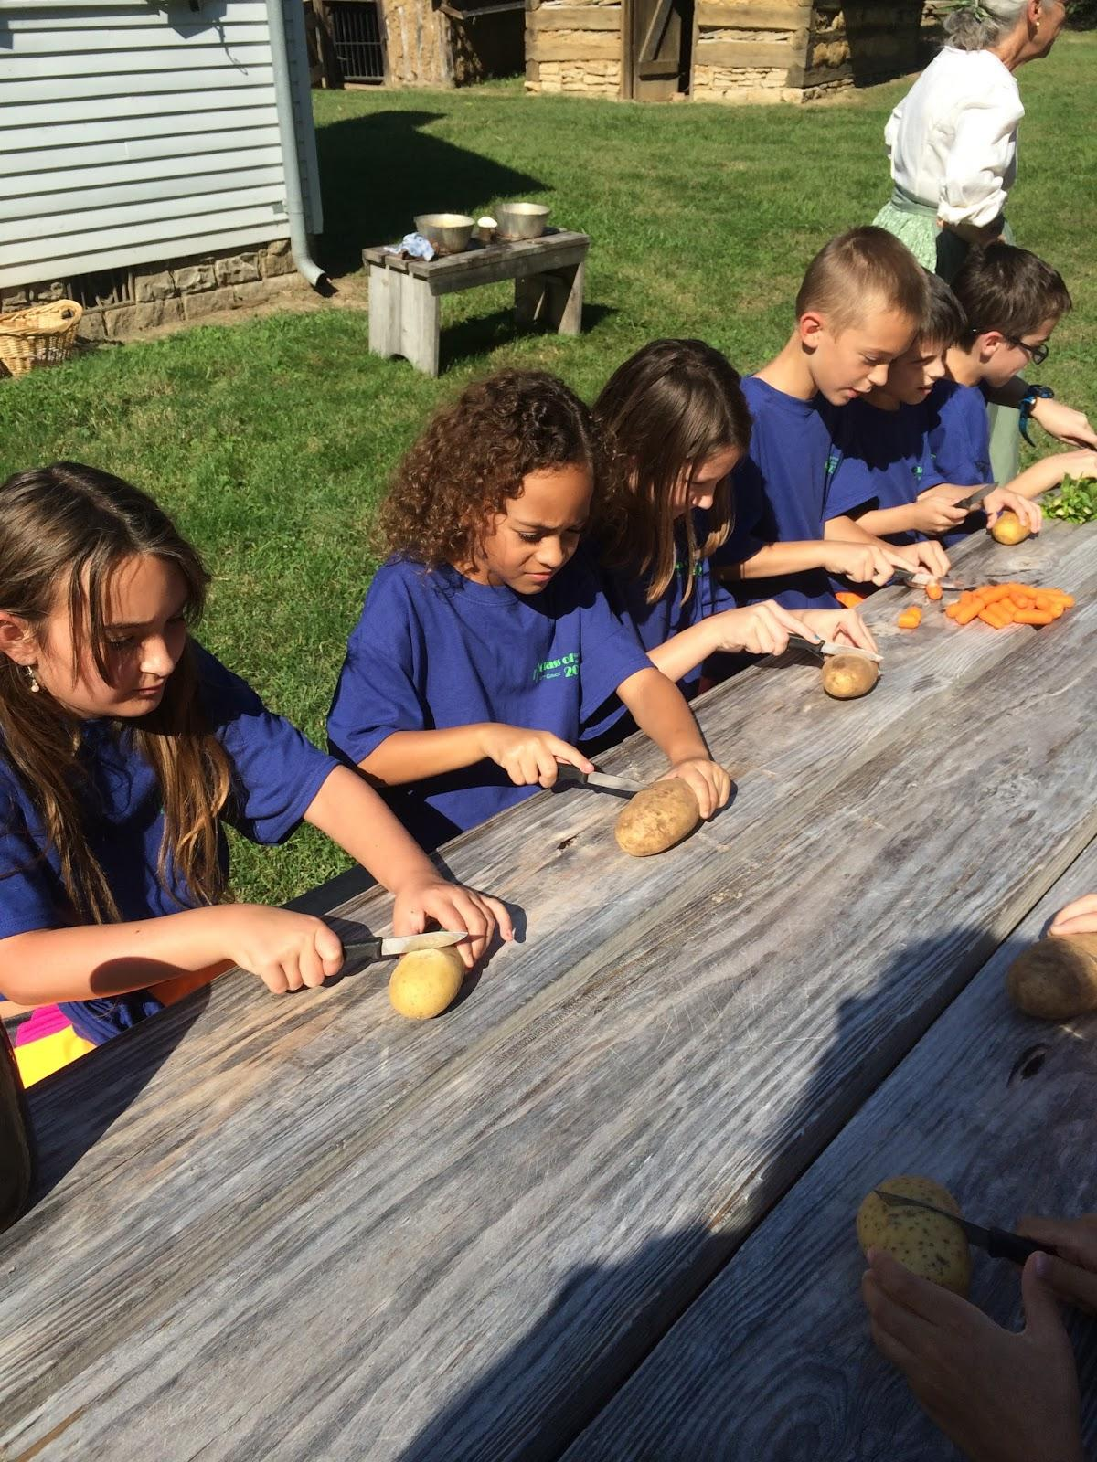
Getting our lunch ready
We chopped up our fruit and vegetables to make our soup for lunch and we washed our hands to not put germs on everyone's meal

Slide 3
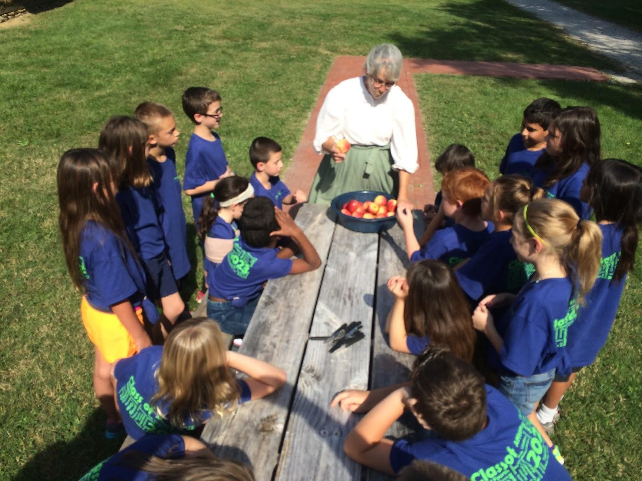
Making diserit
We cuted apples into a chunk of pisces to eat after lunch which I also got to turn butter which was fun also.

Slide 4
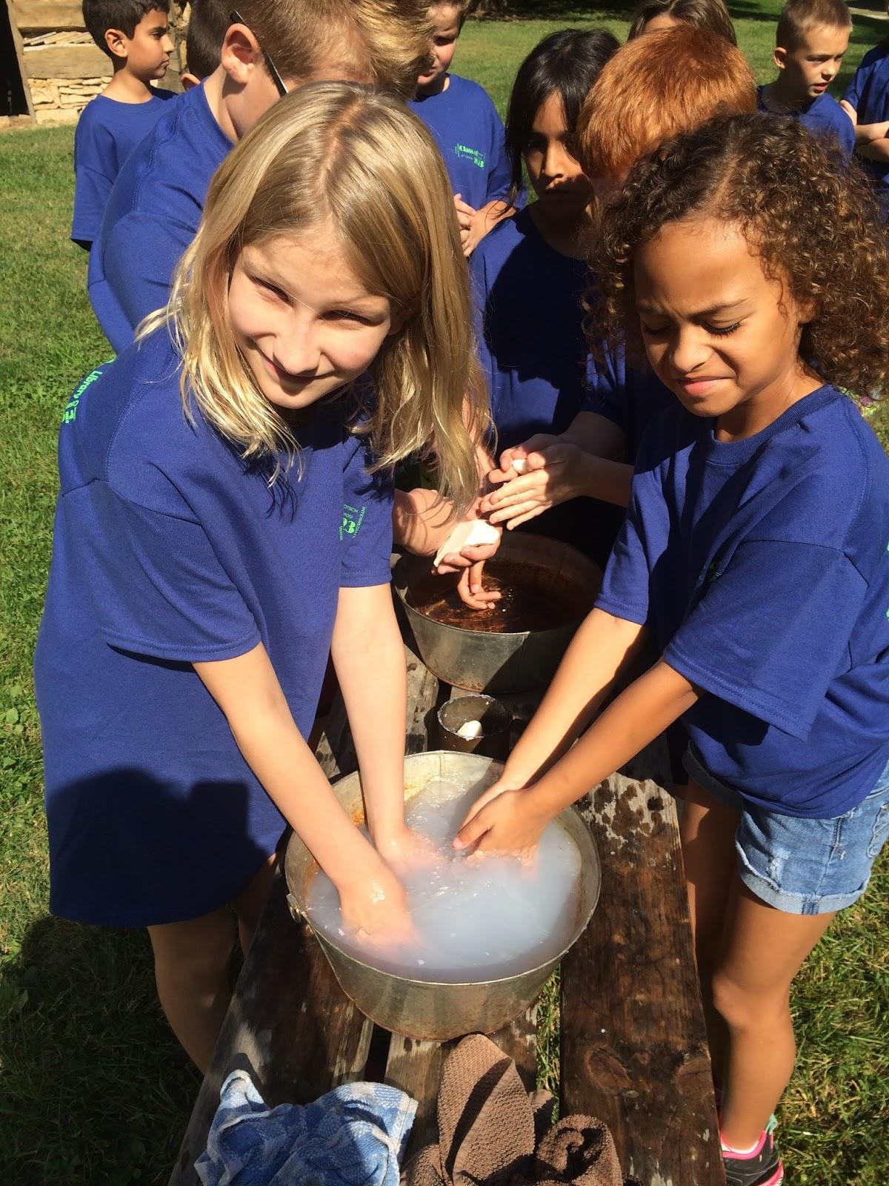
Sope
Also mrs. Micka taught us how people in the 1800s made Soap to wash their hands and now I know for a fact that they did not know what germs where even know what germs was and if their child had said a lot of dirty words the unfinished sope they took and put in there mouths which gave them blisters in their mouths and then they would not say dirty words.

Slide 5
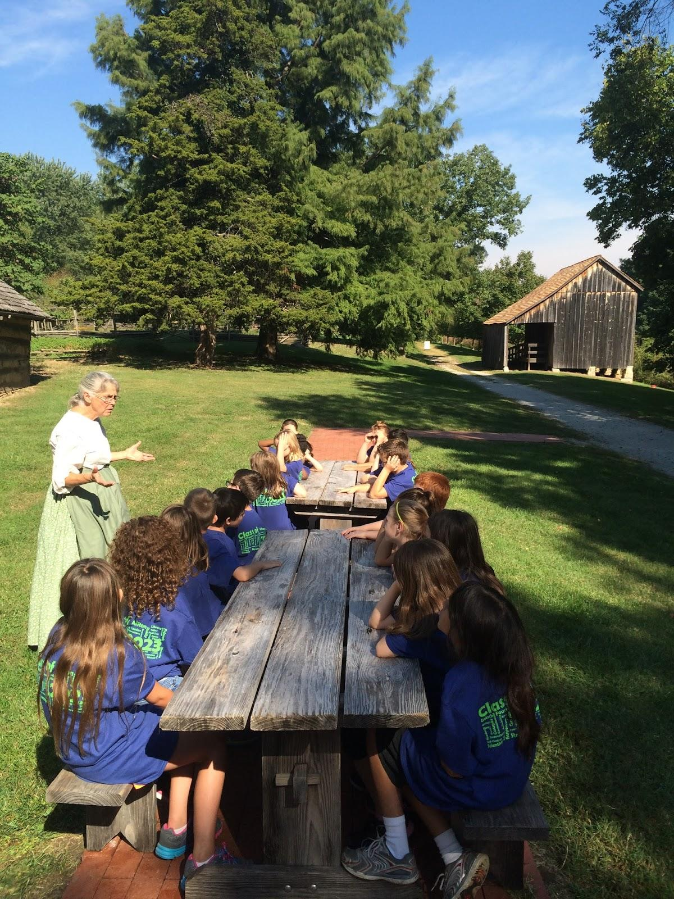
The feast
Then it was time for lunch we had the soup and some people liked it and some people didn't like it and the apples I Was one of the people that didn't like it but I only know because I tried it.For a snack we had small yummy cookies that mrs Micka and the workers made for us to eat.

Slide 6
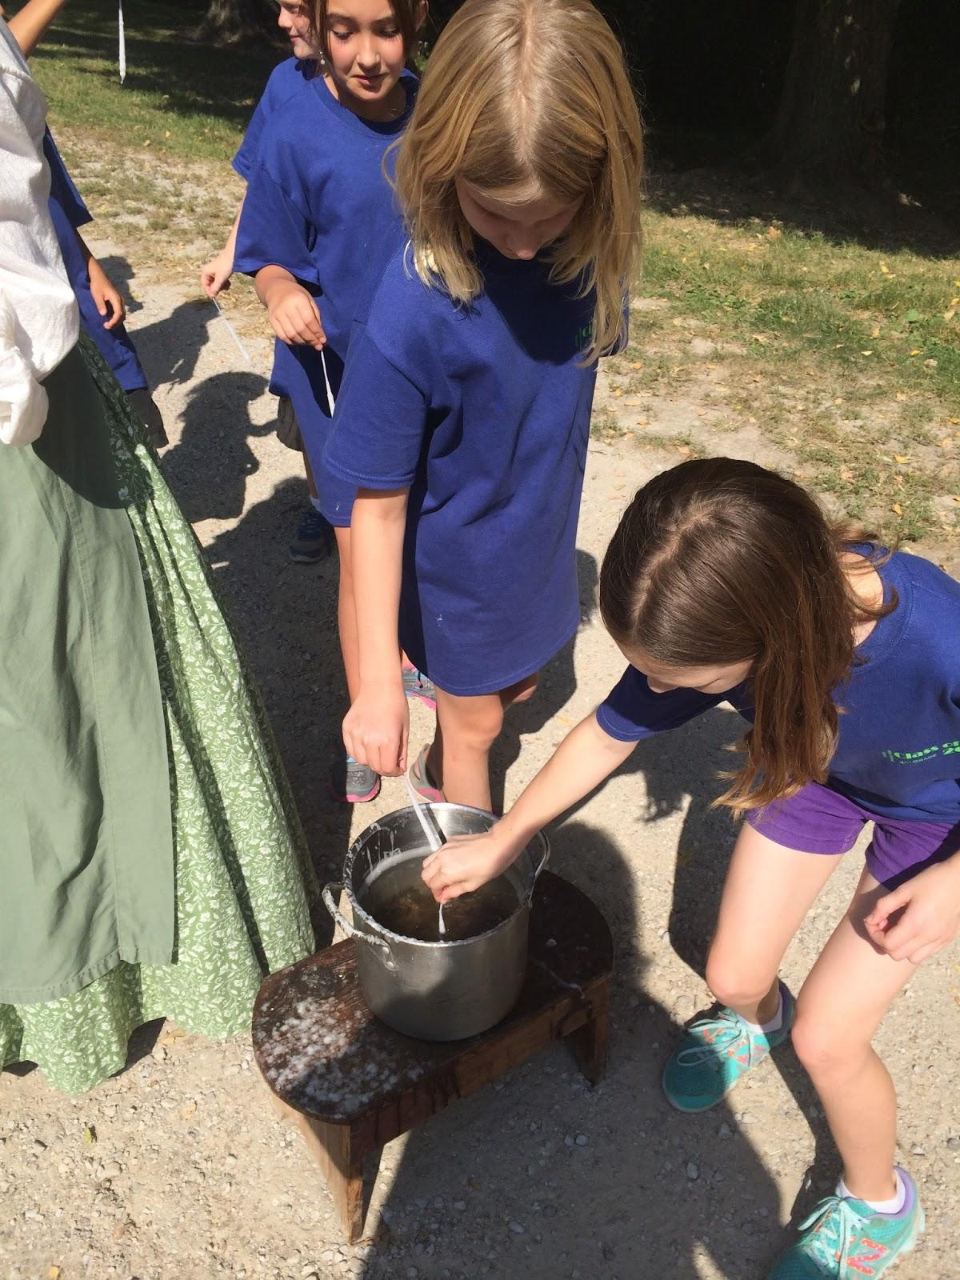
The xtra activity
We got to make candles out of wax and water. We went around five times to make it just right because we want to light the candle not the string.

Slide 7
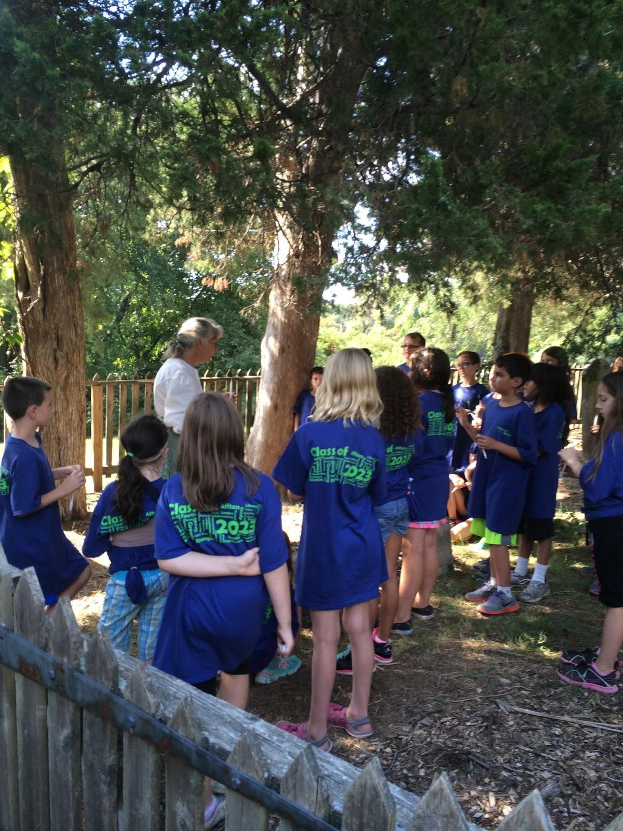
At the end of the day
At the end of the day we went to gov. Frederick bates family grave. It was small but still a family grave. Mrs.Micka taught us when and where the bates died then we got on the bus to go back to the school.

Slide 8
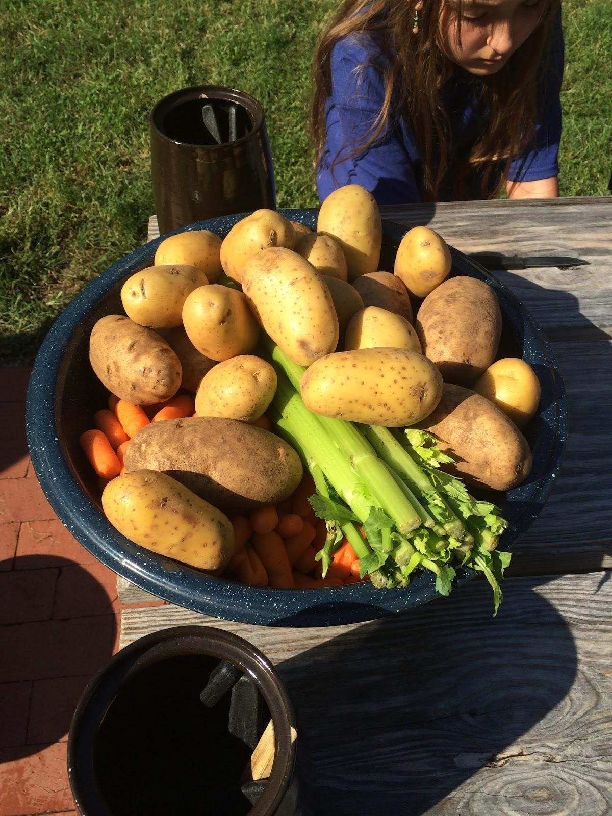
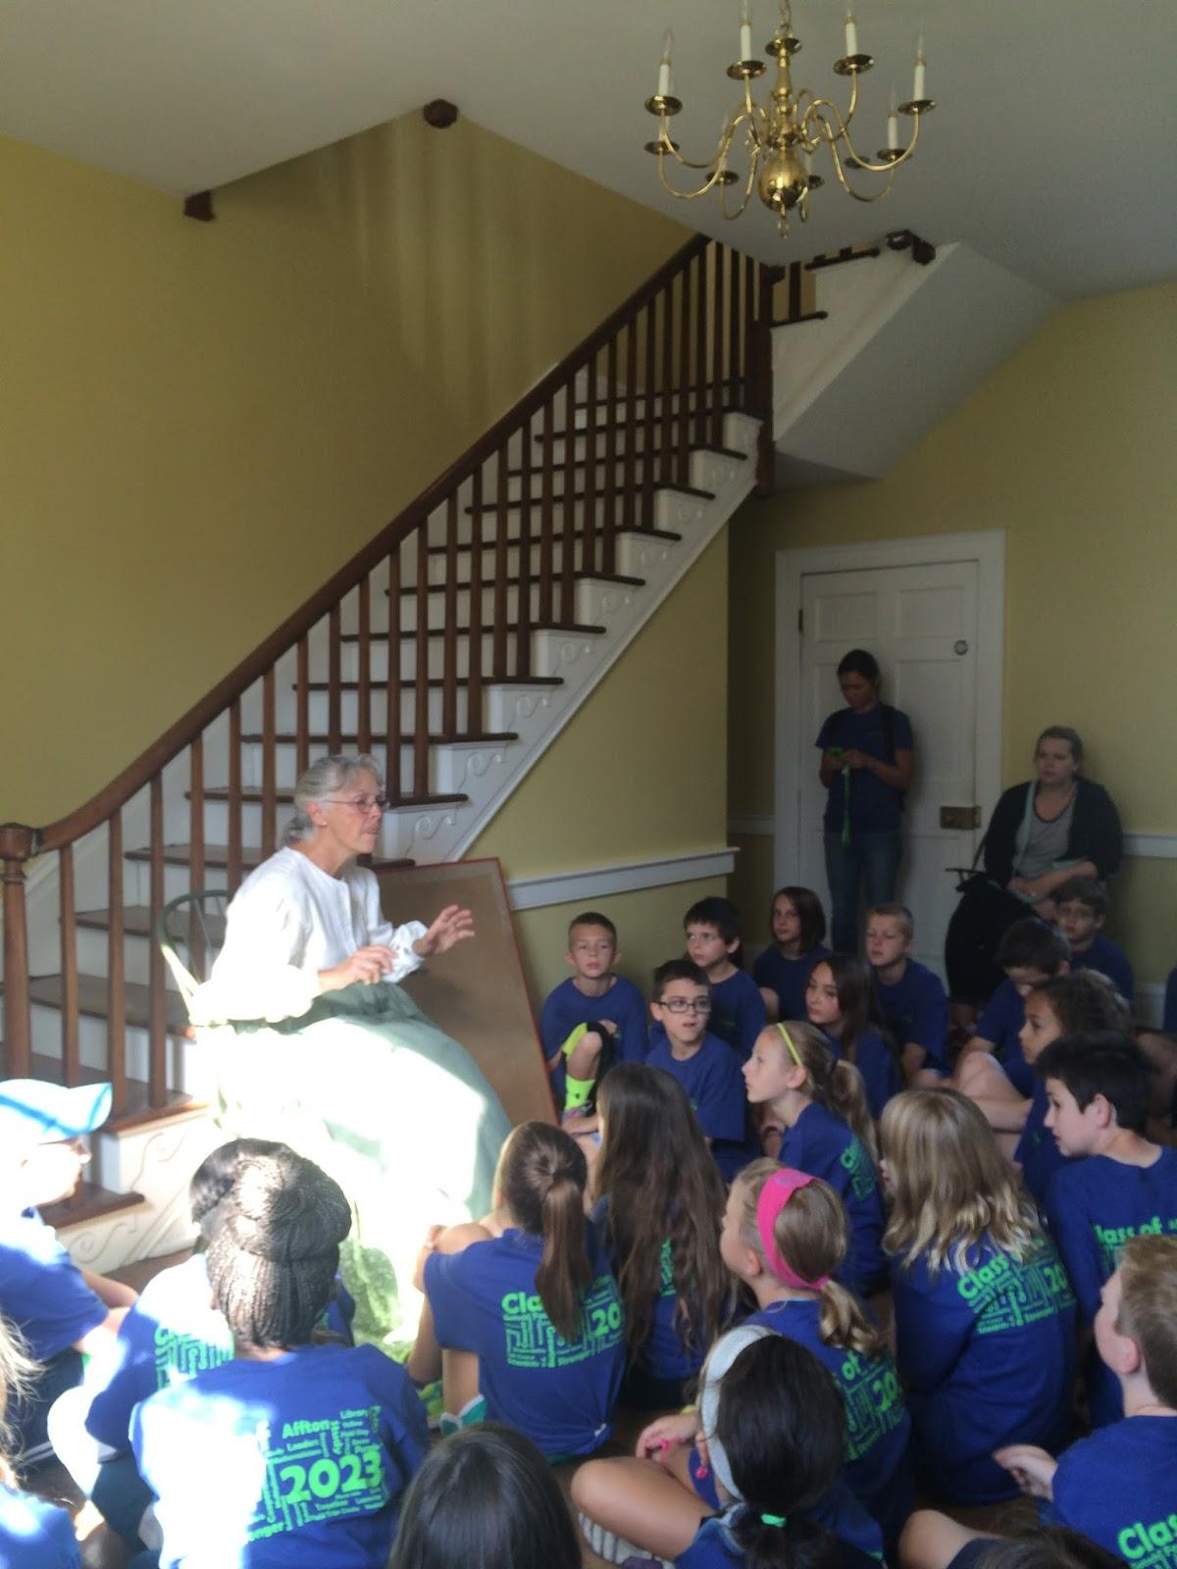
Facts
Gov. Frederick bates and his family lived in a Mansion at thornhill.
Mr.Bates was only a gov. for few months then he died.
When he died his wife Nancy married and had more children than Nancy died then the children.The bates had lots of windows and doors so they was not so scared like the others.

