Slide 1
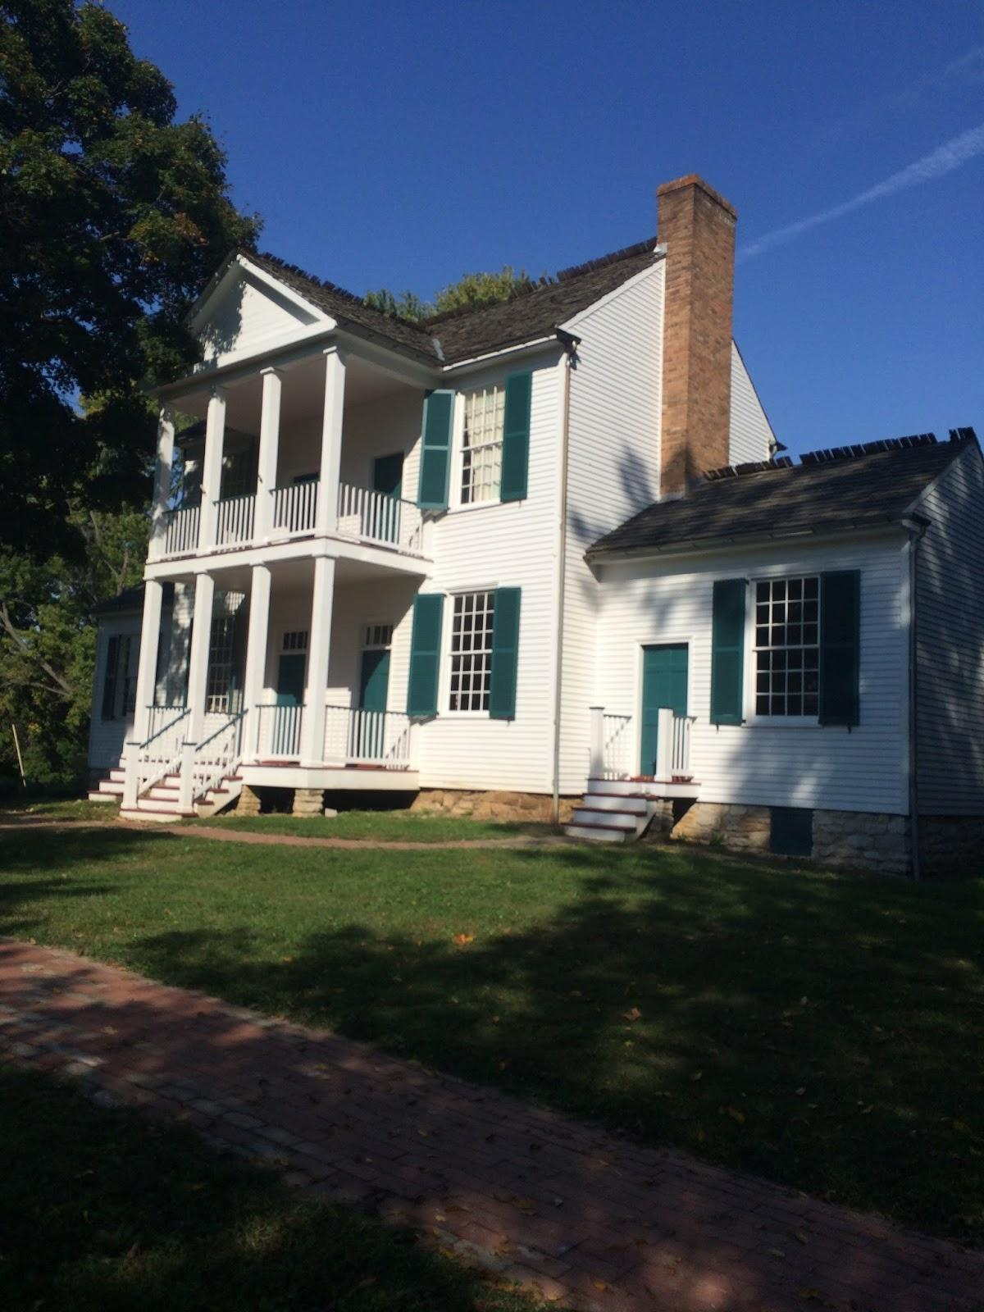
Field Trip to the 1800s
By Aldina Masic

Slide 2
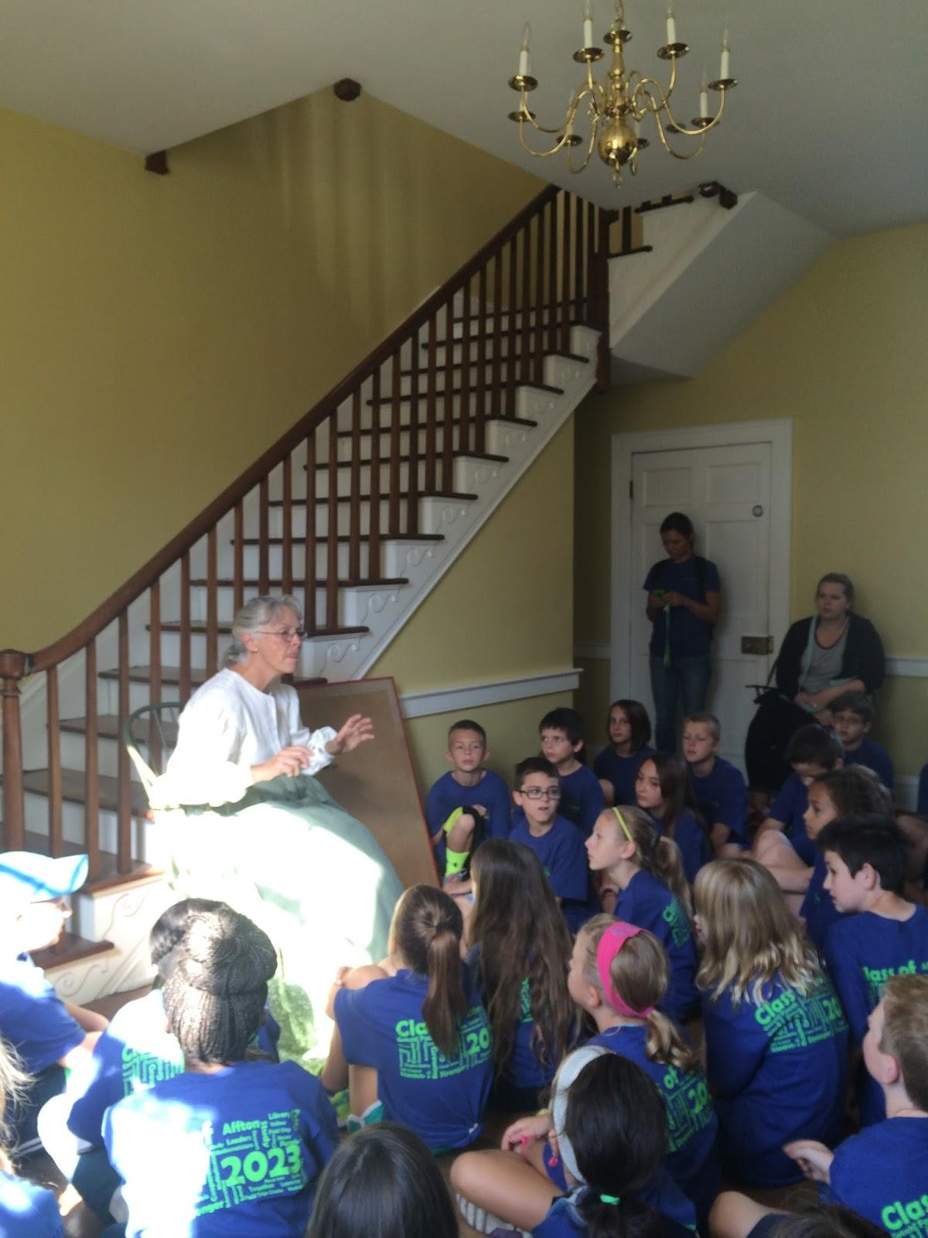
Frederick Bates House
First we went to Frederick Bates house and Mrs Mika are history teacher for the day talked about Frederick Bates life and how 1800s was like.

Slide 3
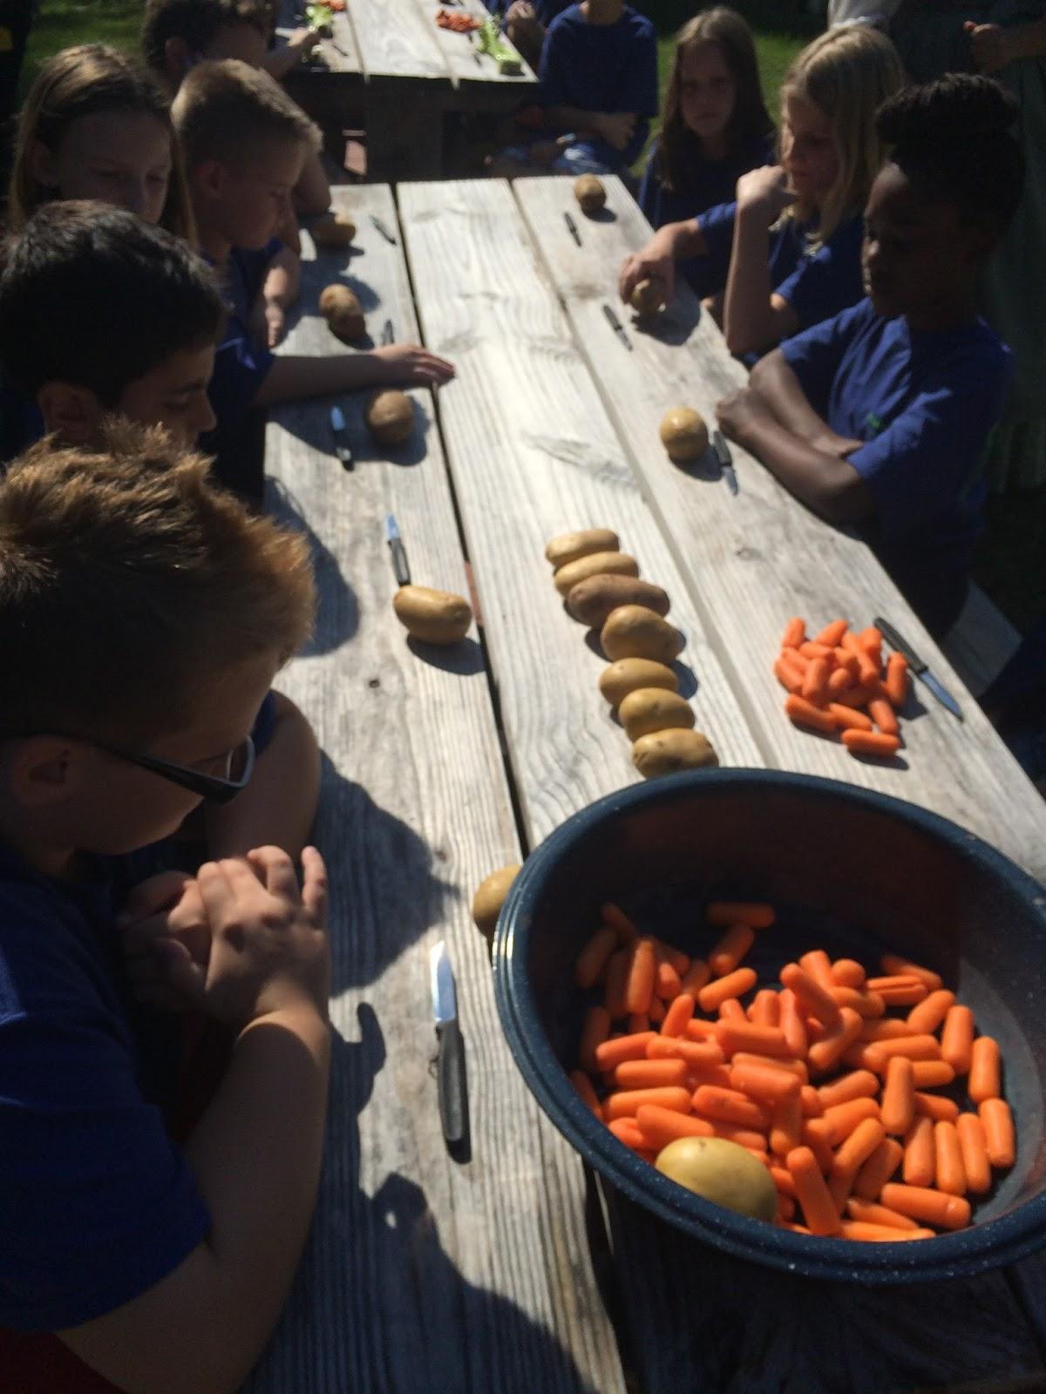
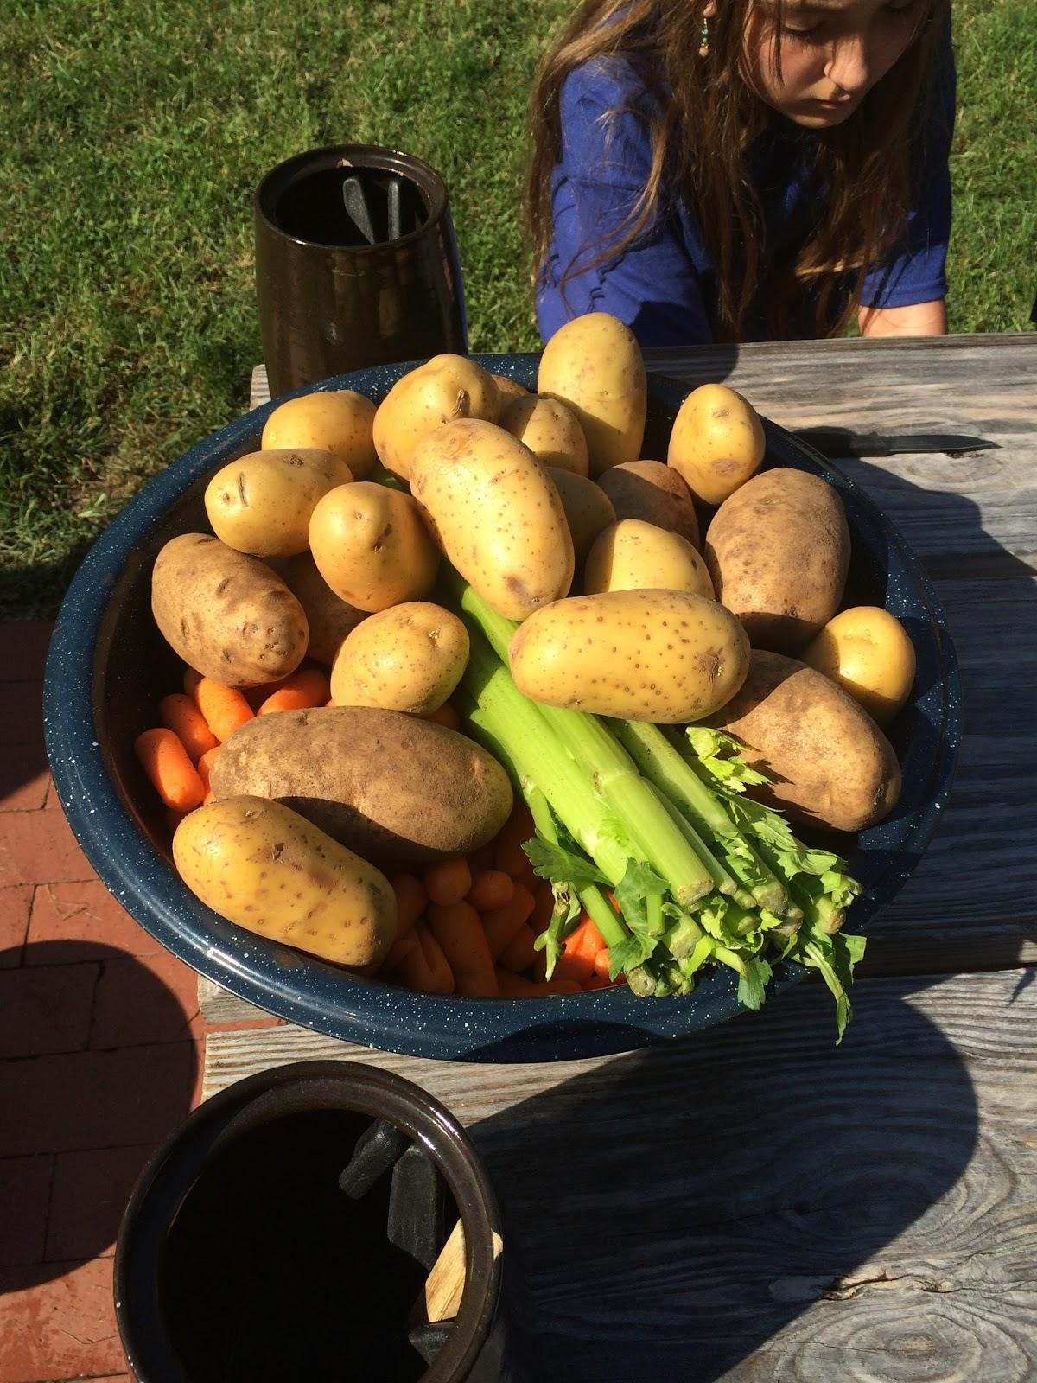
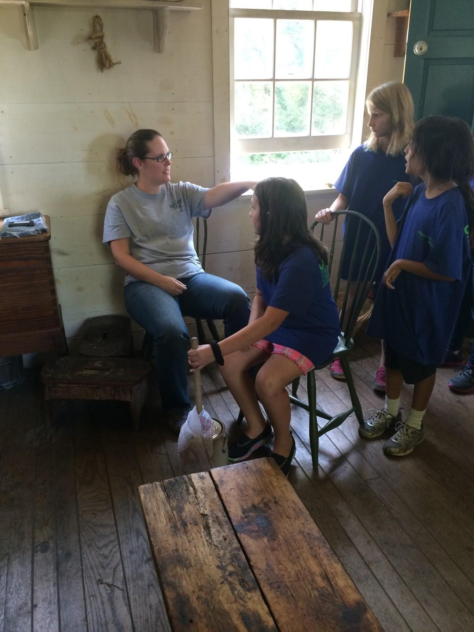
Making Food
Then we sat at the benches and Mrs Mika gave us a knife and she past out vegetables for us to cut up I had a potato. Then we had to cut up apples for dessert and then Mrs Mika would tap your head and that meant you to go and churned butter and we got to churn butter 25 times.

Slide 4
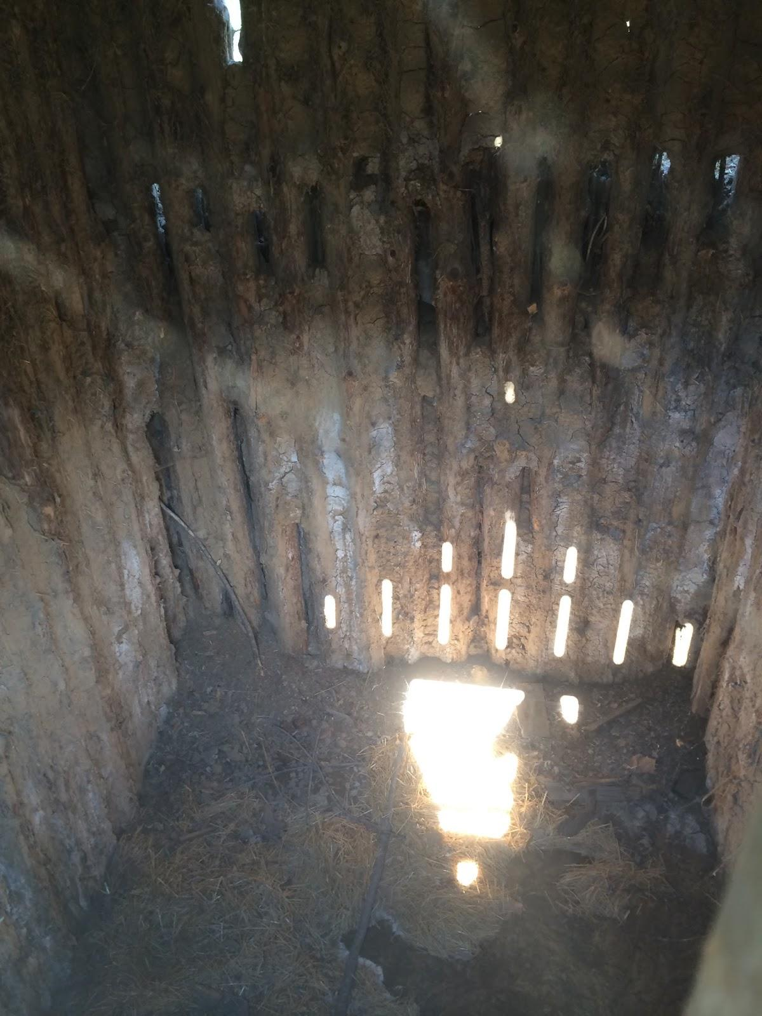
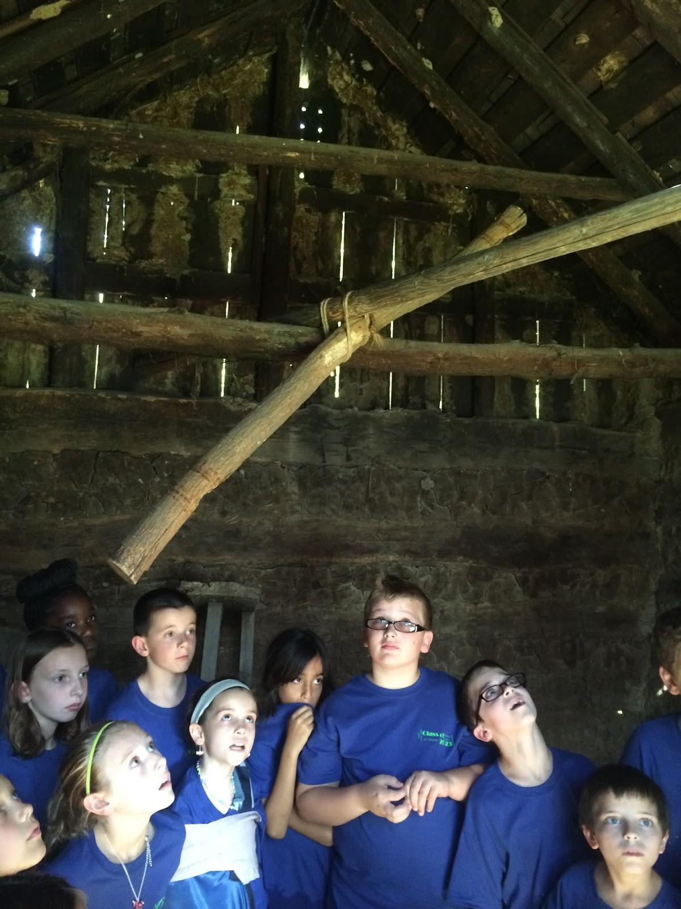
Smoke House and Ice House
The smokehouse is a place were you used to get a animal in the summer time and bring it in the smoke house and cook it and leave it in there and go and cut it when it's winter and it's called smoke house because it's trapped with smoke because it can't get out. Ice house it's a Pit and it's 12 feet long and you gather ice and put ash in between the ice so it won't melt.

Slide 5
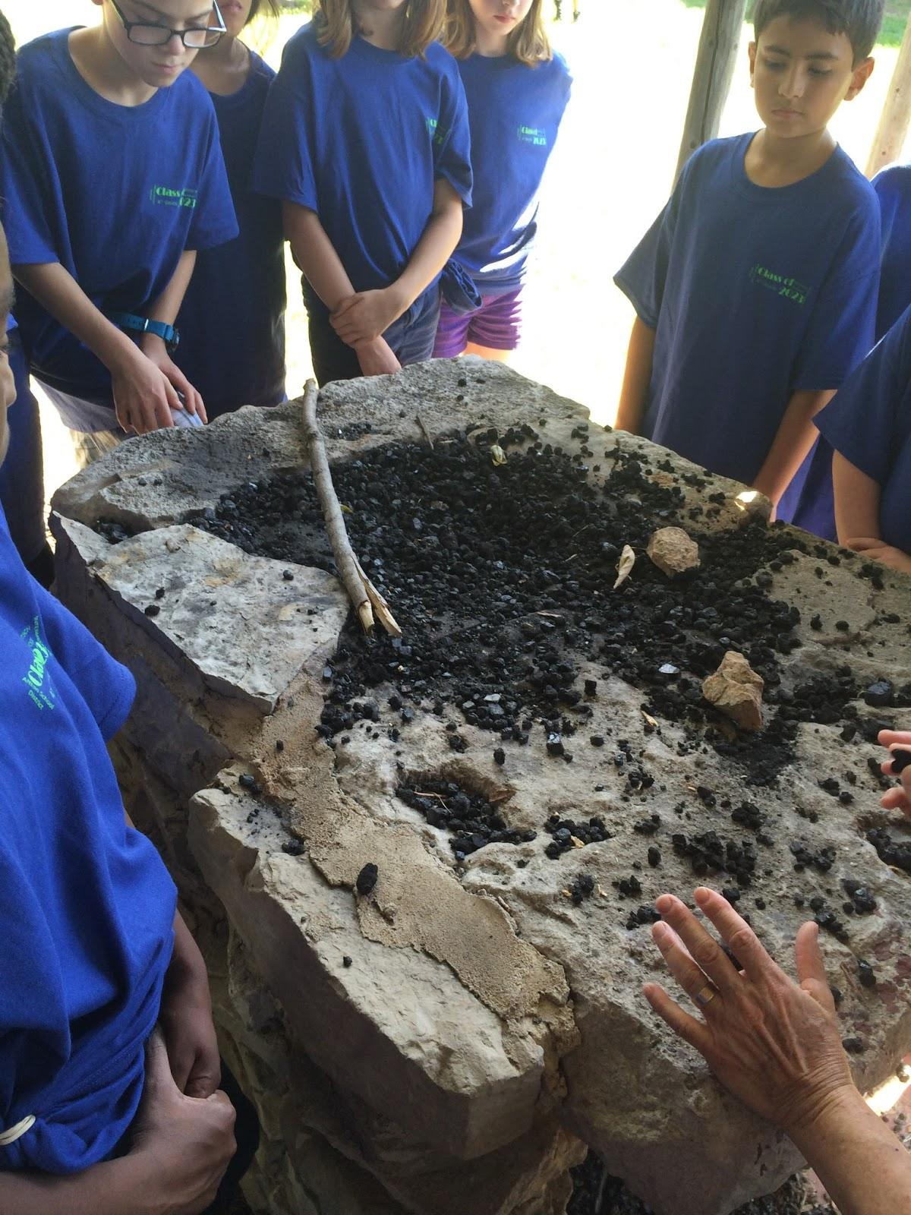
Black Smith
Then we went and saw where Ben the blacksmith worked. He would make useful things like a wedge and other stuff that involves with mental. And they were going to make a shelter for Ben but if there was no oxygen he would die and so there's is always a breeze were her works so that way he will not die.

Slide 6
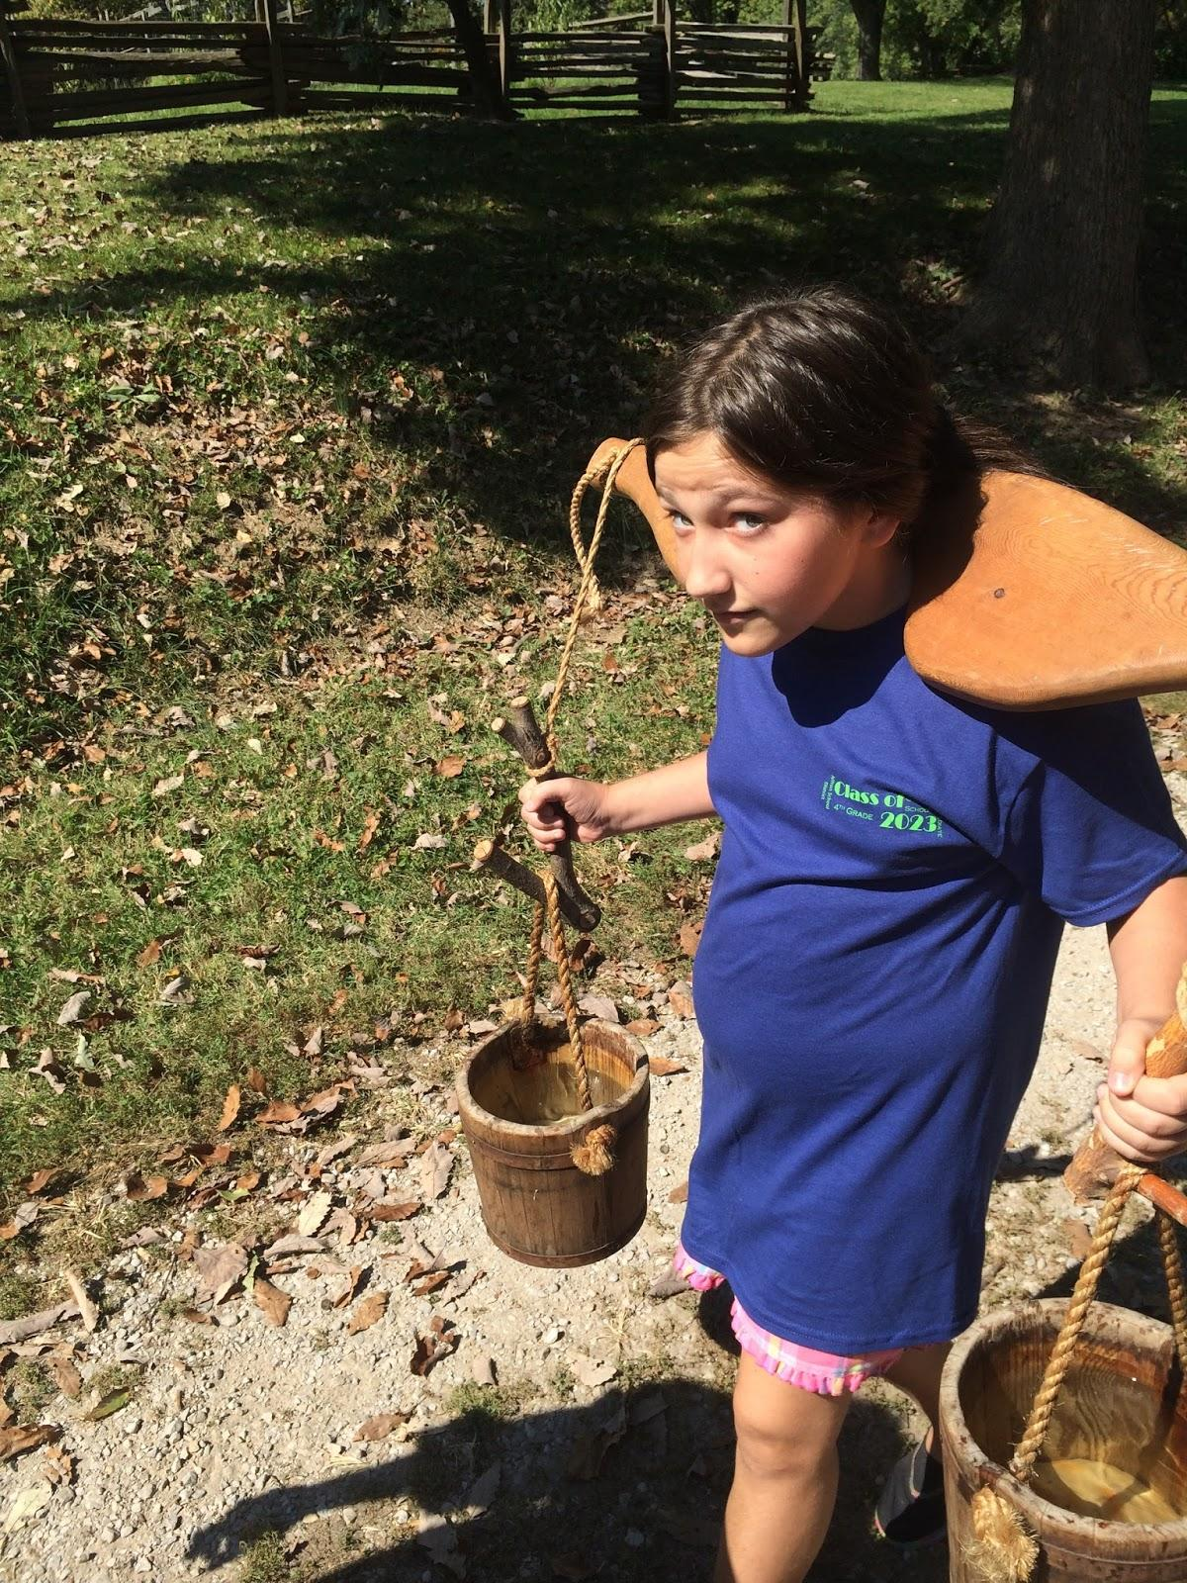
Yolk
Back in 1800s they didn't want to carry buckets of water so they had a yolk and so my classroom had to carry buckets of water with a yolk and we took 20 steps with the yolk on are shoulders and it was heavy. Then we had to get one log with a sling and get 5 little sticks.

Slide 7
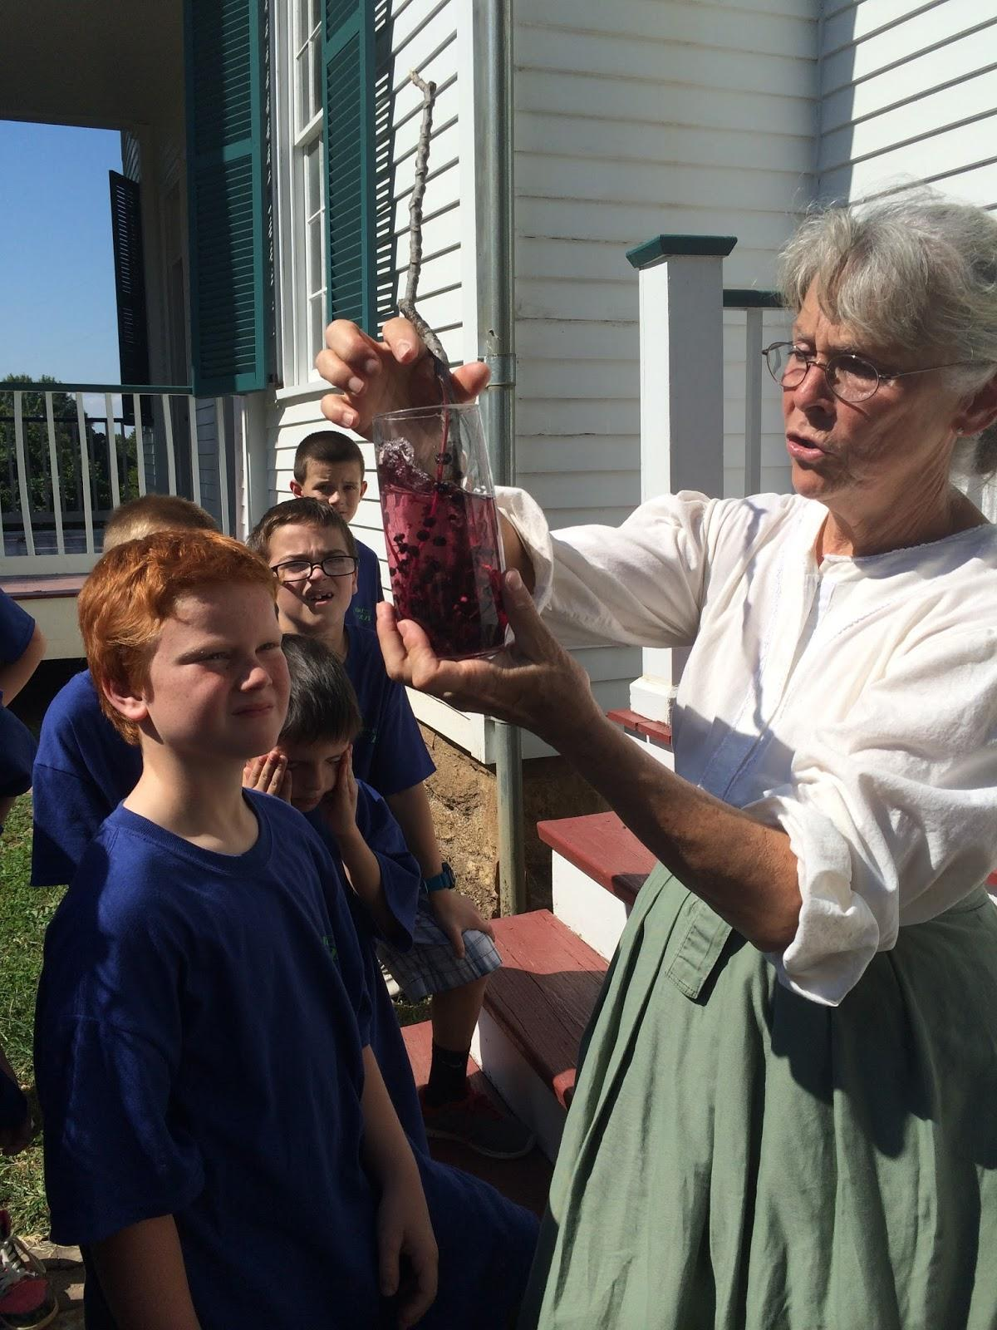
How to make Ink
After that we learned how to make ink. For black ink you used a glass cup and a fruit with a walnut in it and and put it in the sunshine and how to make purple ink you used poke berries and it makes purple ink but if it sits in the sun too long its going to be brown ink and when the pokeberry has a leaf you have to boil it 3 times and you can eat it.

Slide 8
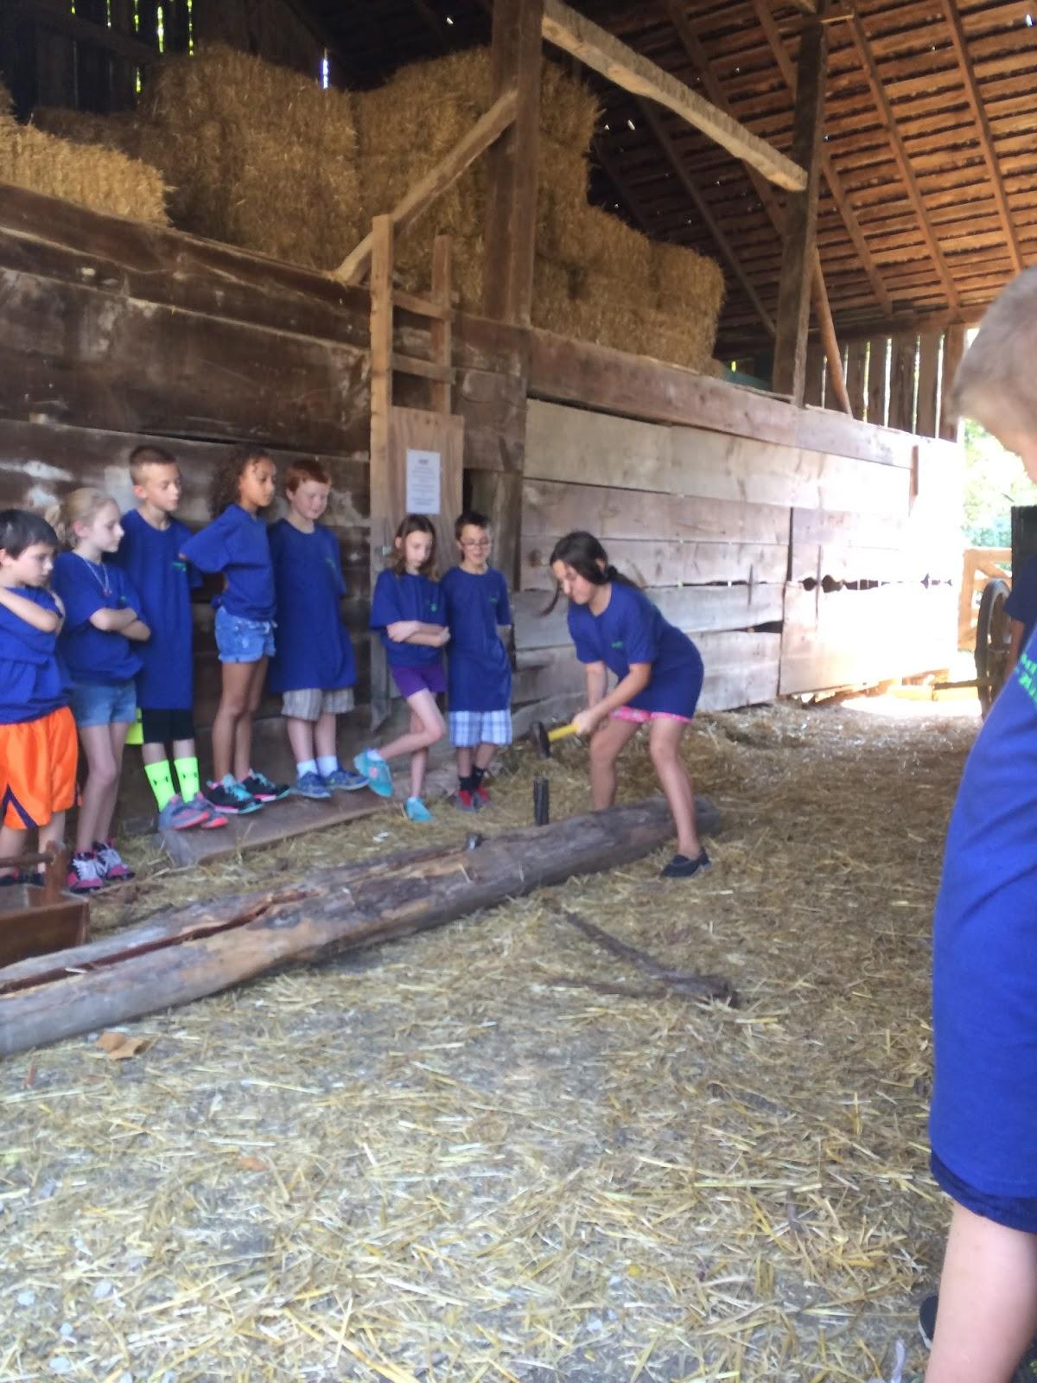
Cutting wood
Then we cut up wood with a wedge and a hammer and we hit it 5 times and we learned that someone cut up 400 a day and got 25 cents and that person was are president Abraham Lincoln.

Slide 9
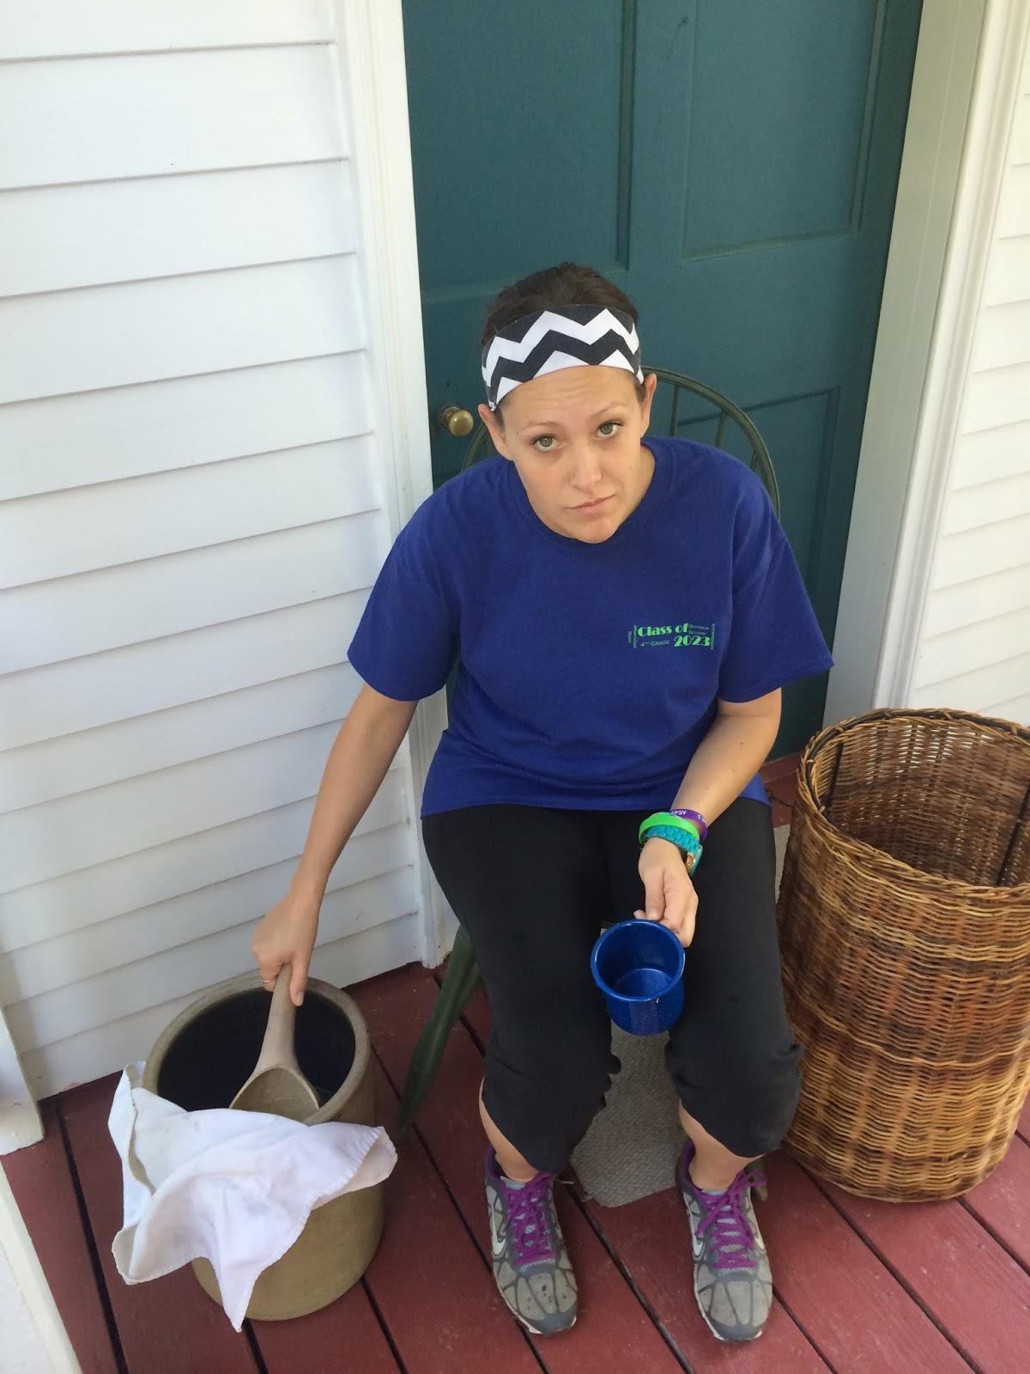
Lunch
Next it was time for lunch and we had to get a cup of soup and get another cup for lemonade and when I tried the lemonade it was awful it didn't even have sugar and it was warm and the soup I didn't like it. Then we had roasted apples with cinnamon and honey. I don't know how it was because I didn't get it. Finally we got a ginger cookie and I loved it it was really good.

Slide 10
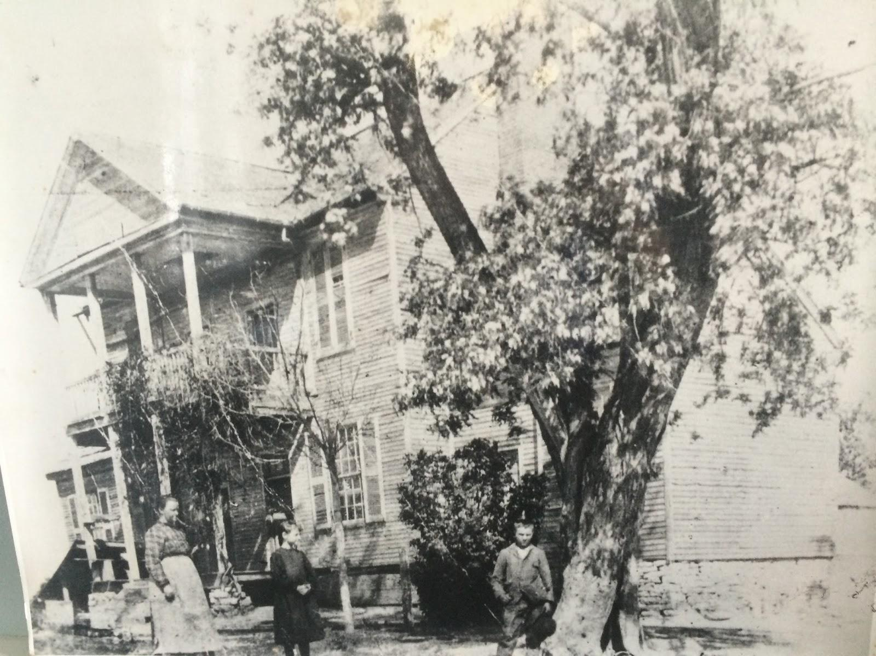
Frederick Bates History
Then we went back inside and learned that Frederick Bate was 42 when he got married and his wife Nancy was 17 years old and they had a lot of kids and we learned how Frederick Bates died he was going to work and he crossed the Missouri River and fell in and swallowed some of the water and got really sick and died when he was 48.

Slide 11
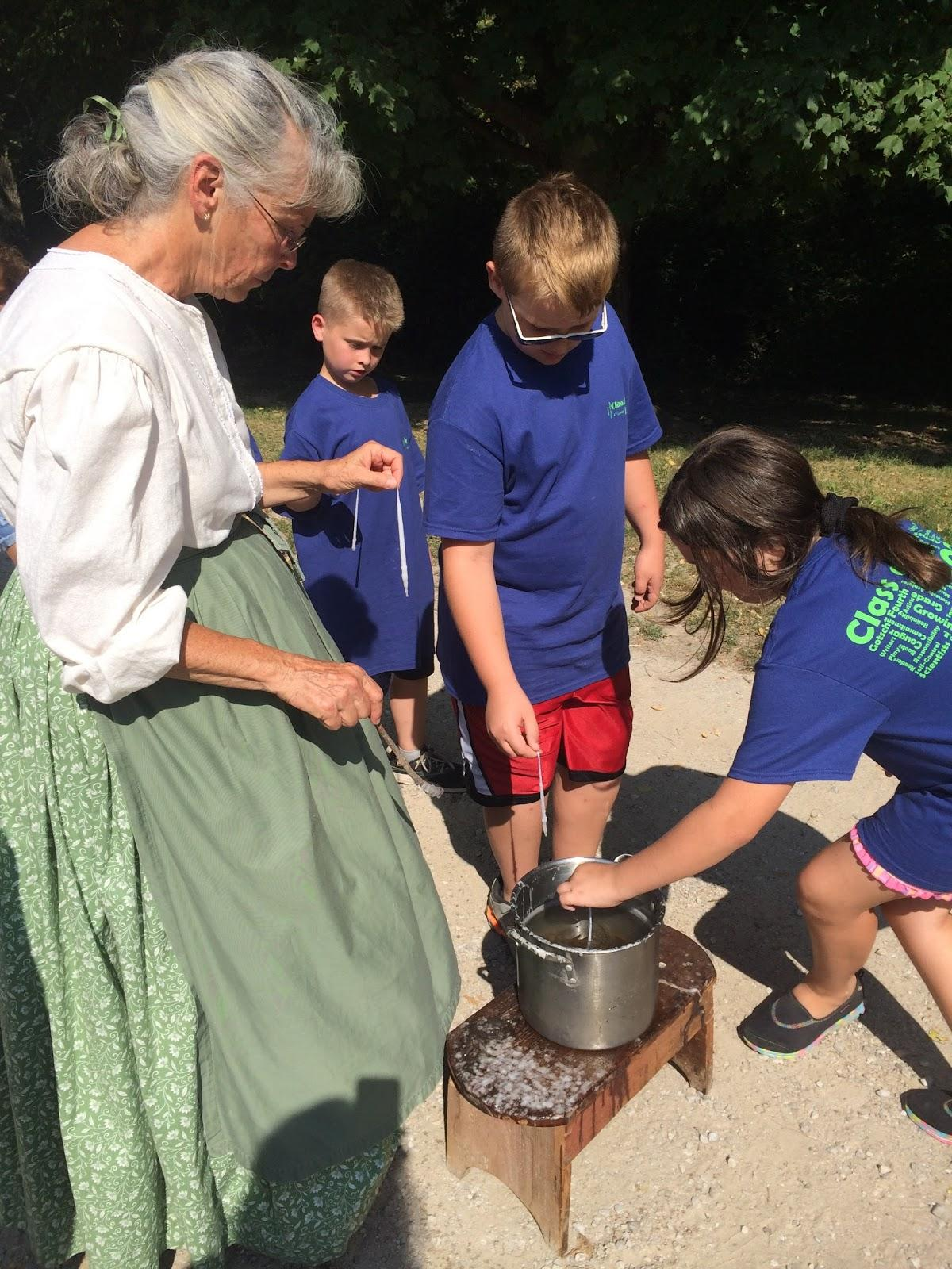
Candles
We made candles with string, water and hot wax and we went back and forth and finally we were done making candles.

Slide 12
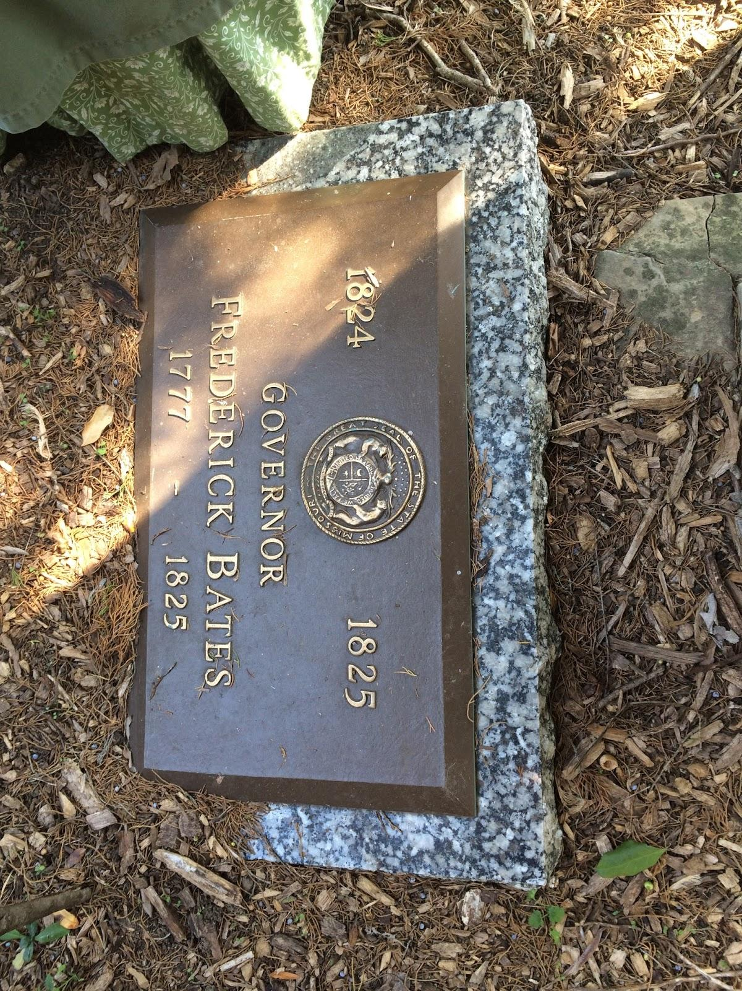
Grave
Mrs. Mika let us go to Frederick Bates Family grave and it was my first time in a grave. It was cool to look at and I feel bad because they had a longer life to live and now they can't because they past away!

Slide 13
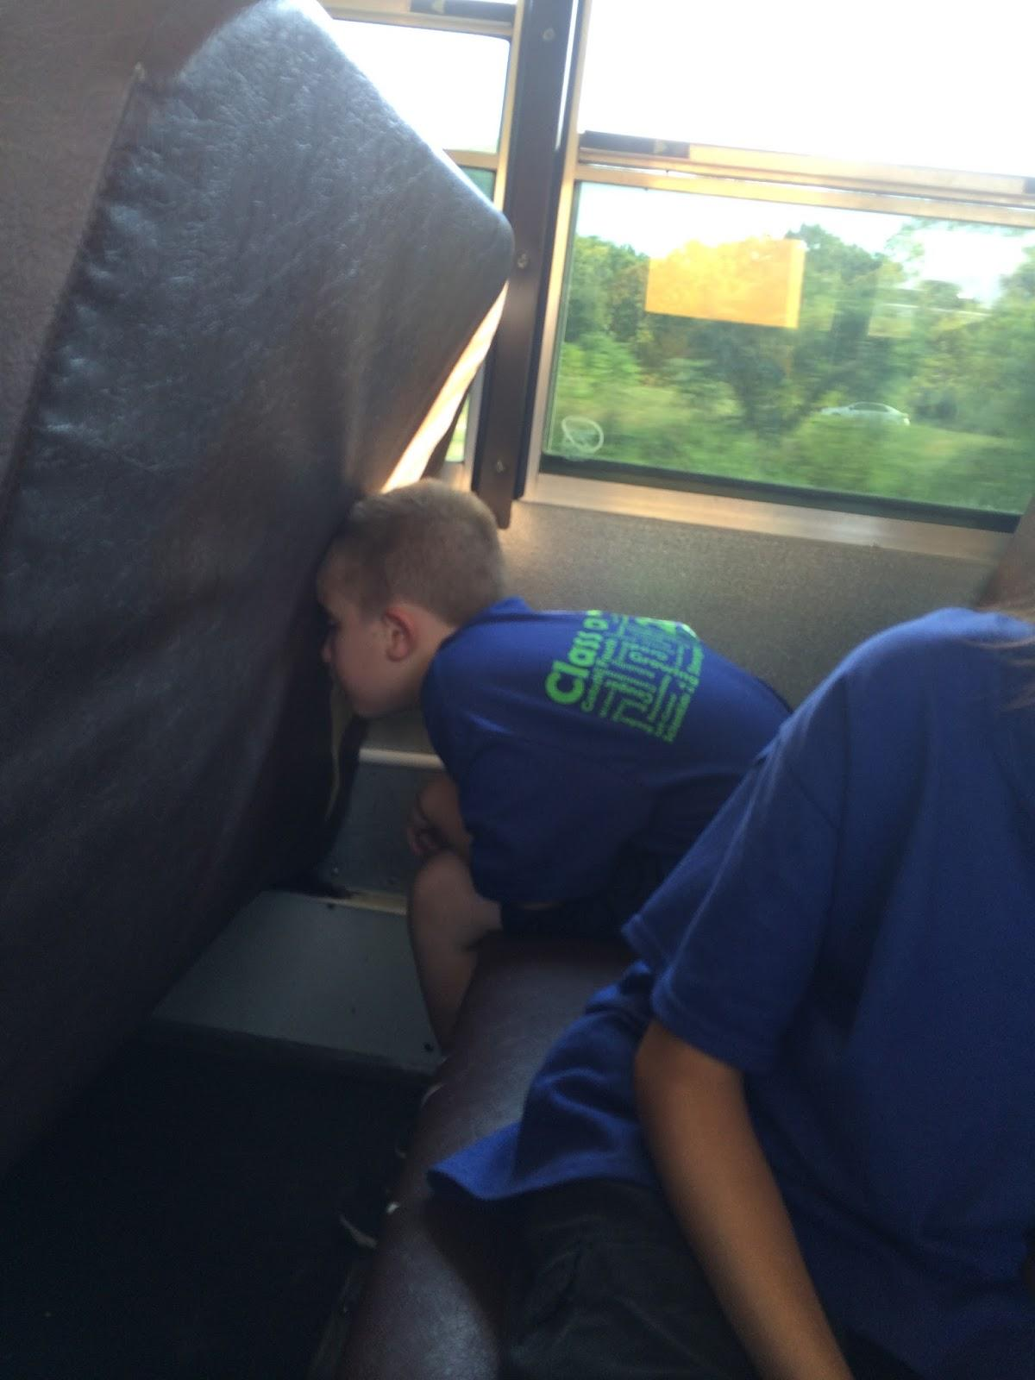
Going back to School
I loved are Field Trip it was so much fun! Frederick Bates house was so unbelievable! It was pretty and amazing! I was disappointed when we had to go to school! I wanted to stay there all day! I had a fun day in the 1800s!

