Slide 1
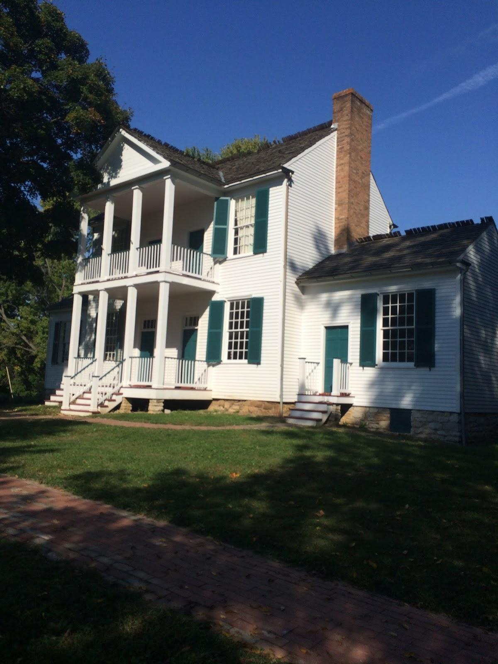
Faust Park
By Olivia M. Basso

Slide 2
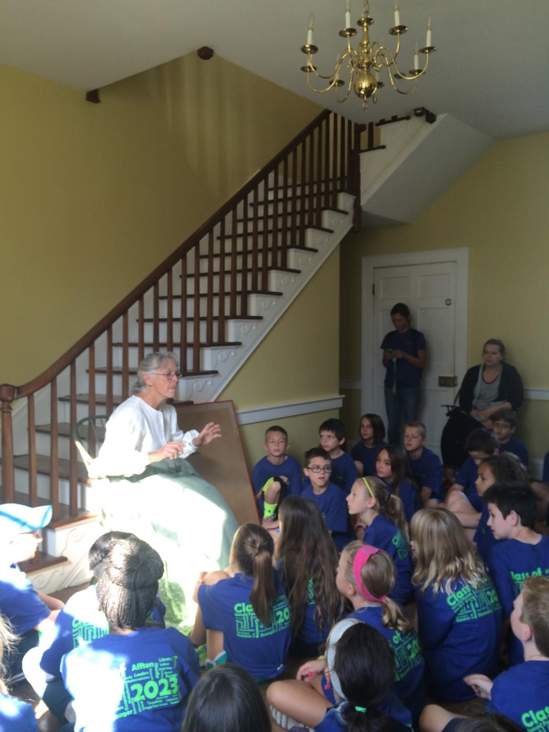
Who Lived There?
Frederick Bates Mansion, the place where Frederick Bates lived until he died. He was our governor for nine months. That is a pretty short time to be governor!

Slide 3
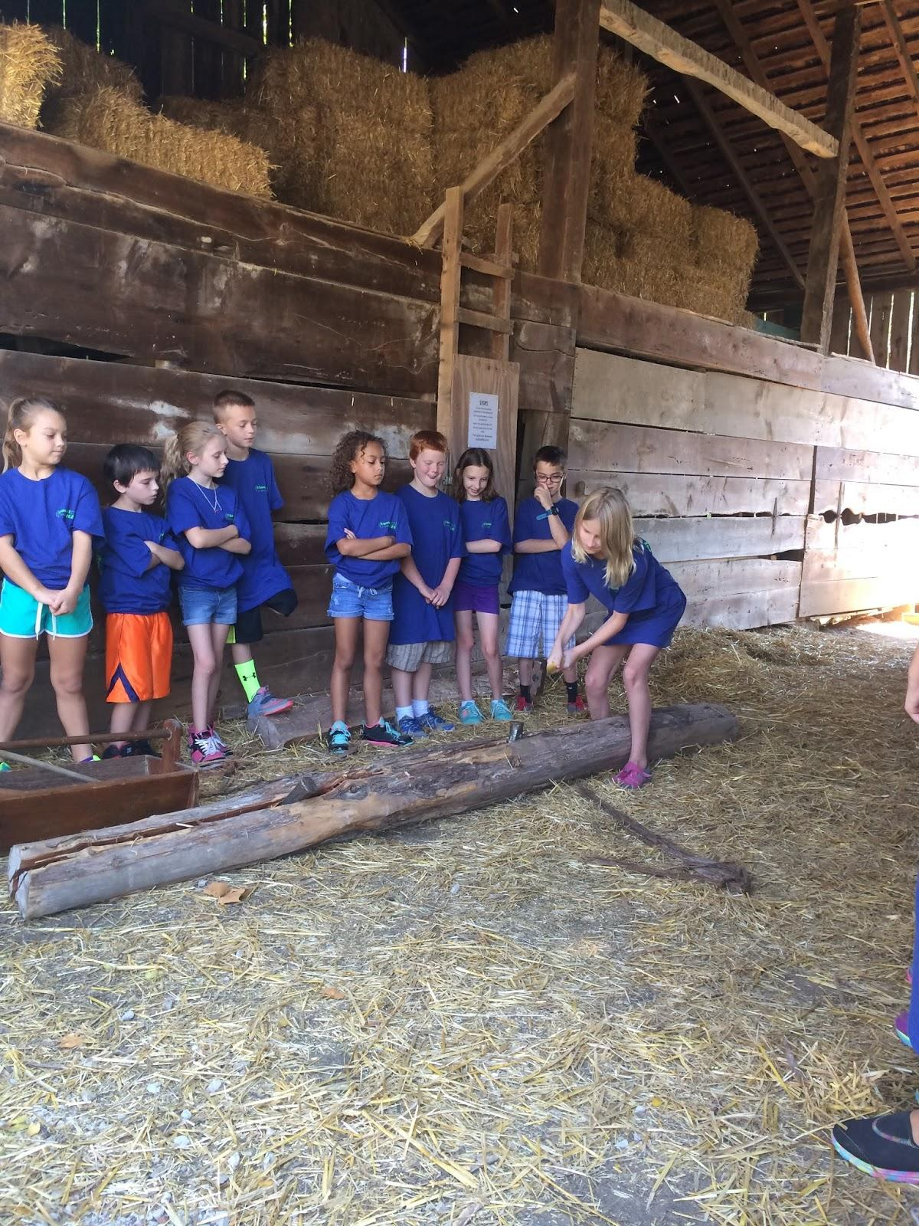
Log Splitting
When we were done with learning about who lived there we did some log splitting. We each did 5 hits and there were 25 of us so in all we did 125 hits.

Slide 4
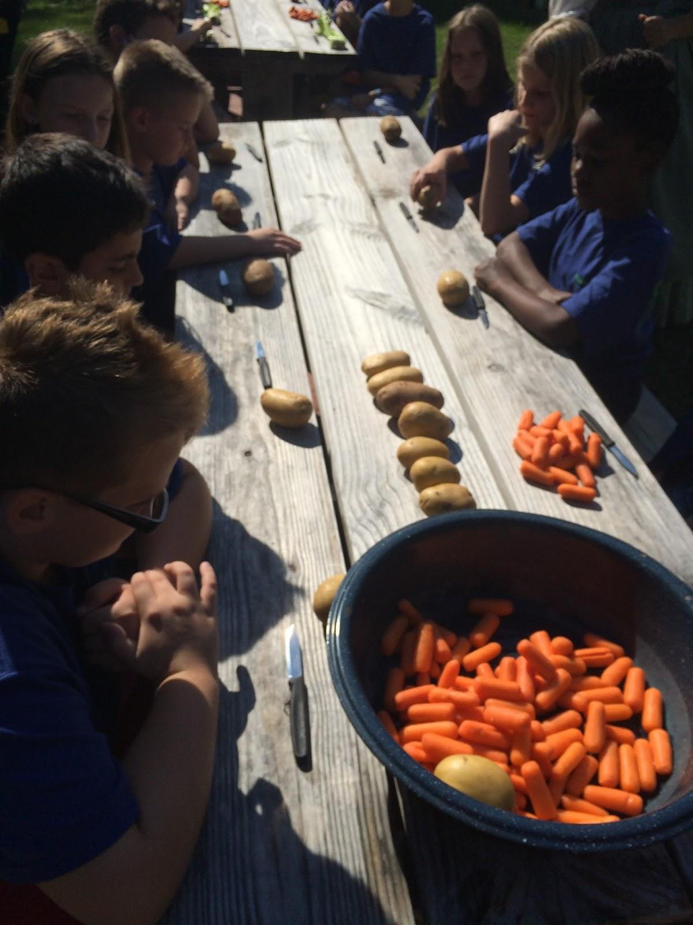
Making Lunch
Making lunch was fun, we got to chop potatoes, carrots and onions,but there was only one onion. We also chopped apples,but those were for desert. I didn’t like lunch, but desert was delicious.

Slide 5
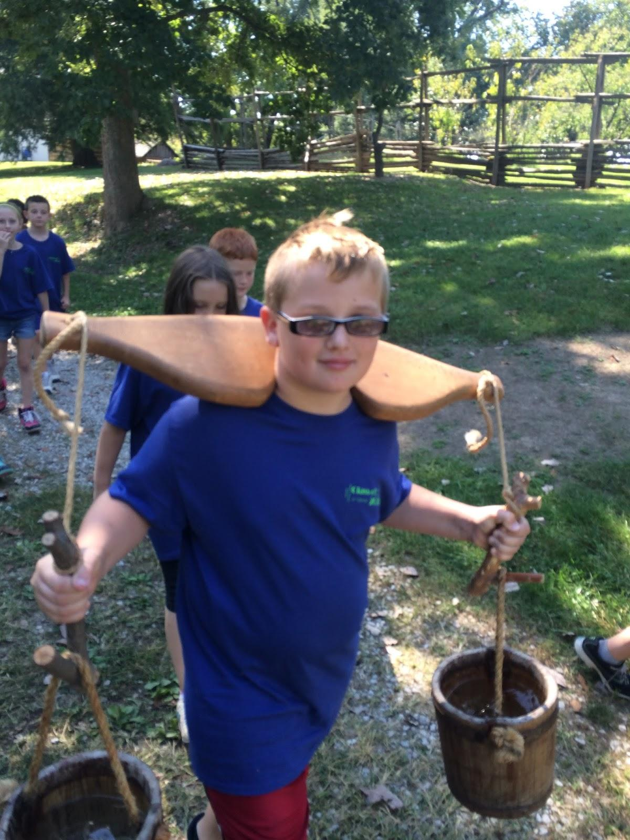
Chores
After lunch we did our final chores. My final chore was taking the lemonade cups inside. To clean our dishes, we got a large spoonful of water and mixed it around the soup cup, and then we had to splash it out of the cup.

Slide 6
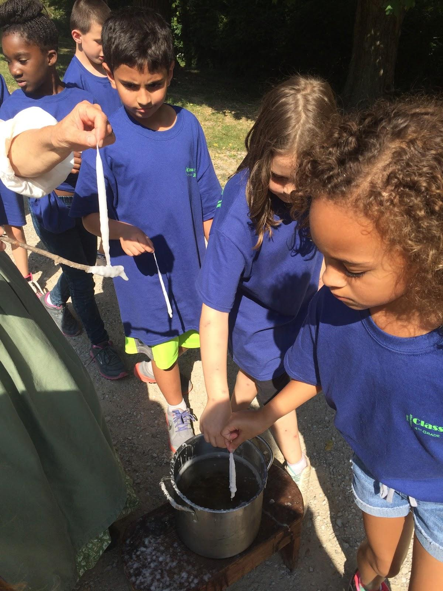
Candle Making
The last thing we did was make candles.We had to dip a piece of string in water 10 times and in wax 10 times.

