Slide 1
Faust Park
By Makynzi Rhoads

Slide 2
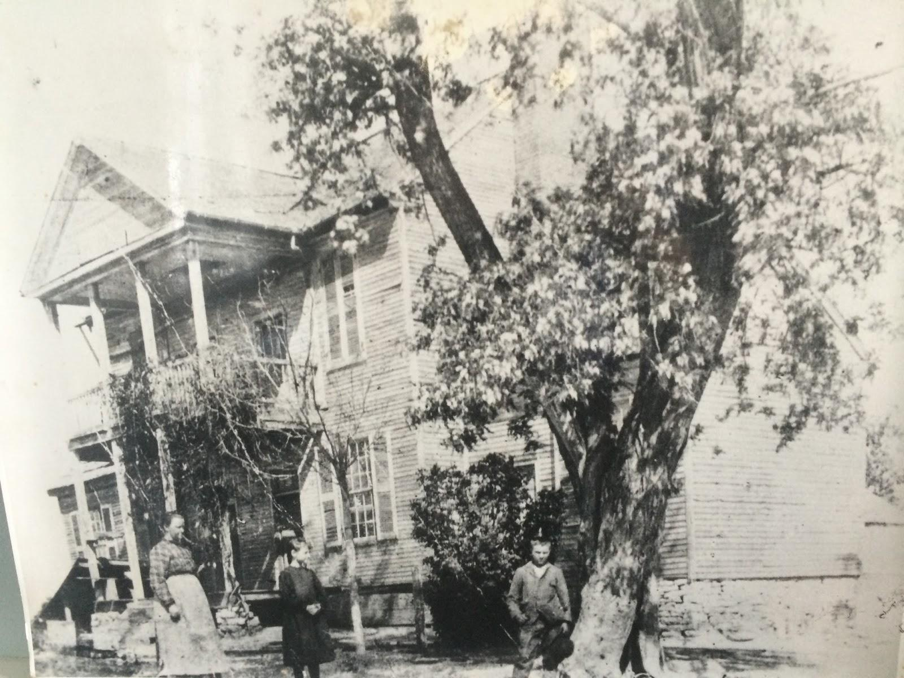
Who lived here
Frederick Bates and Nancy Bates lived in Faust Park Mansion.Frederick Bates had four children.

Slide 3
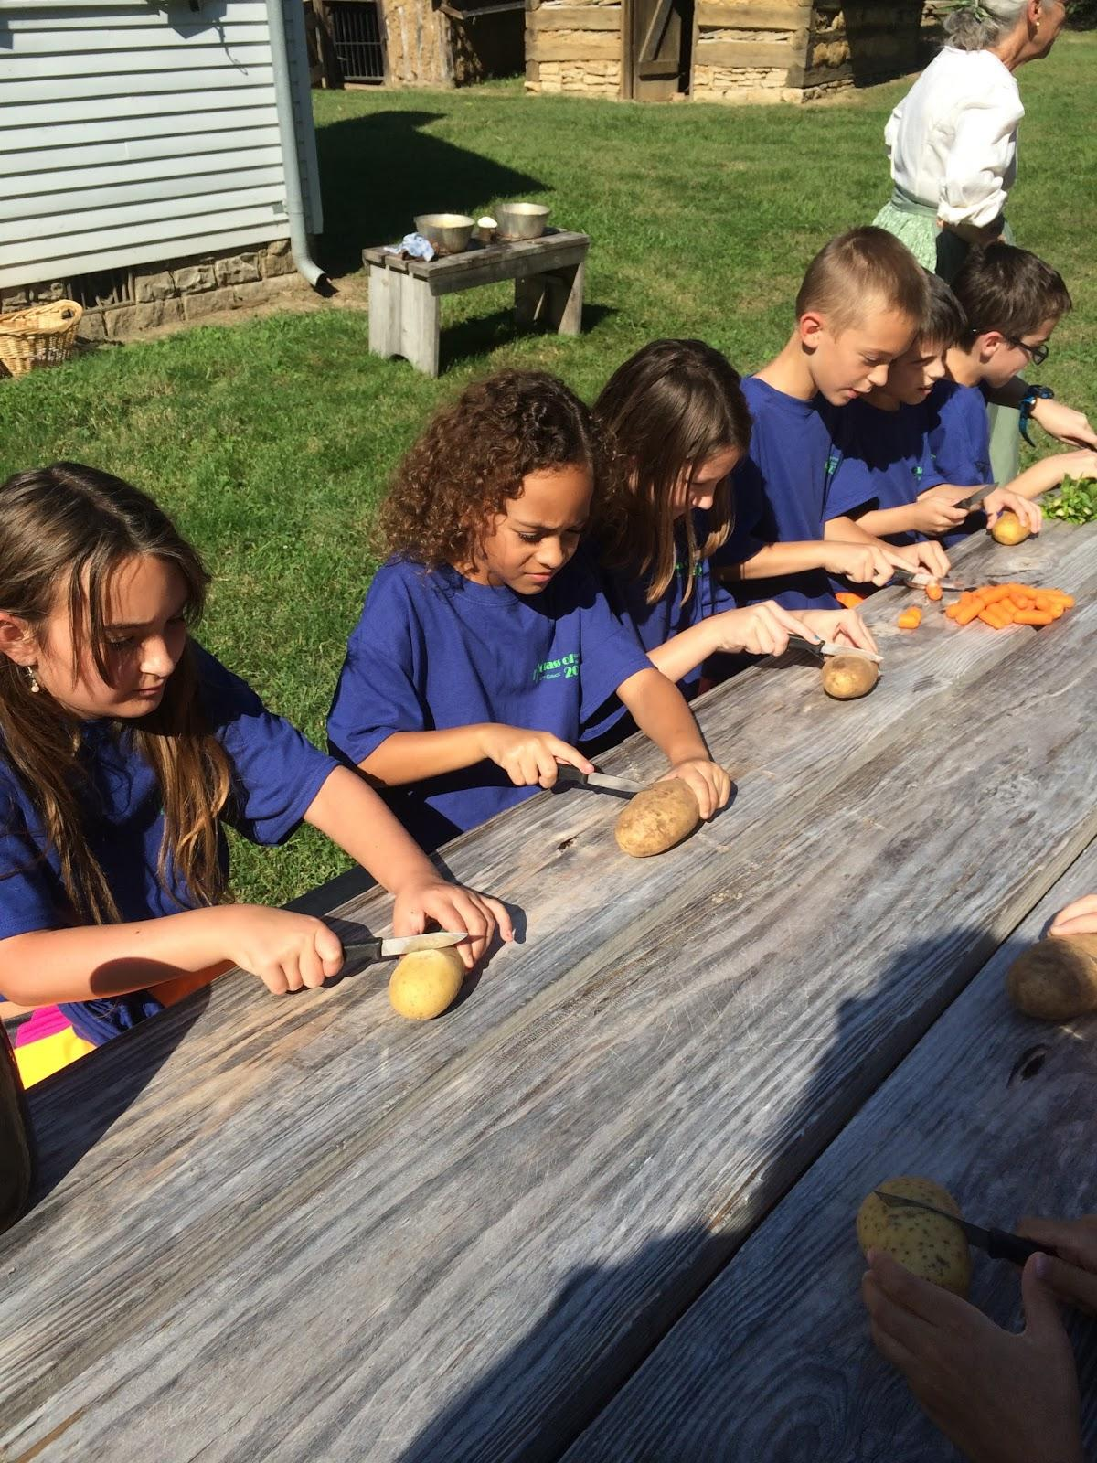
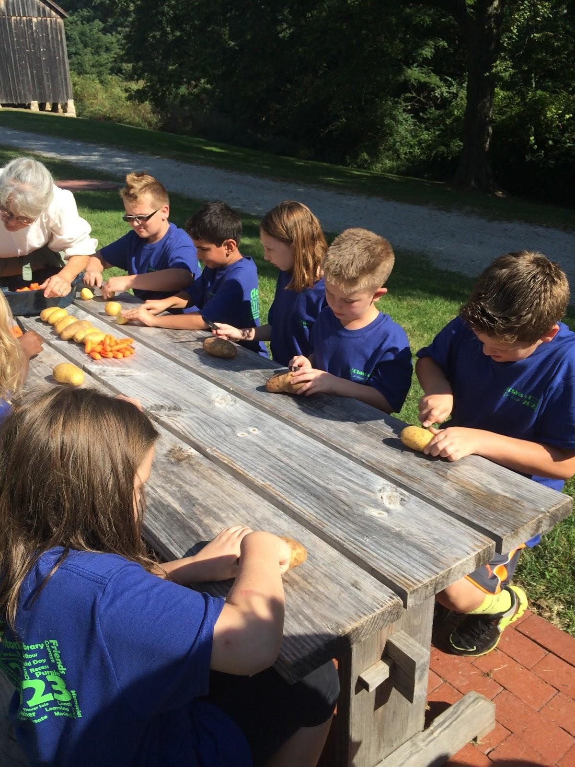
Making lunch
We cut up food for our lunch yum! Also cut up apples for dessert yummy! Although the food looked not so bad, but tasted good.

Slide 4
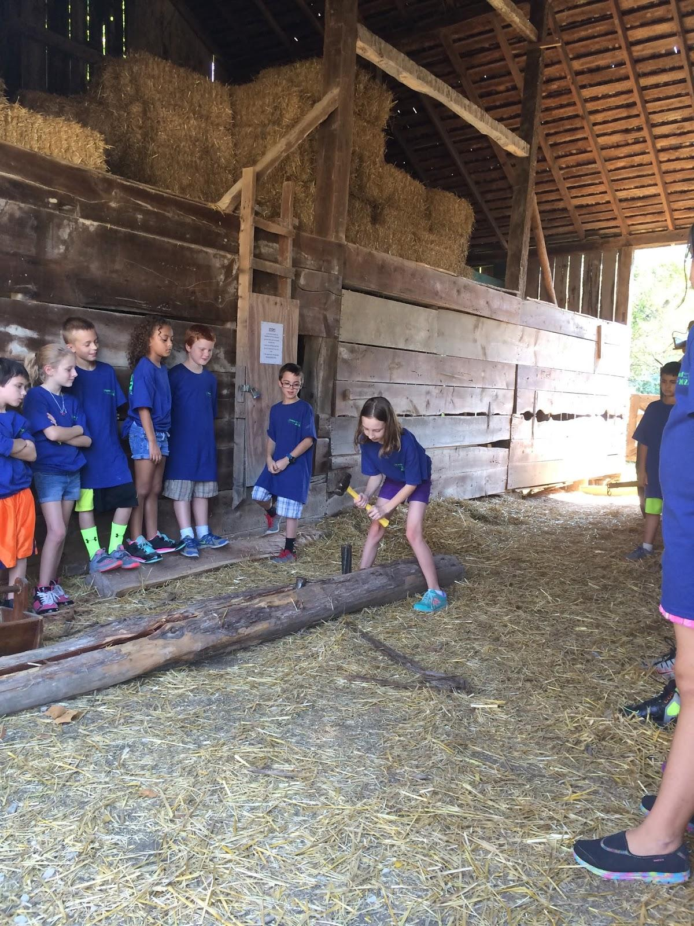
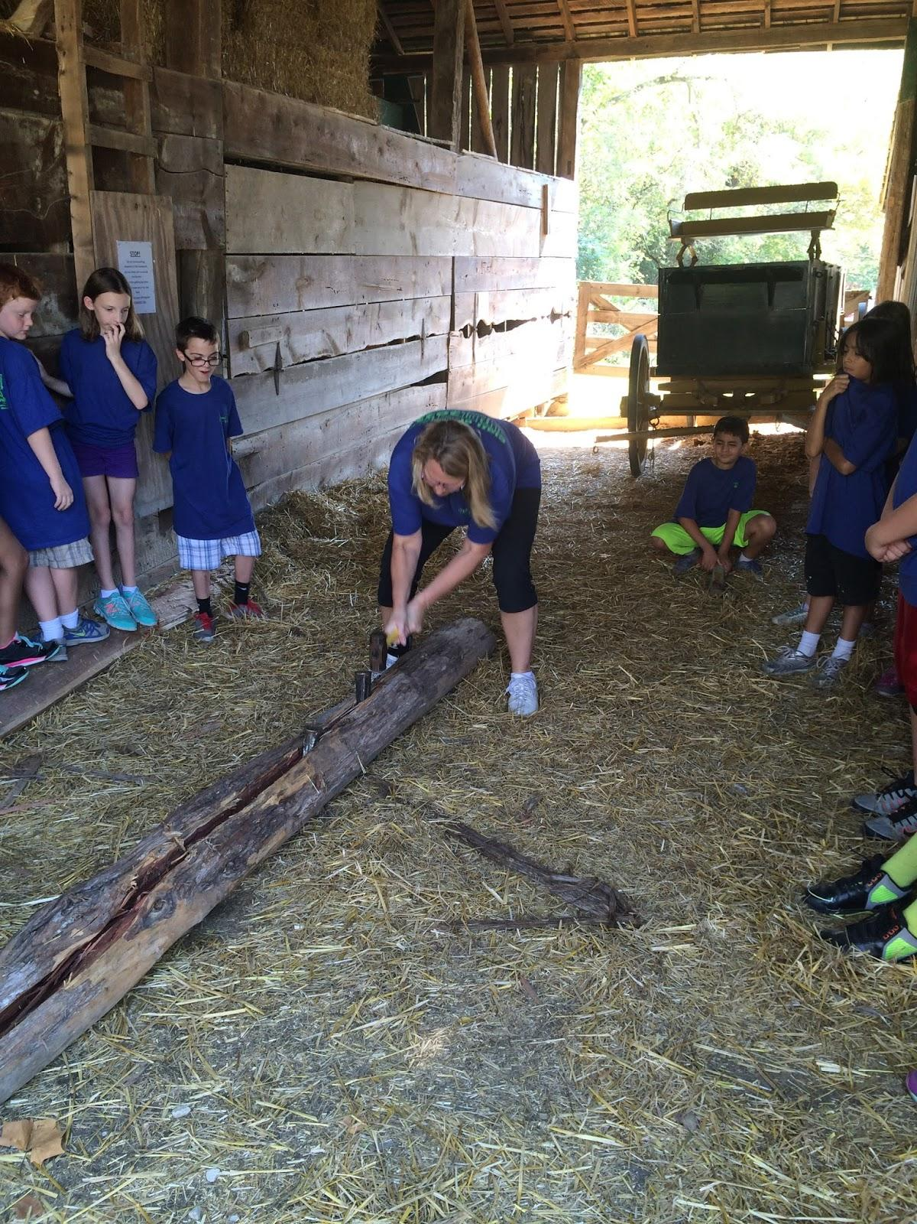
Splitting the log
One of my favorite activities was when we tried splitting a log in half. Unfortunately we could not split the log but we tried.

Slide 5
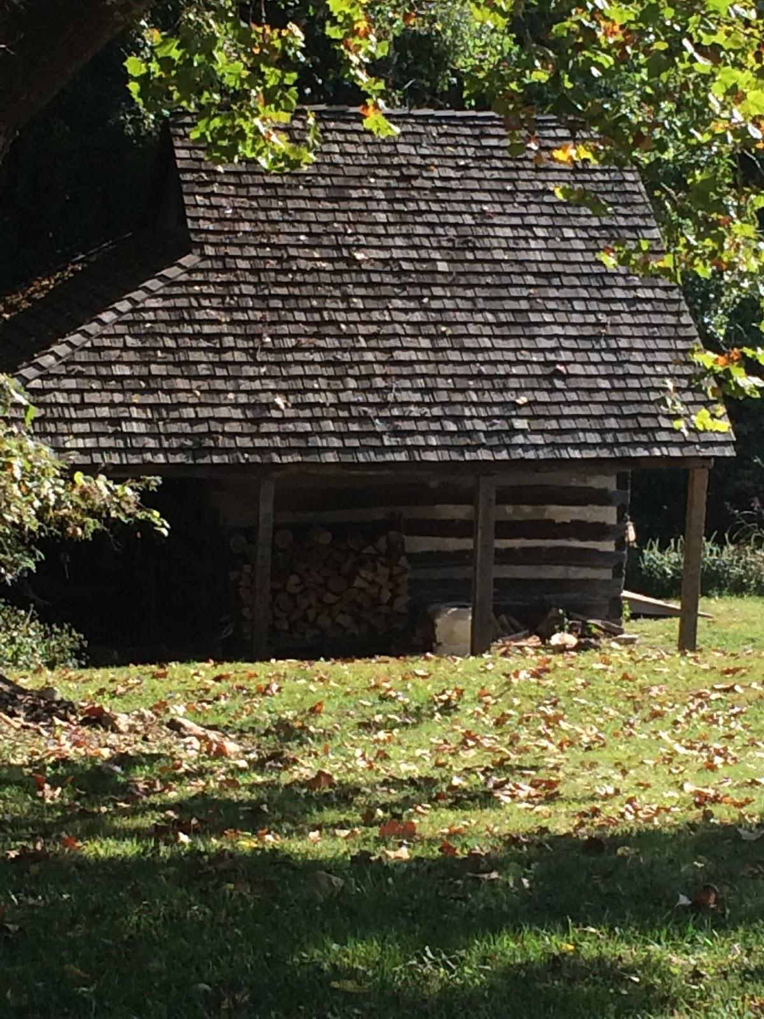
The end
IT WAS AWESOME!!!!! I love to learn about history. History is amazing.

