Slide 1
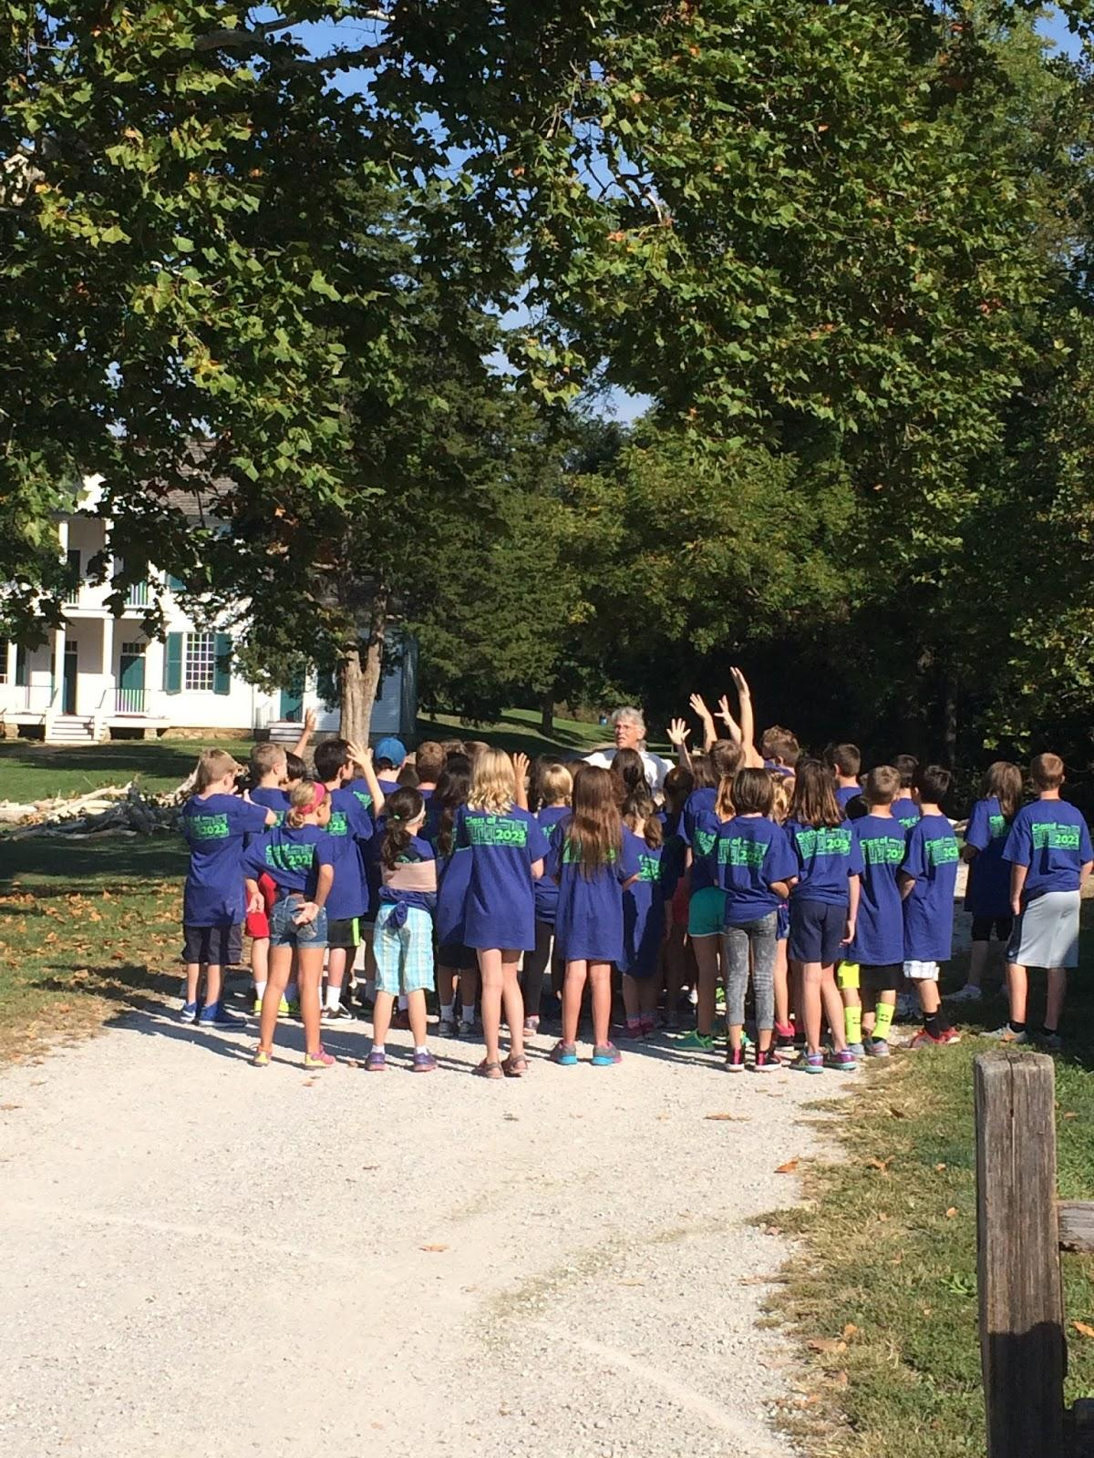
Faust Park Field Trip
By Jazmyne Fernandez

Slide 2
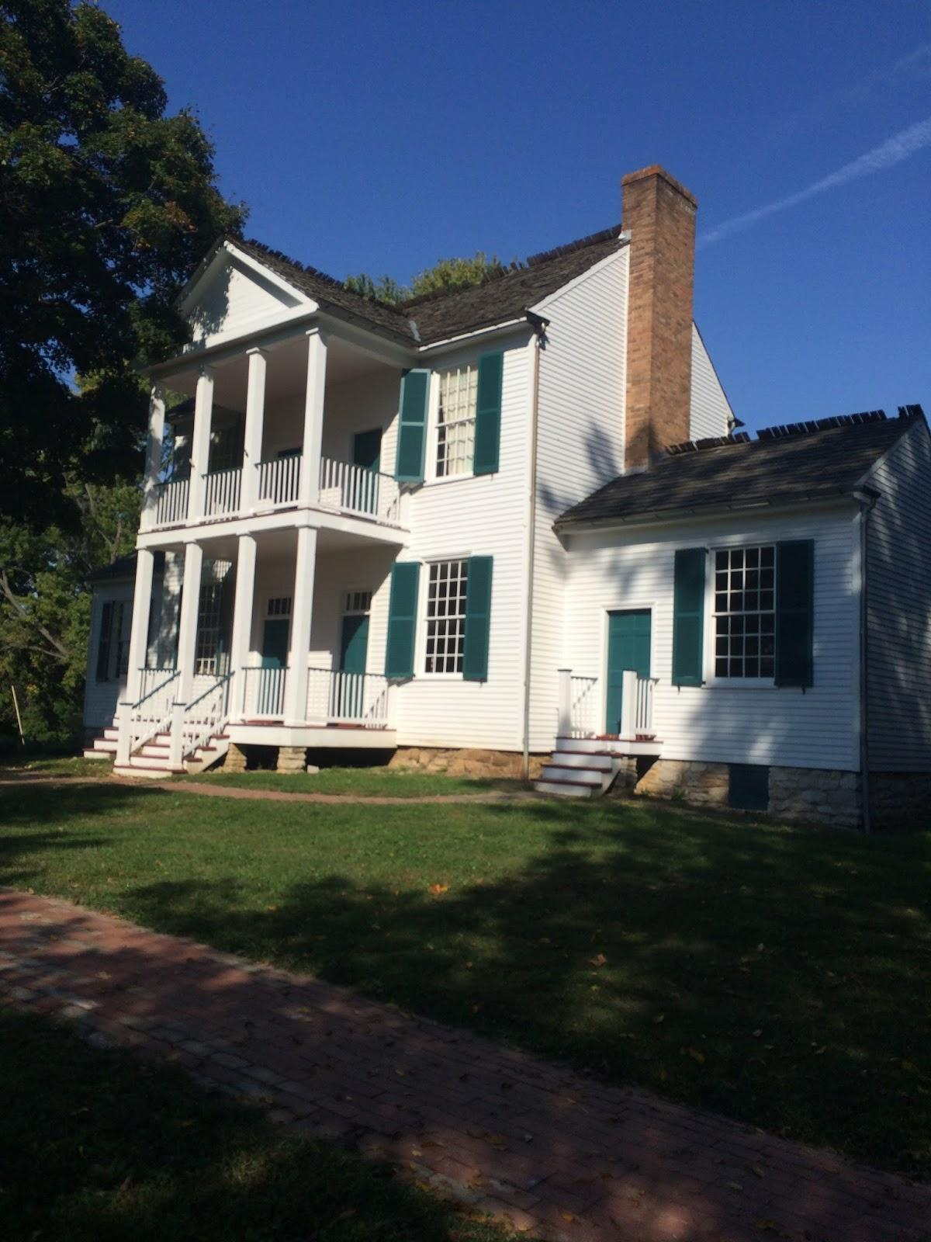
The Beginning
My Faust Park Field trip was awesome! It all started on the bus. The loud bumby squeaky bus. As soon as we got on the bus everybody I mean everybody immediately talked. I played a small game on the way. We all were having fun!!

Slide 3
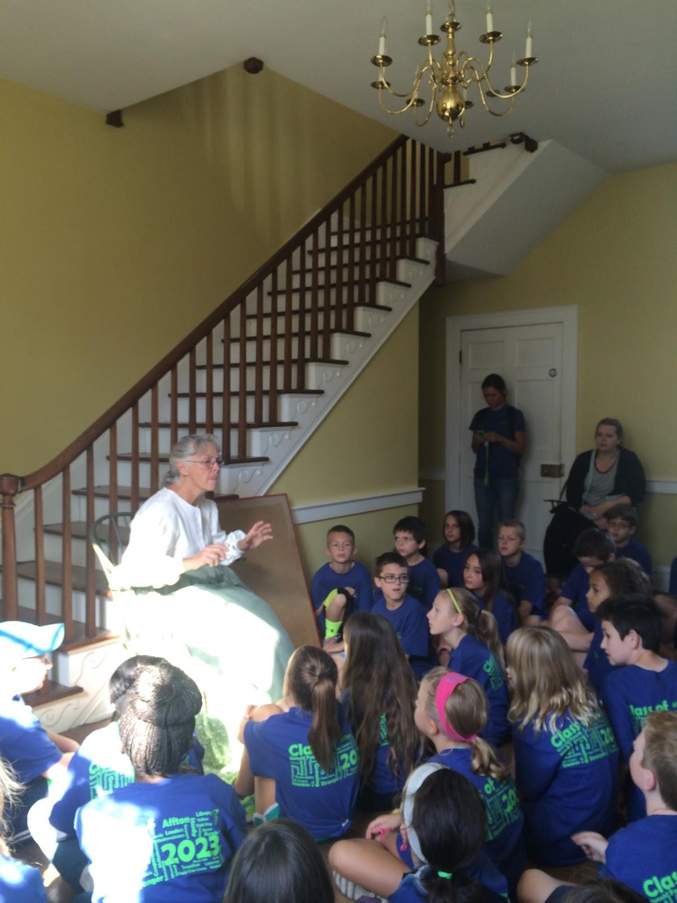
The Big Mansion
Then we went into the mansion. We talked about the Louisiana purchase and how tribes fought for land. Governor Bates was sent to ask some questions. "Who has a fence? Who has a barn? Who has a farm? Who has a house?" There was only one person who had time to build all those things. You get the land!

Slide 4
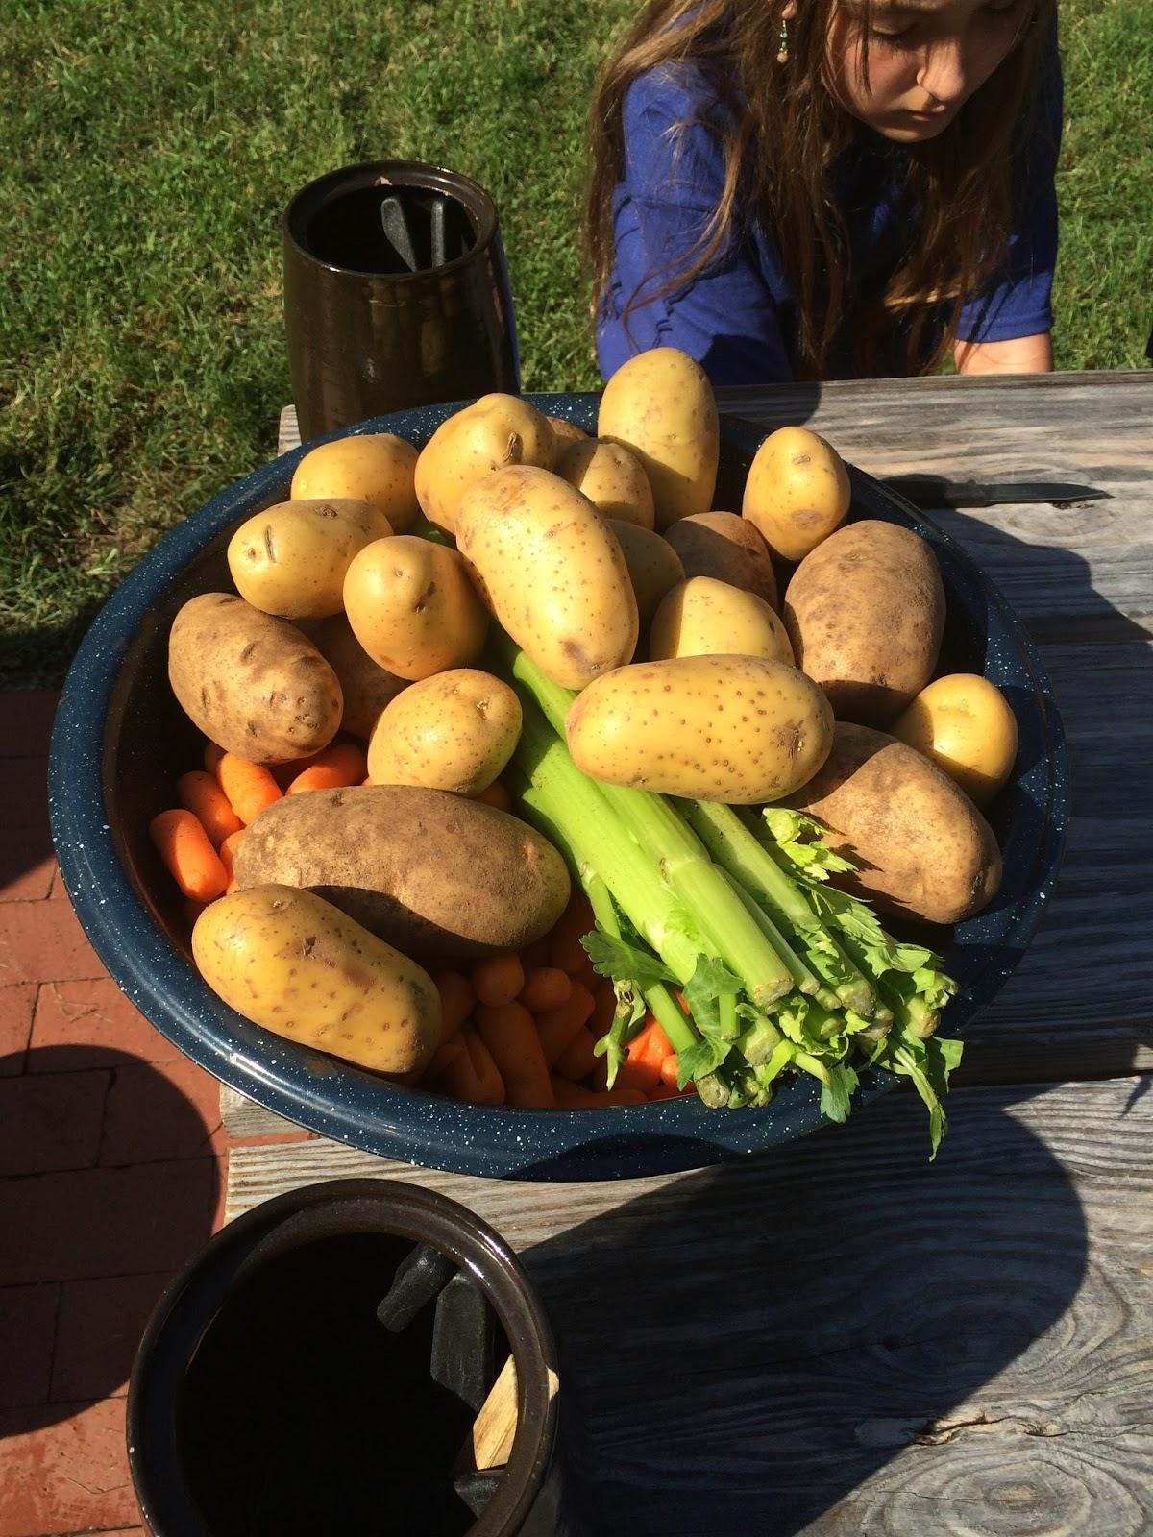
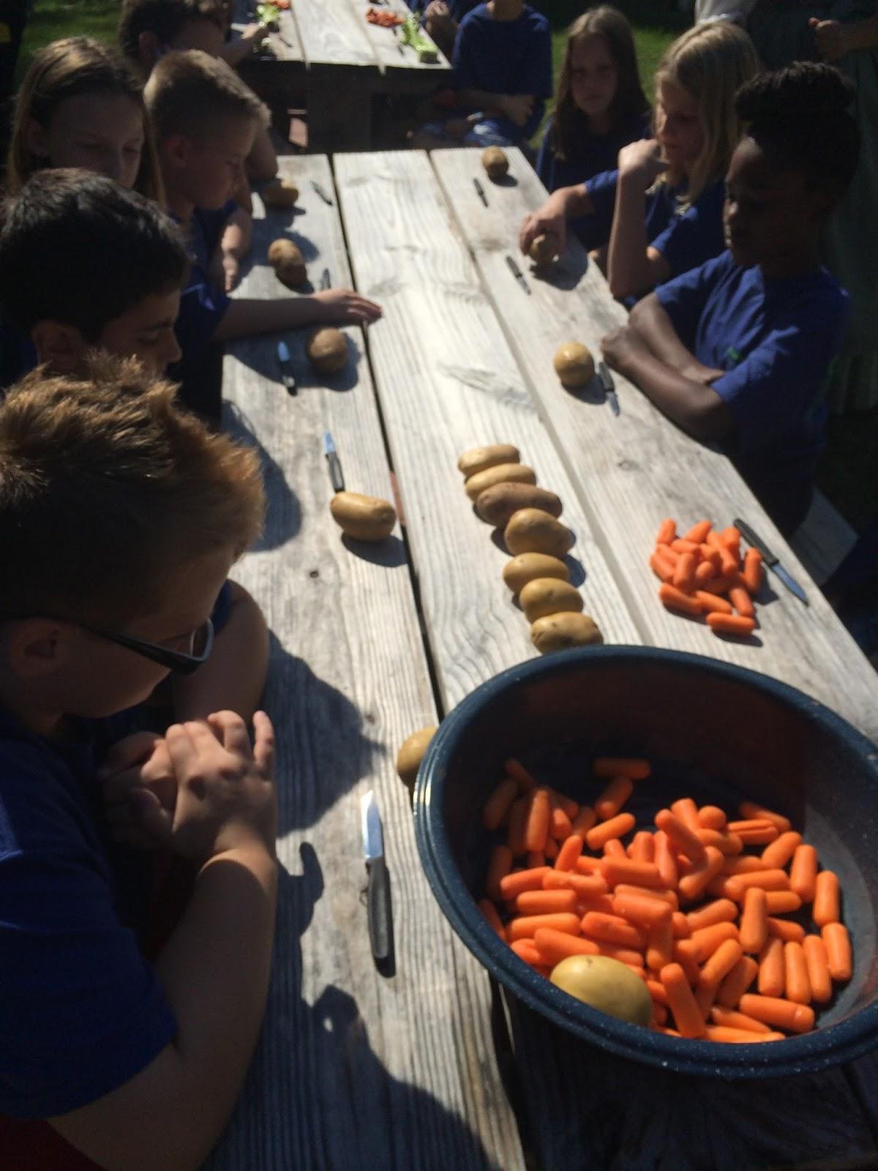
Making Lunch
We also made lunch. We cut potatoes, onions, carrots, and celery. There was a way for each vegetable to be cut. I cut potatoes!! But we didn't cut off the skin. the skin carries a lot of nutrients. they needed that. We also cut up apples for dessert.

Slide 5
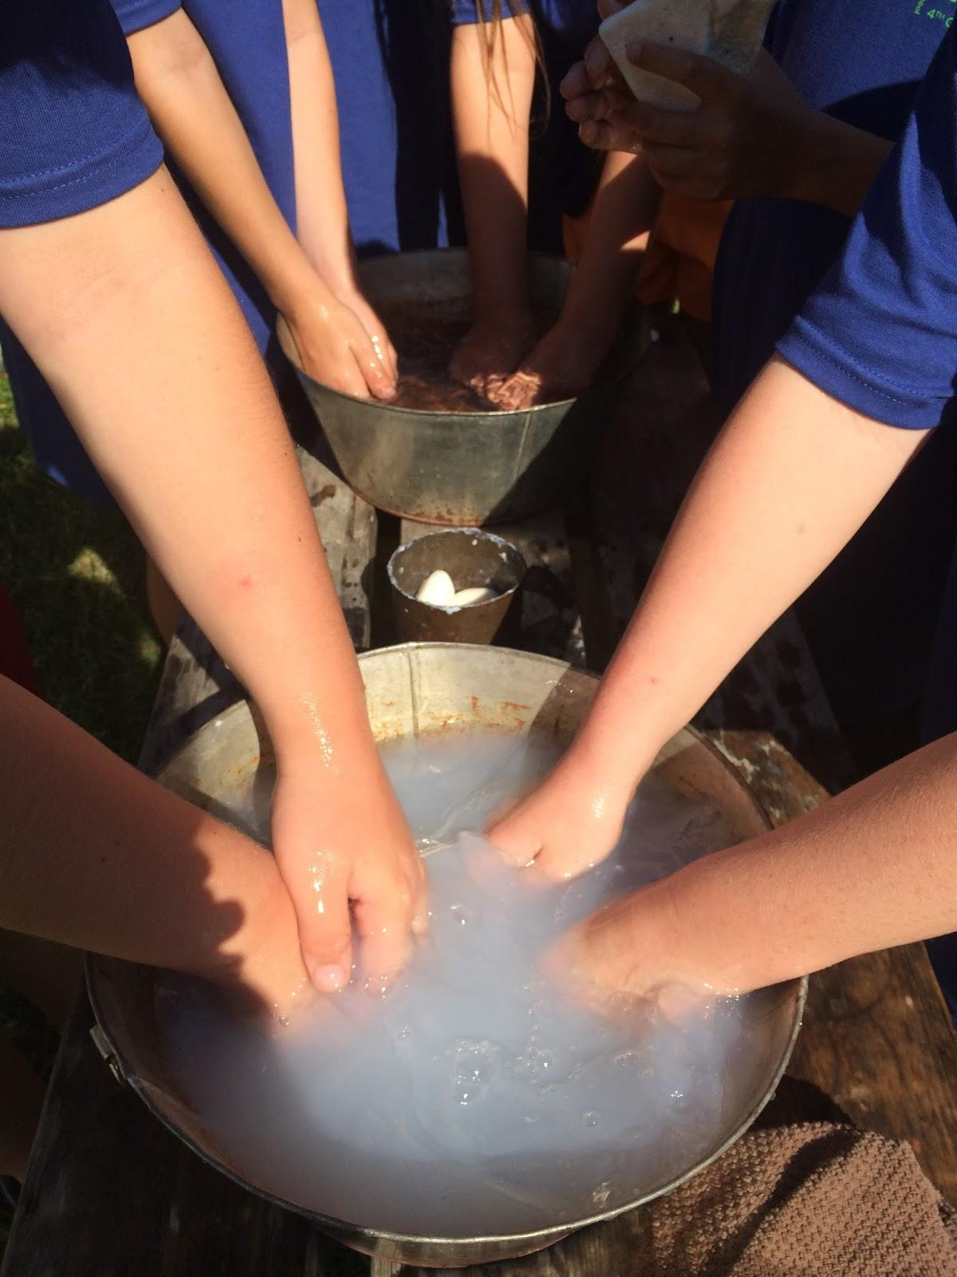
Washing our Hands
To keep clean we have to wash our hands. the soap isn't like ours. The soap is made out of lye and lard. If the lye is not completely done you will get big blisters.

Slide 6
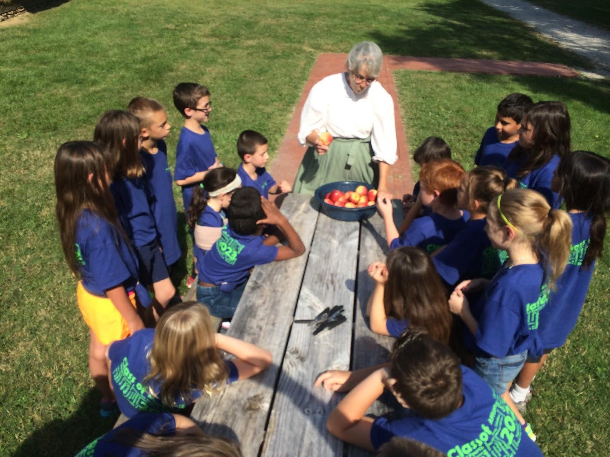
My Delicious Meal
I was not looking forward to lunch. Although I loved it. All I had to do was add some salt and it was the best lunch I have ever made. The apples were delicious they were covered in honey. Best meal I ever had.

Slide 7
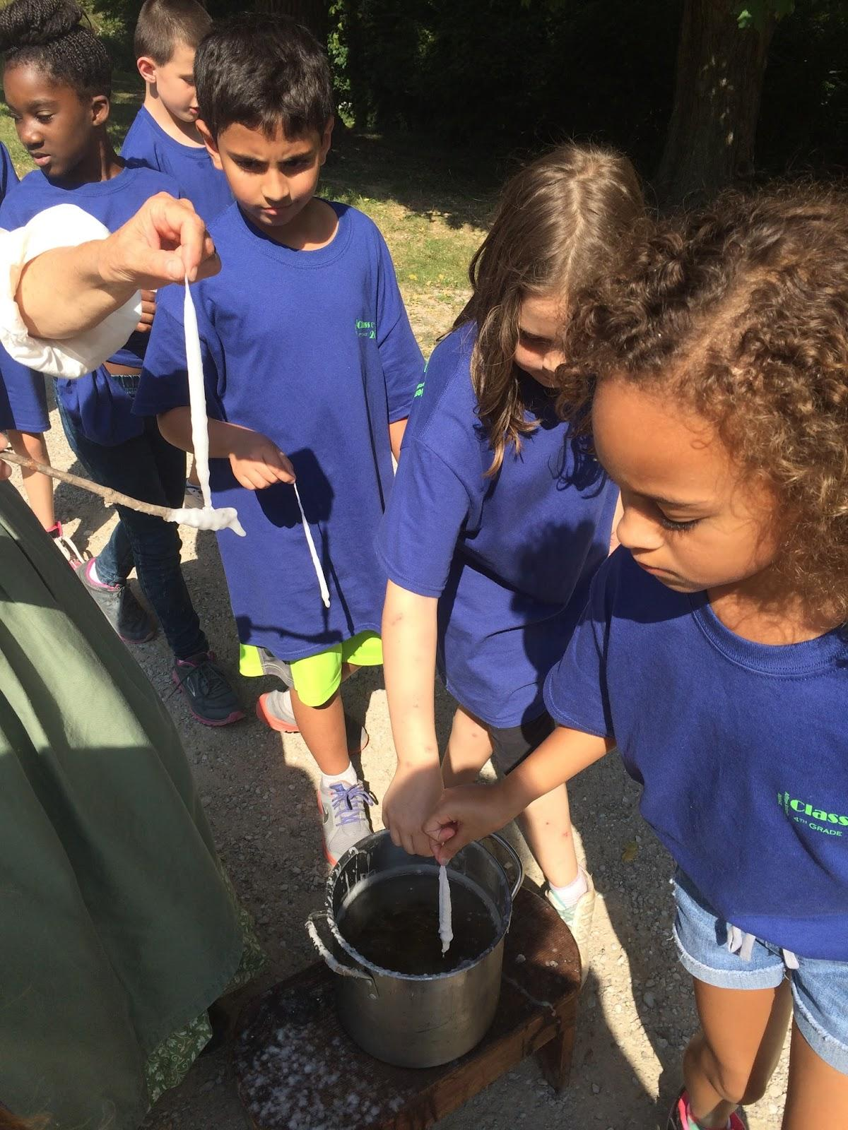
The Best Part
My favorite part was making candles. I was a little nervous with the hot wax. So once I dipped it in I held it far away from me. But it was still fun.

Slide 8
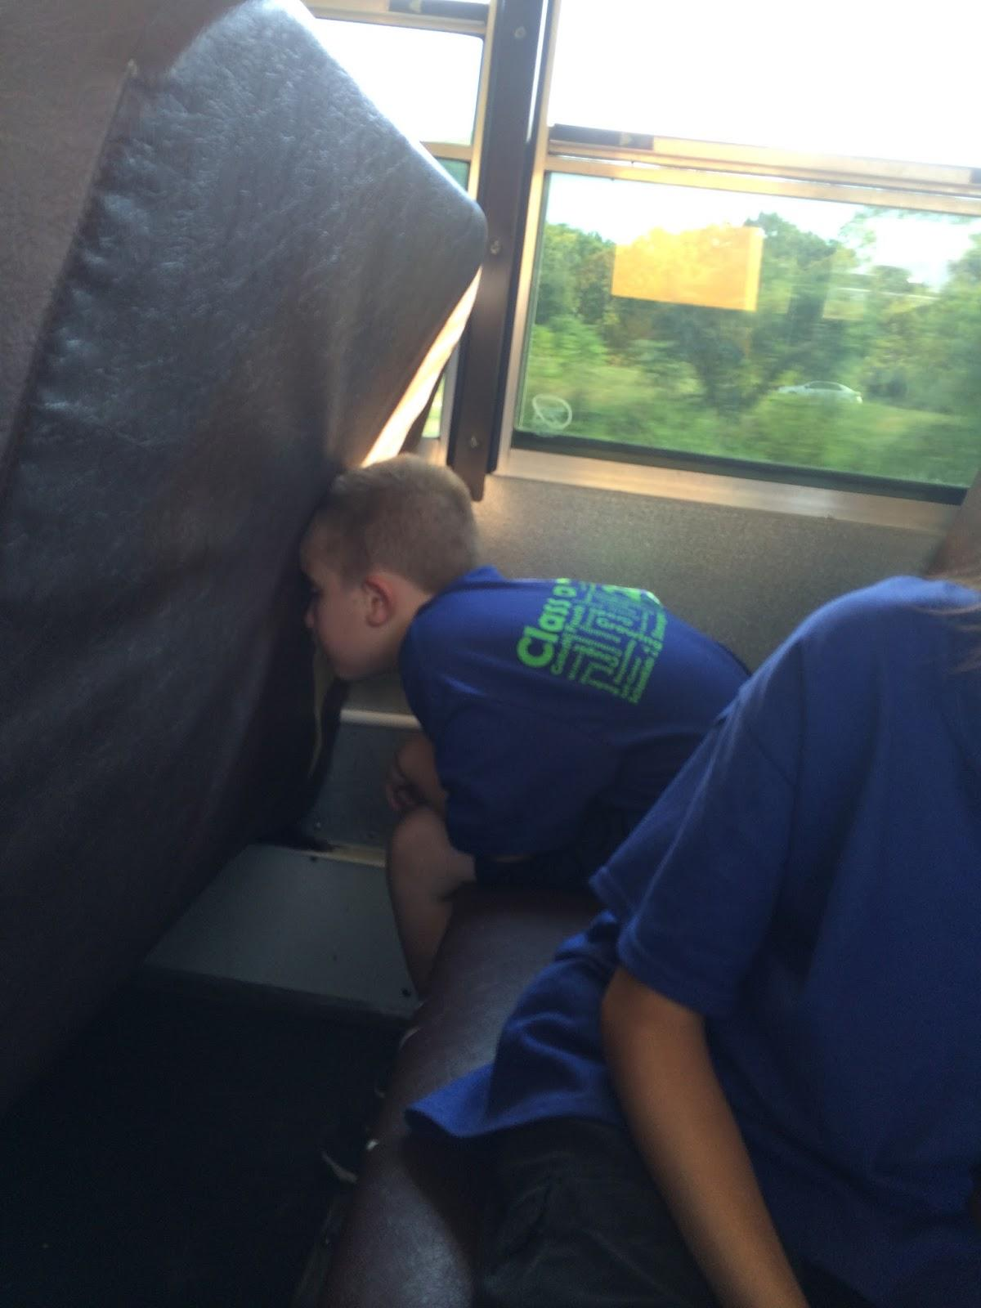
In Conclusion
The bus ride was quiet on the way home. everyone one was quiet and tired. I even saw some people fall asleep! I would not want to live on Governor Frederic Bates farm!!!

