Slide 1
Faust Park!
By Collin Armbruster

Slide 2
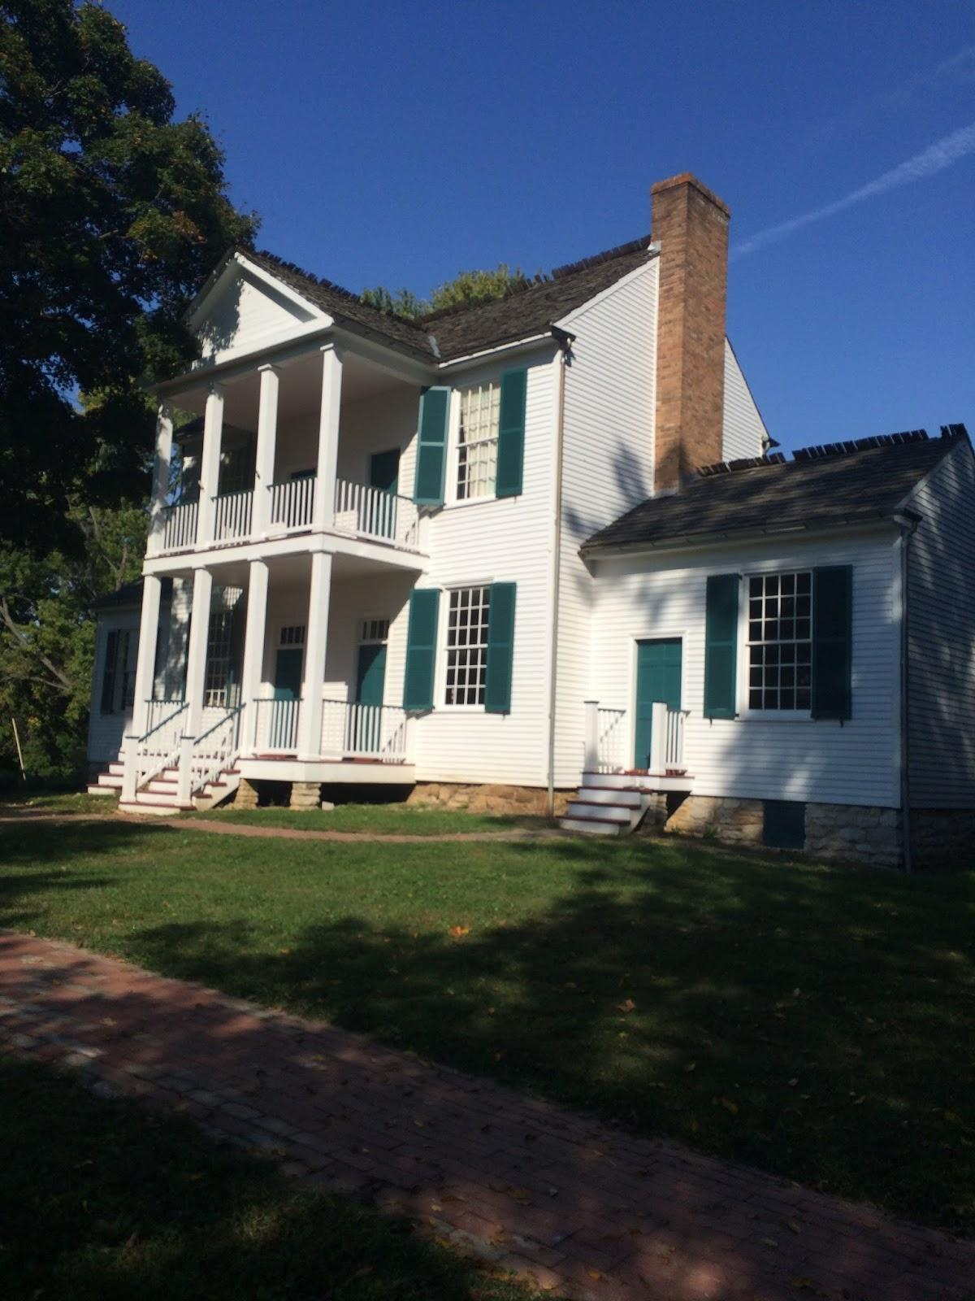
Who Lived Here
Fredrick Bates had 4 kid and wife the kids names where Emily,Lucious Lee,woodvile,Fredrick.jr
And his wife was named Nacey.
And he was governor from 1824-1825
And they lived in ThornHill mansion.

Slide 3
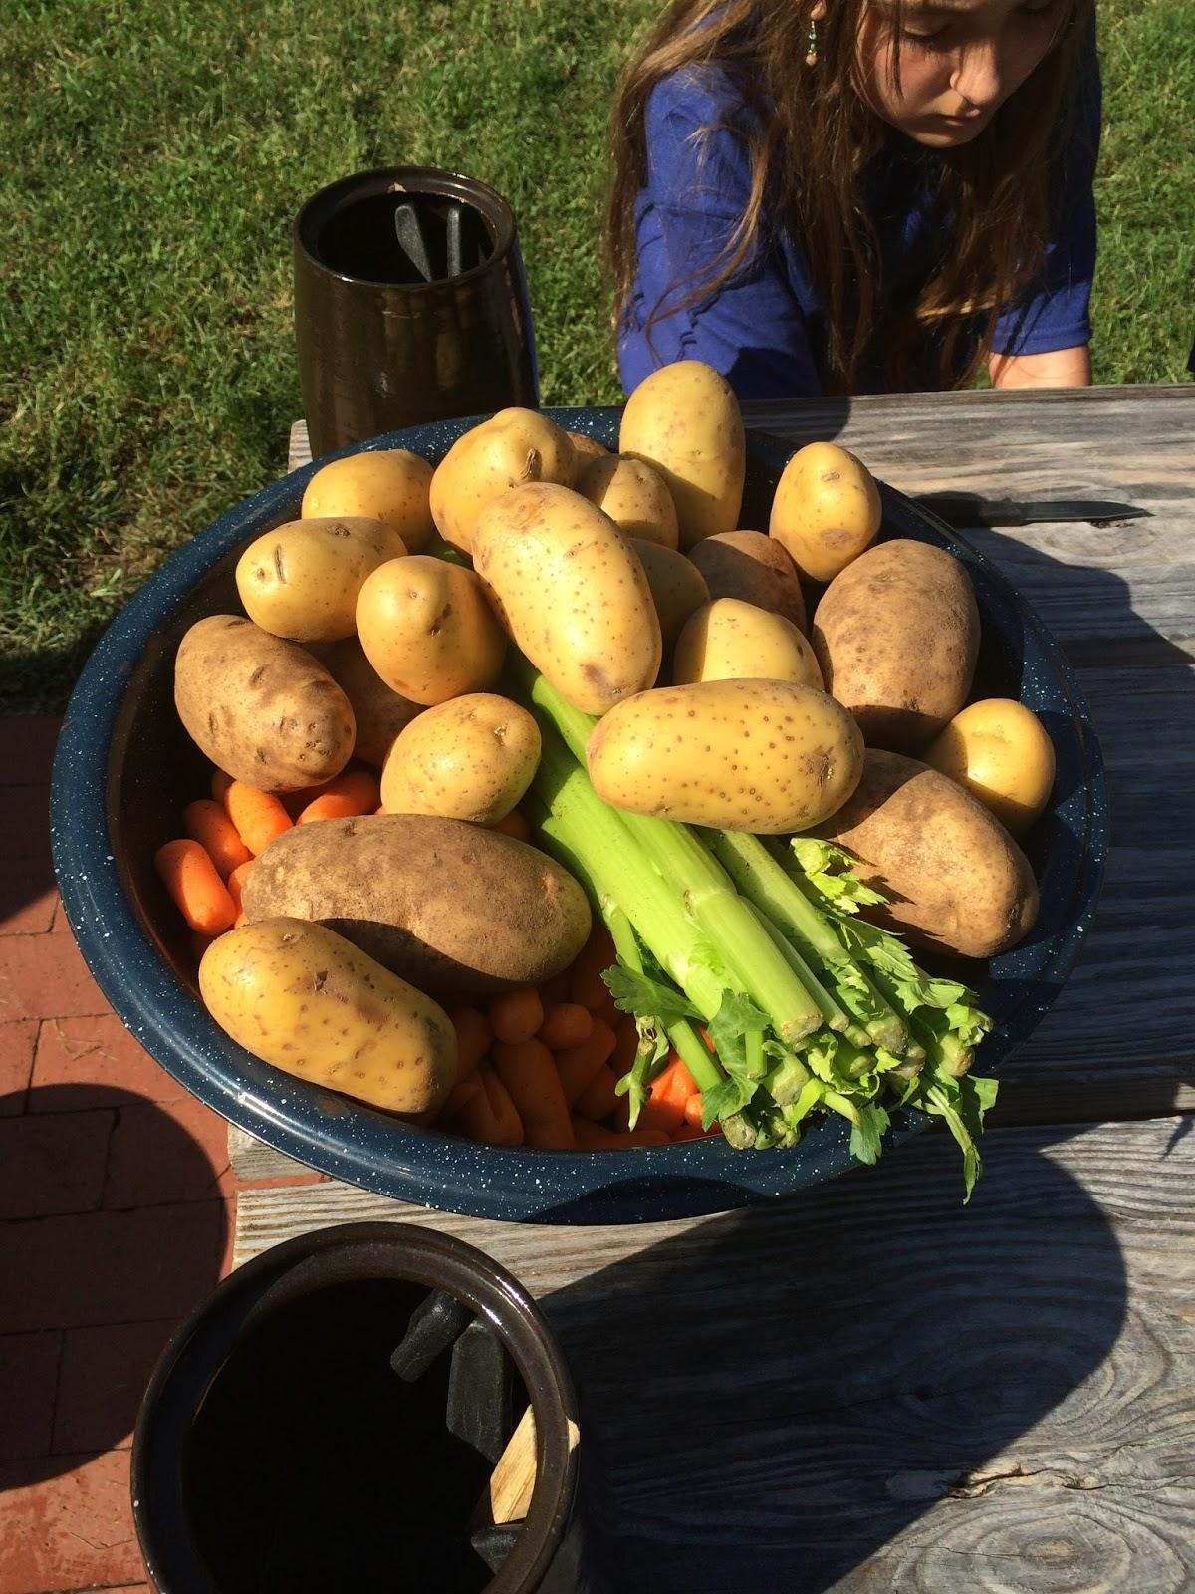
What They Ate
They ate vegetable soup and apples for lunch and stuff like that.

Slide 4
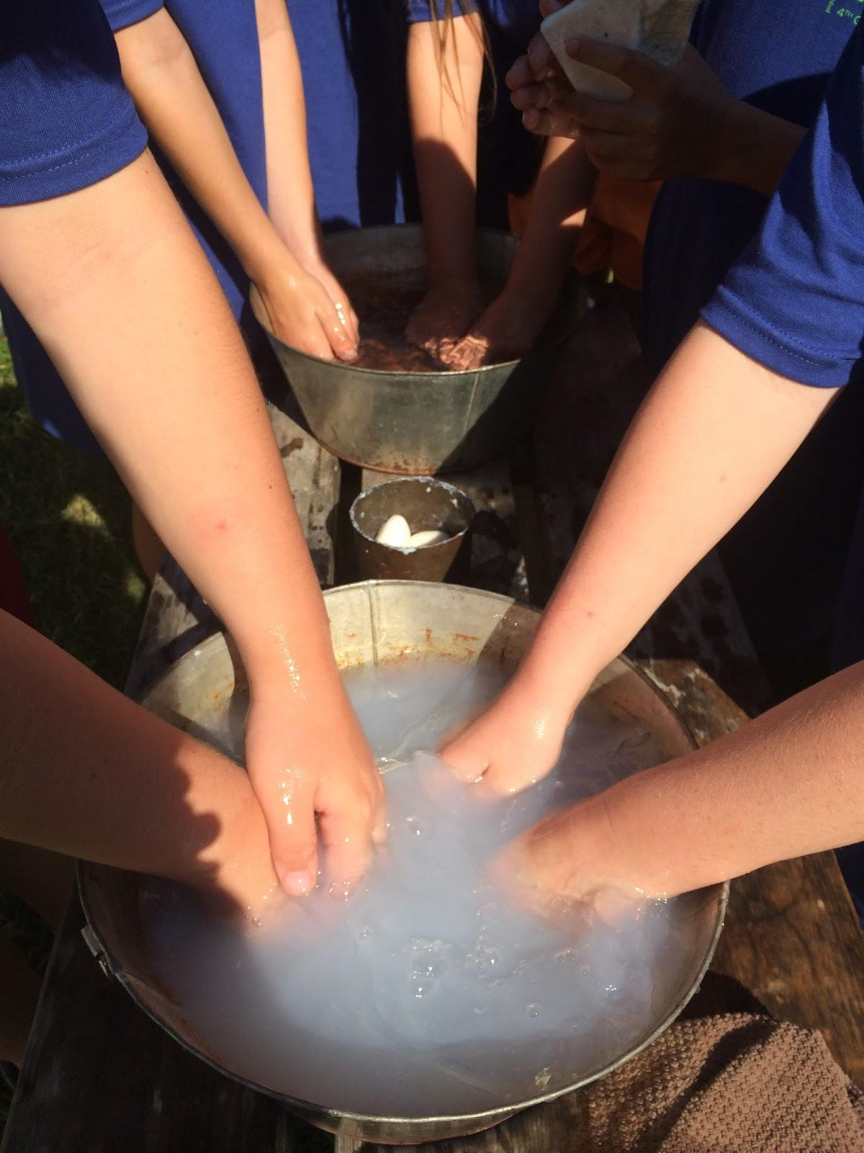
The punishments
if a kid kept saying bad words they would put lyie in there mouths that would give them blisters on there tongue.

Slide 5
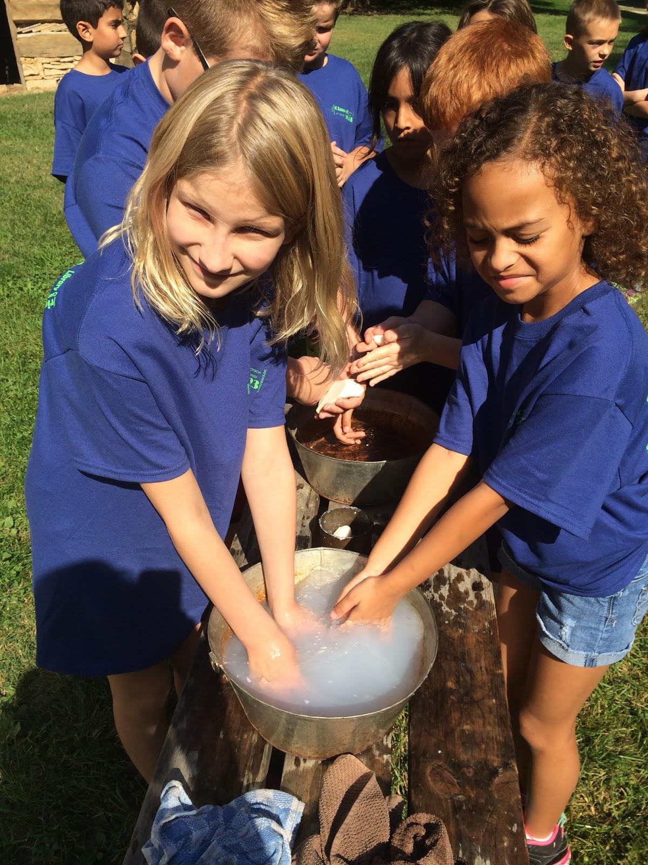
Making Soap
So first the had to mix lye and beacon Greece then they had to wait about 6 months for the lye to cure.

Slide 6
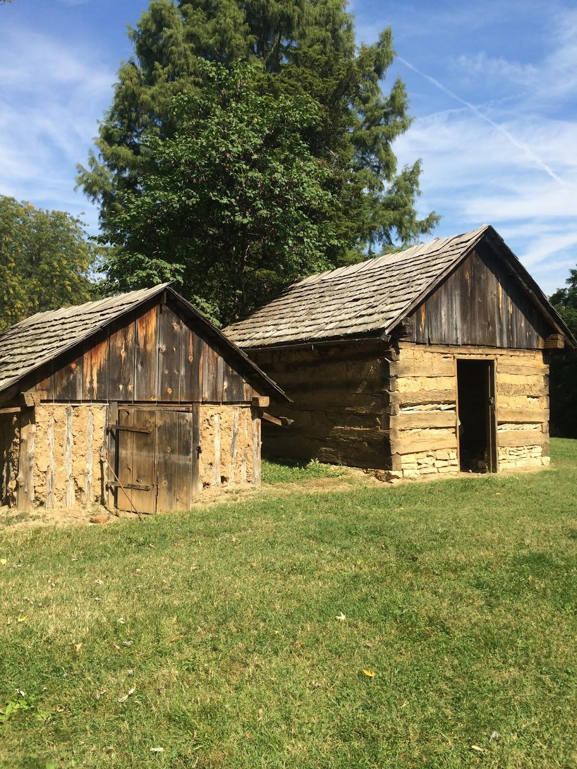
Ice/smoke house!
The smokehouse smoked all the meats and keep them there so they last longer and if there were holes you would plug it up with hair in mud so that the smoke can't get out.and the ice house kept all the meats cool they also kept ashies on the ice to make it melt slower.

Slide 7
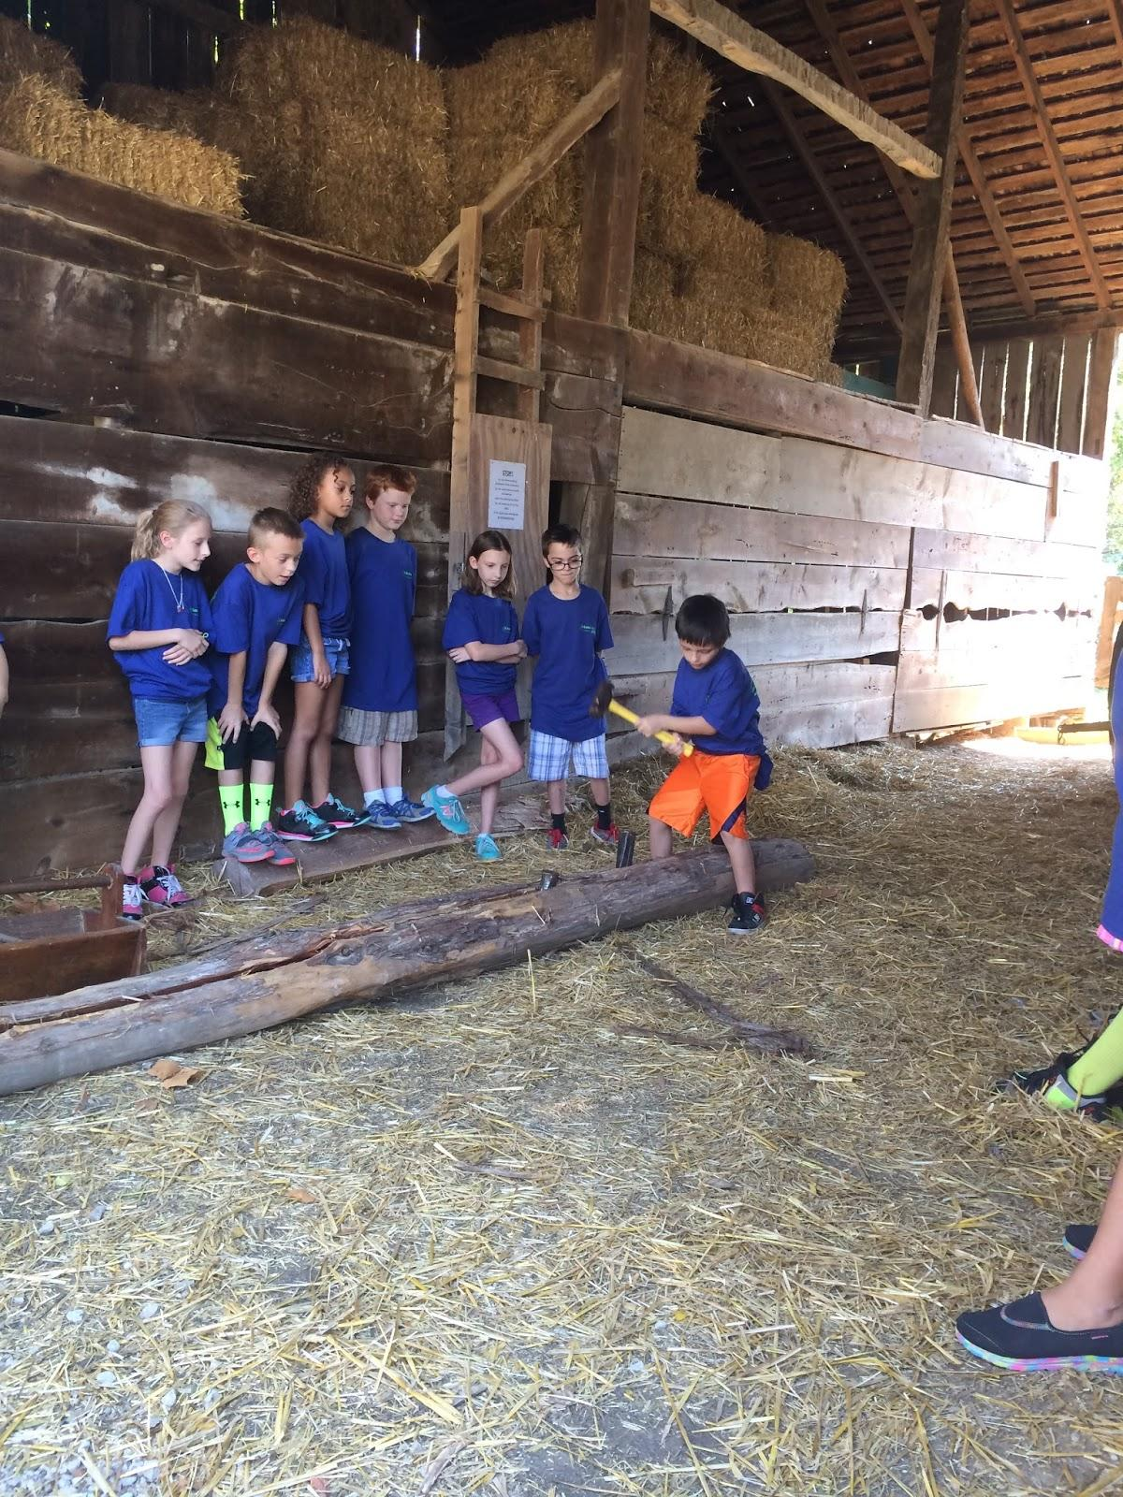
Making the fences!
What they had to do i put wedges in the wood and start hammering until the wood broke and abraham Lincoln could break 400 a day and get paid 25 cents.

Slide 8
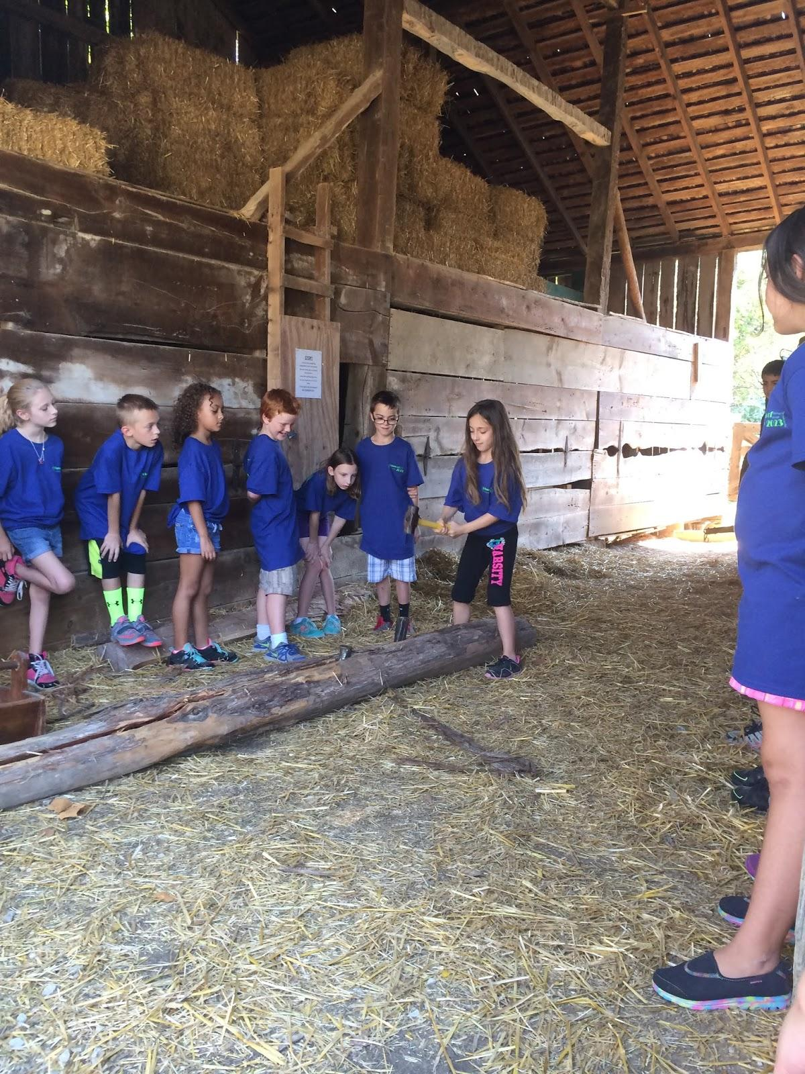
My favorite chore
My favorite chore was splitting the Frances find out on slide 7.

