Slide 1
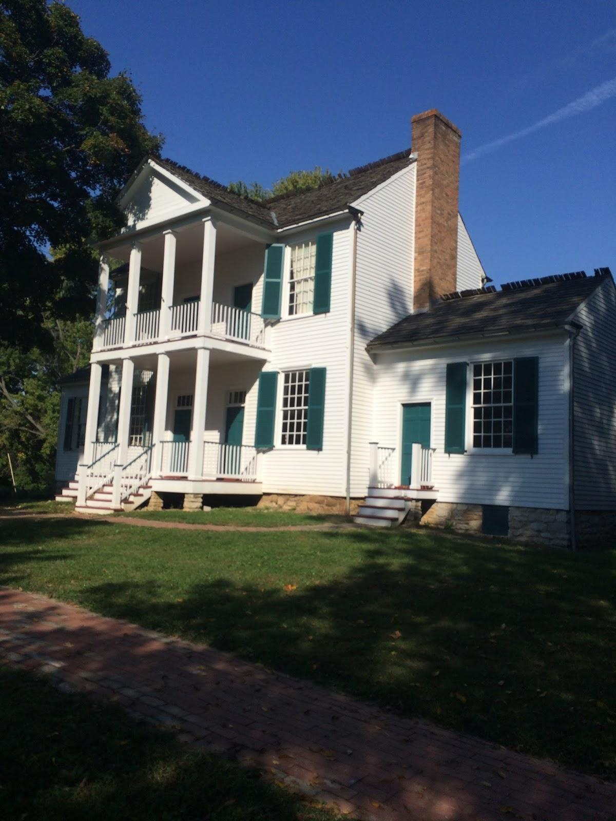
Faust Park
By Caden Vialton

Slide 2
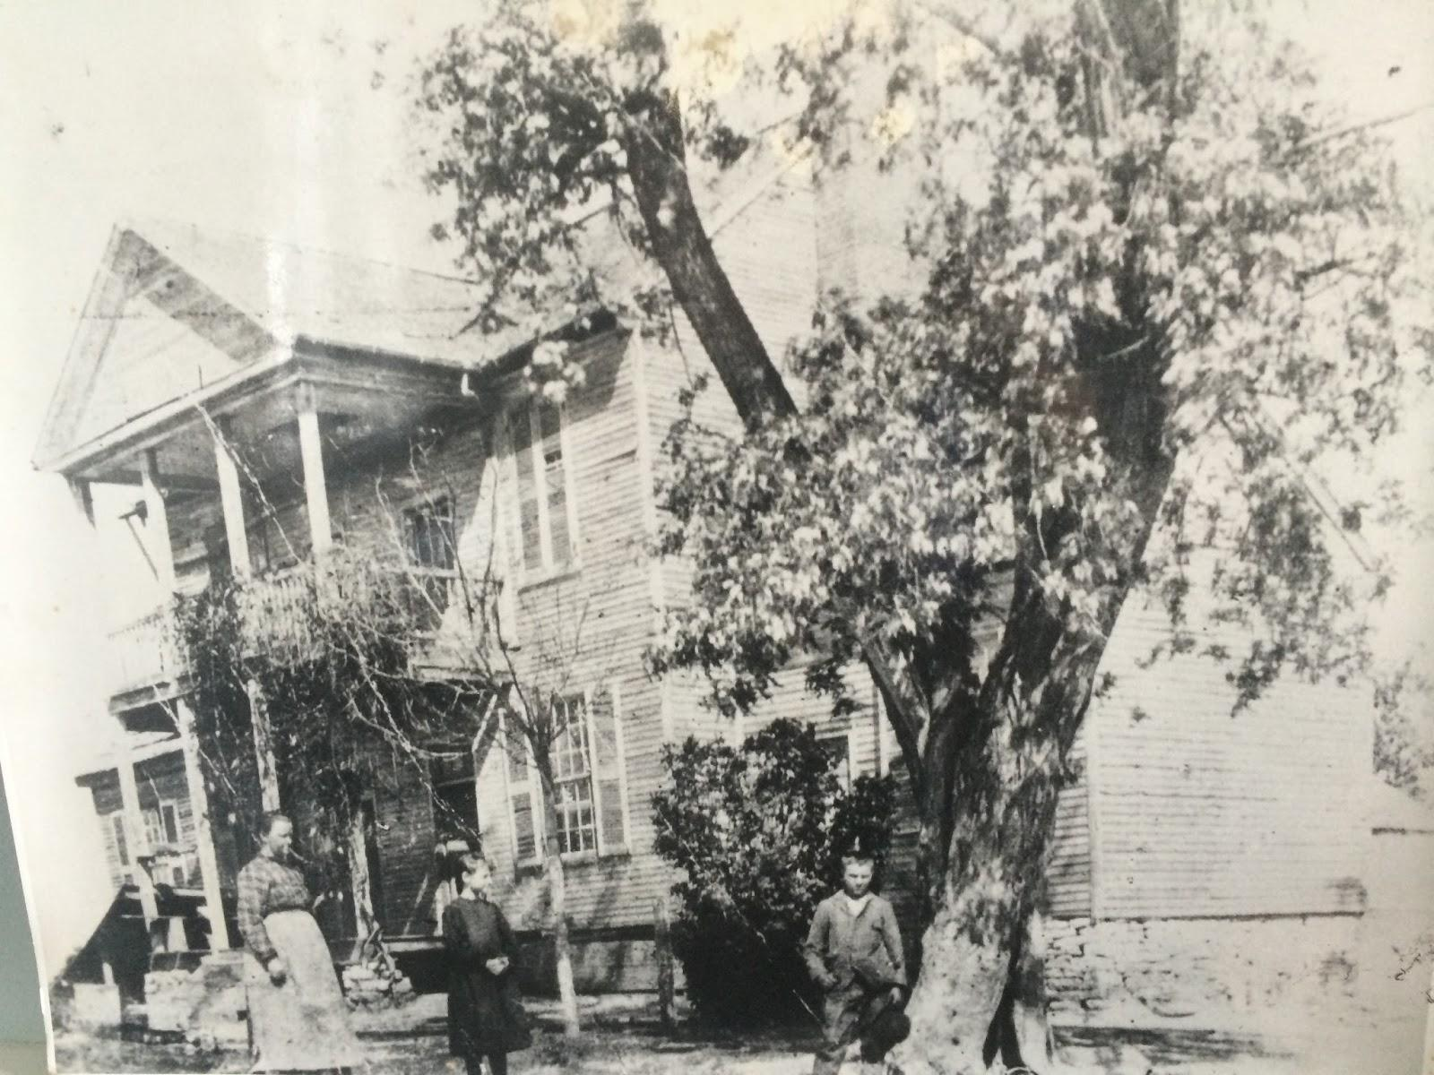
Who Lived Here
Fredrick Bates and his family lived in the Thornhill Mansion. Fredrick was the Governer from 1824-1825. And Fredrick actually built the house. His wife's name was Nancy and his kids names were Emily,Woodvile,Lucious Lee, and Fredrick jr.

Slide 3
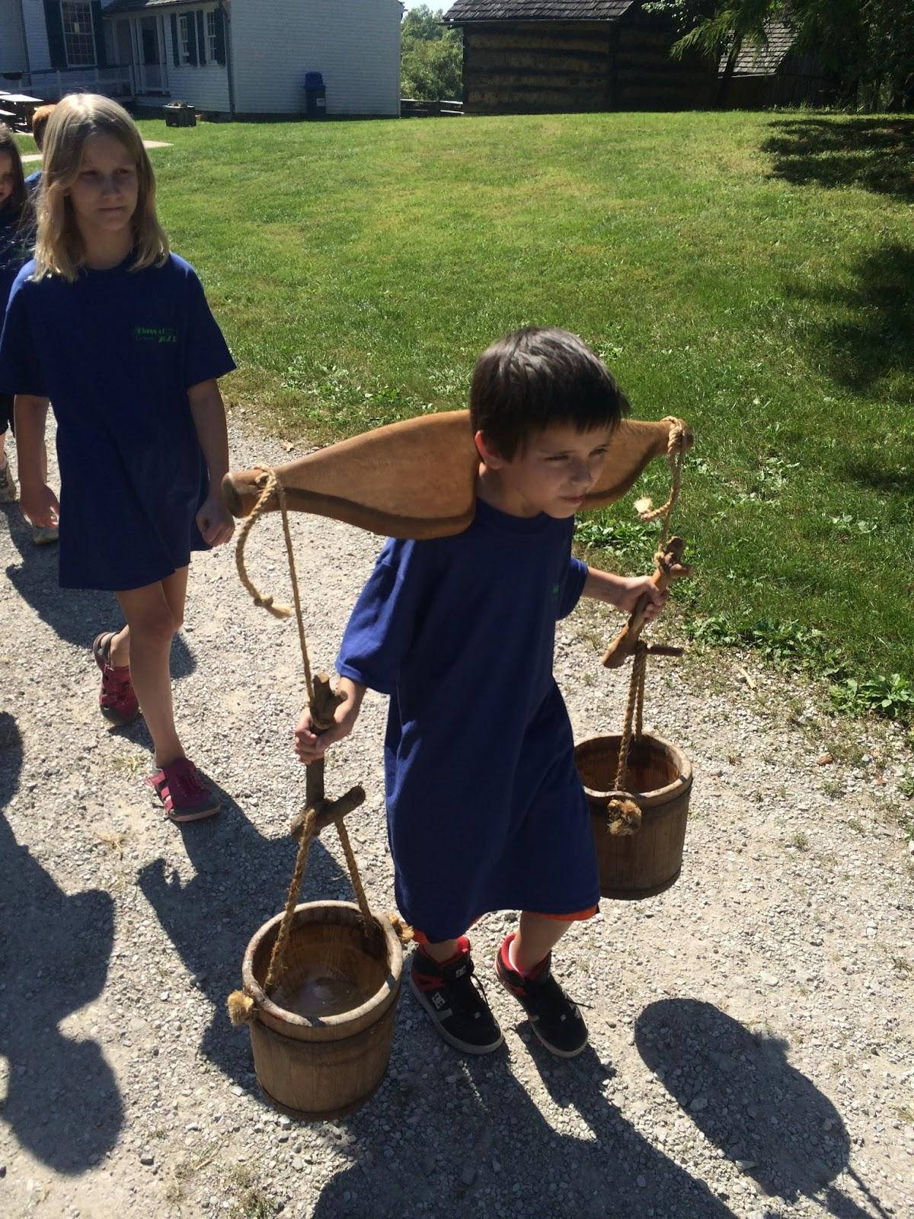
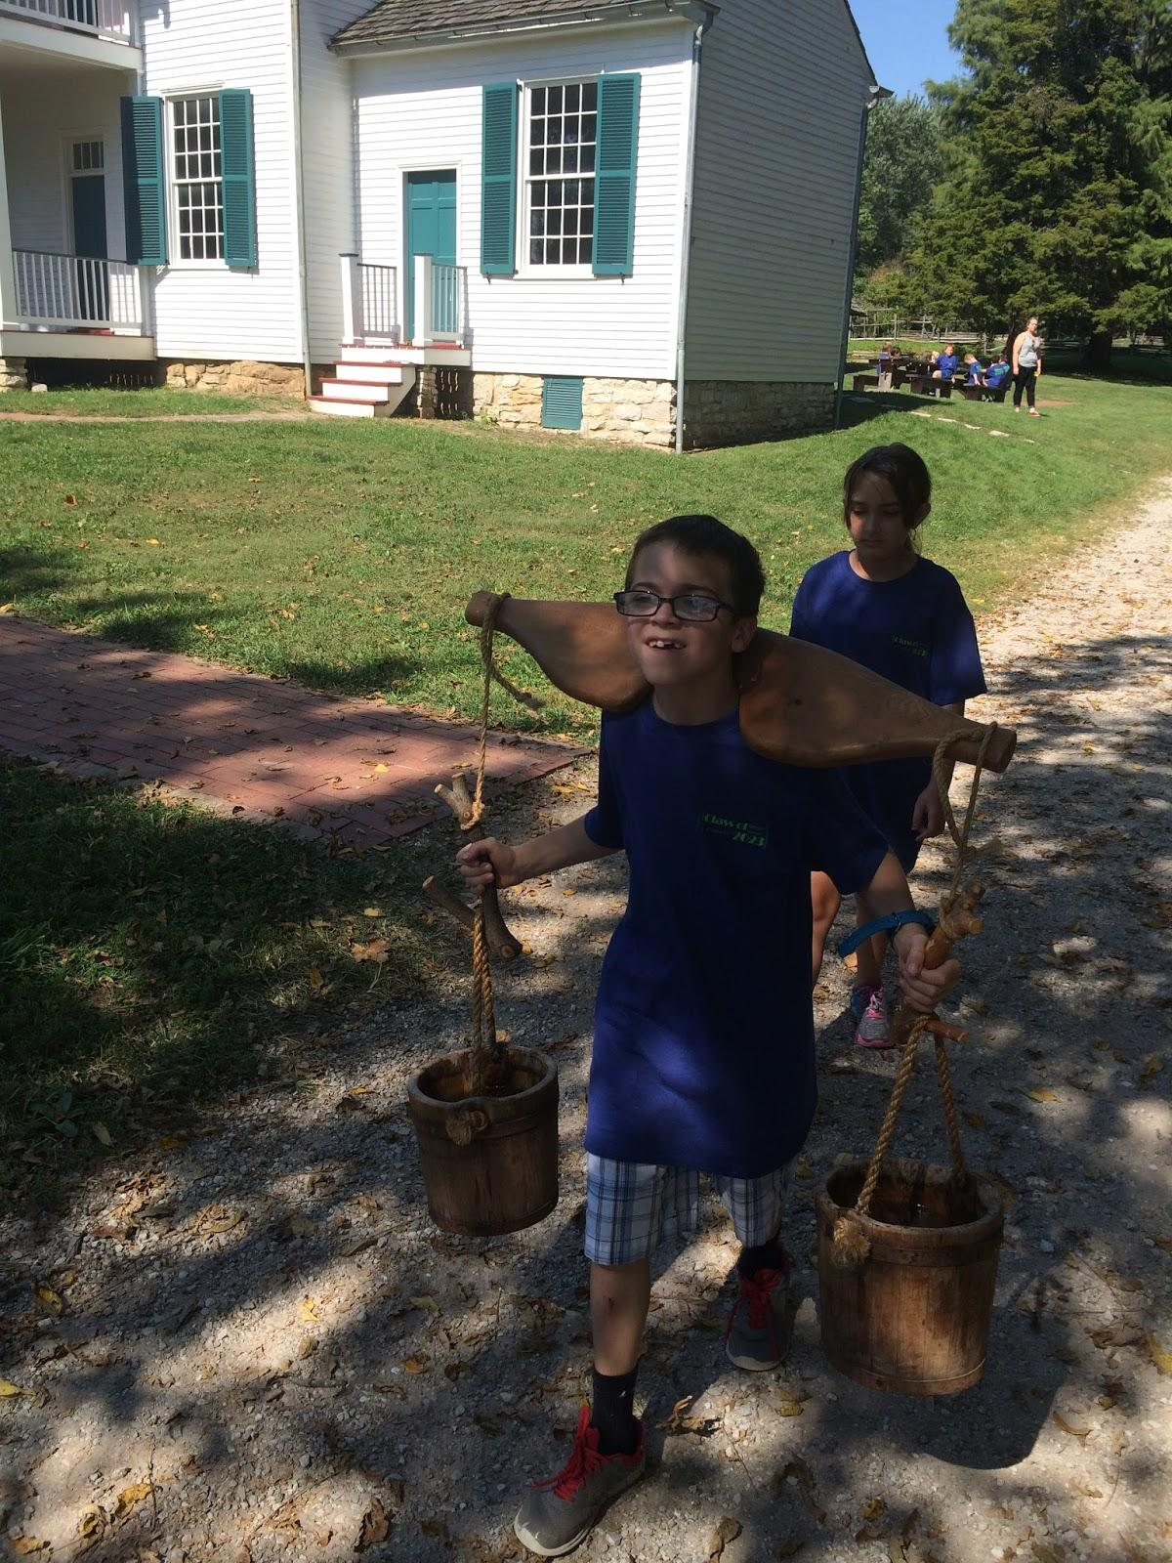
The Chores
There are many chores to do they can be very hard like carrying water with yokes, carrying things with a sling,getting kindling,cutting things for dinner,splitting rails,or putting the meat in the smoke house but they are sometimes hard or really easy but you need to do chores.,cutting things for lunch,splitting rails,putting the meat in the smoke house,there are many chores hard or easy.

Slide 4
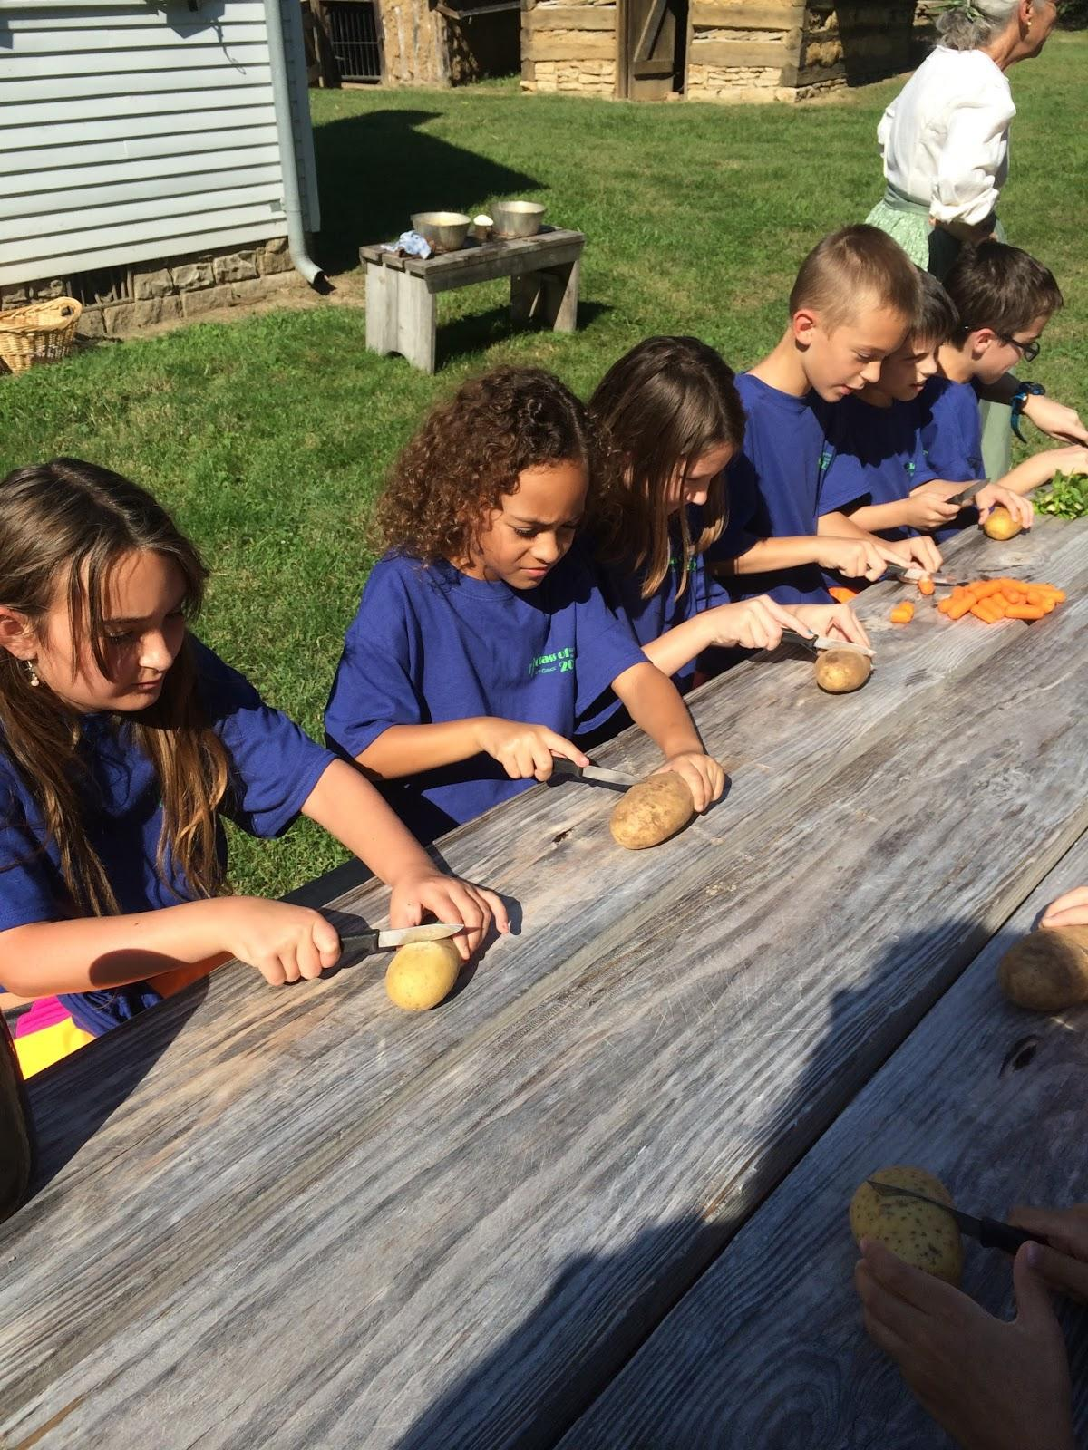
What we eat
In the 1800's what they ate was butter bread and they churned it there self they cut things for soup like celery,carrots,potatoes, and onions or soup and apples for Apple pie stuff but it is delicious.

Slide 5
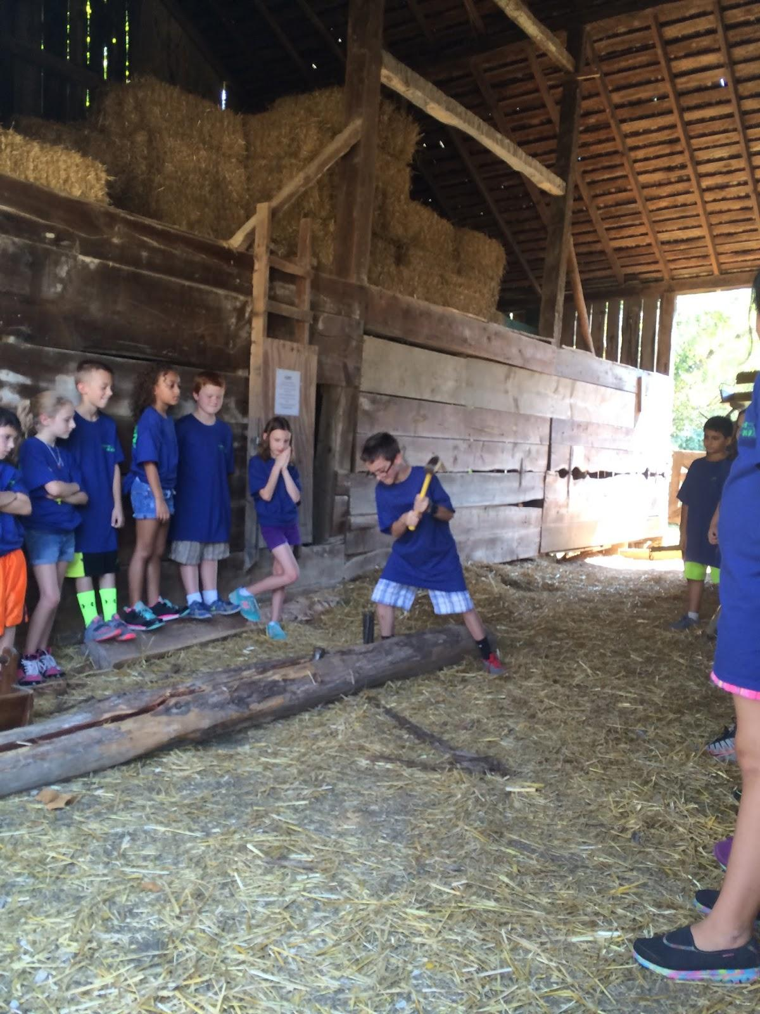
My favorite thing
My favorite part was when we got to split rails even though we didn't split one Aberham Lincoln could split 400 in one day for 25 cents not for each but all together.

Slide 6
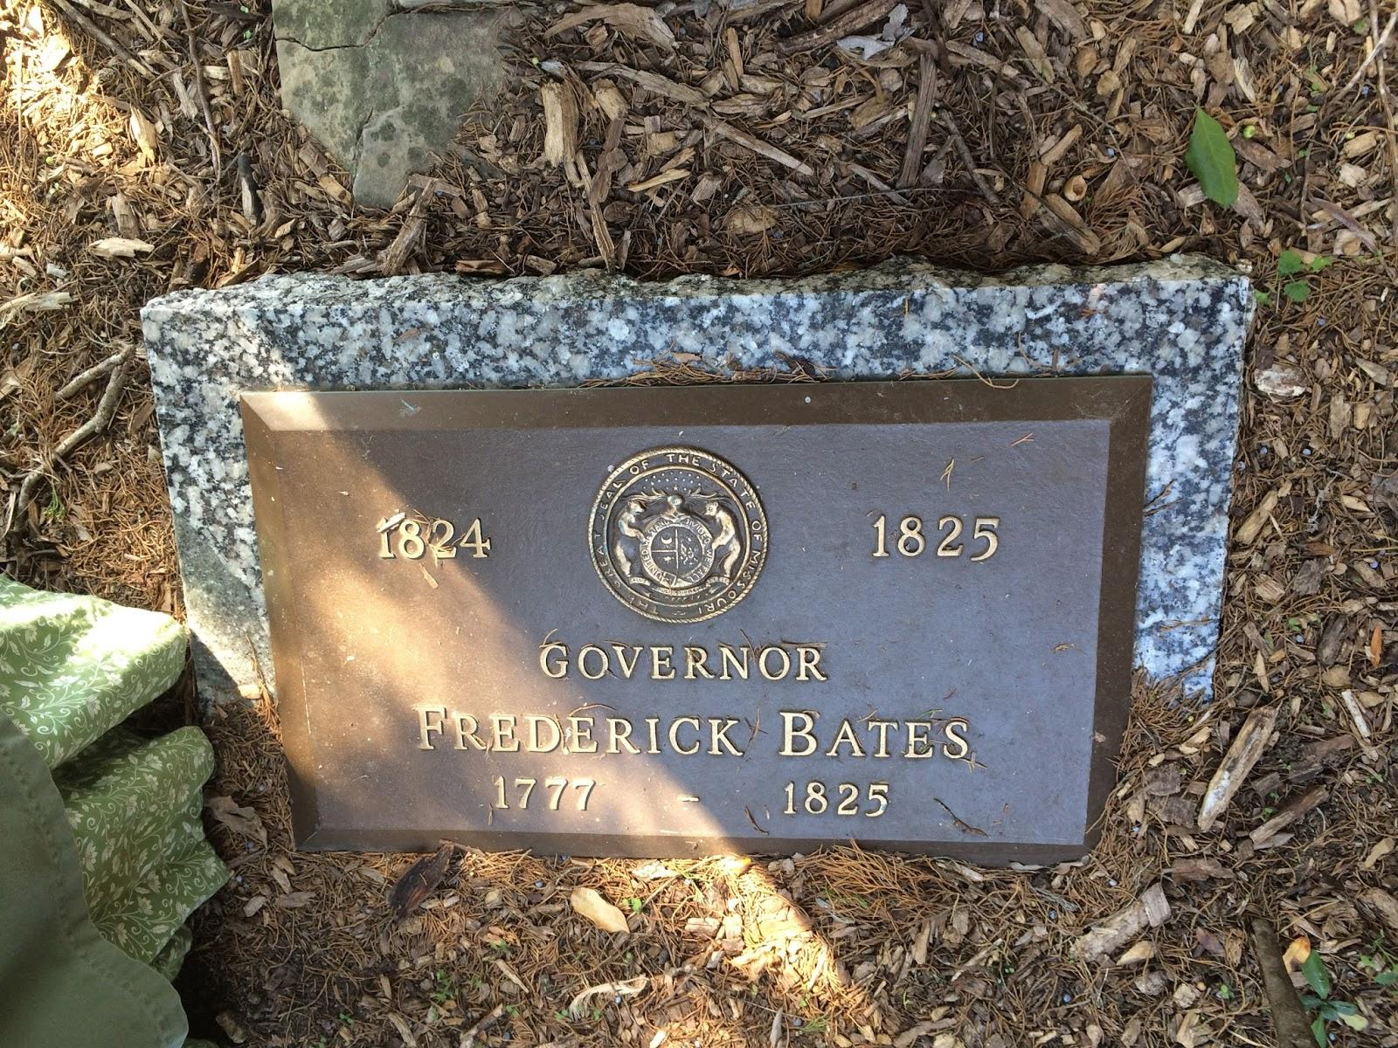
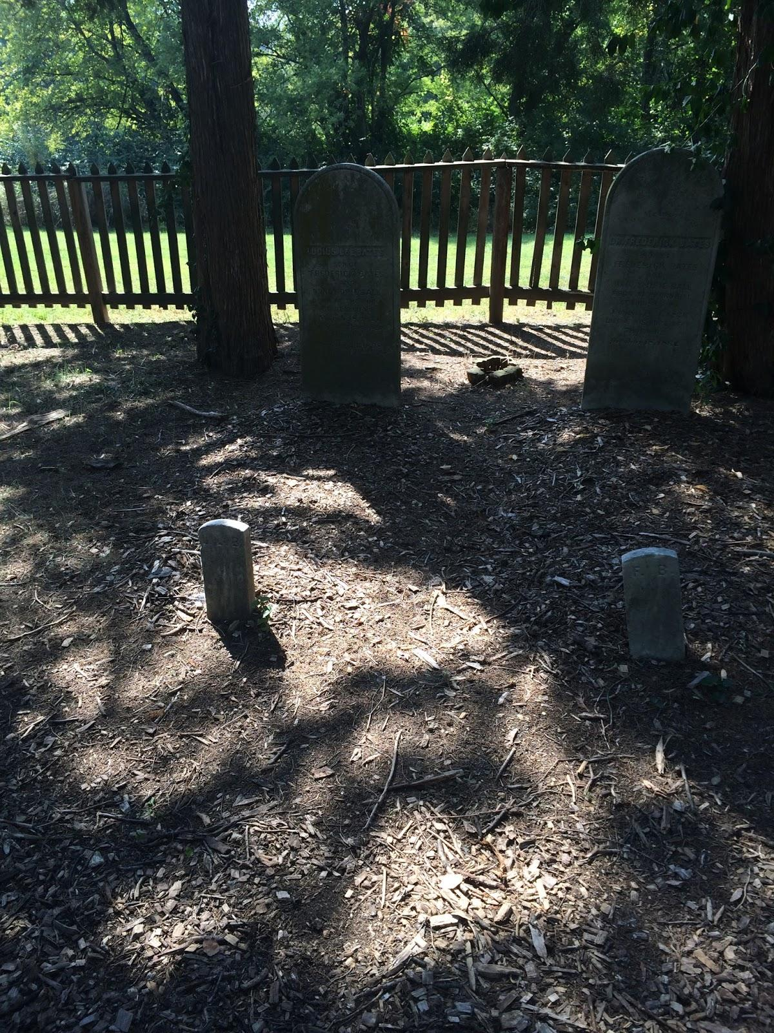
The Grave Yard
The Bate family has there own grave yard there are the head and foot stones Fredrick,nancy, luscious lee, and Fredrick jr.

